Slide 1

Radon
[backgrounds, measurement, control] in rare event searches]
i.e. LXe Based
$0νββ$ & Dark Matter
Brian Mong
SLAC National Lab
McGill - 2025/11/11

Slide 2
Radon
Brief Introduction, hopefully thought provoking
Rn backgrounds
Rn assay techniques
Rn Mitigation
I want to hear your thoughts in discussion!
~15 min
~15 min

Slide 3
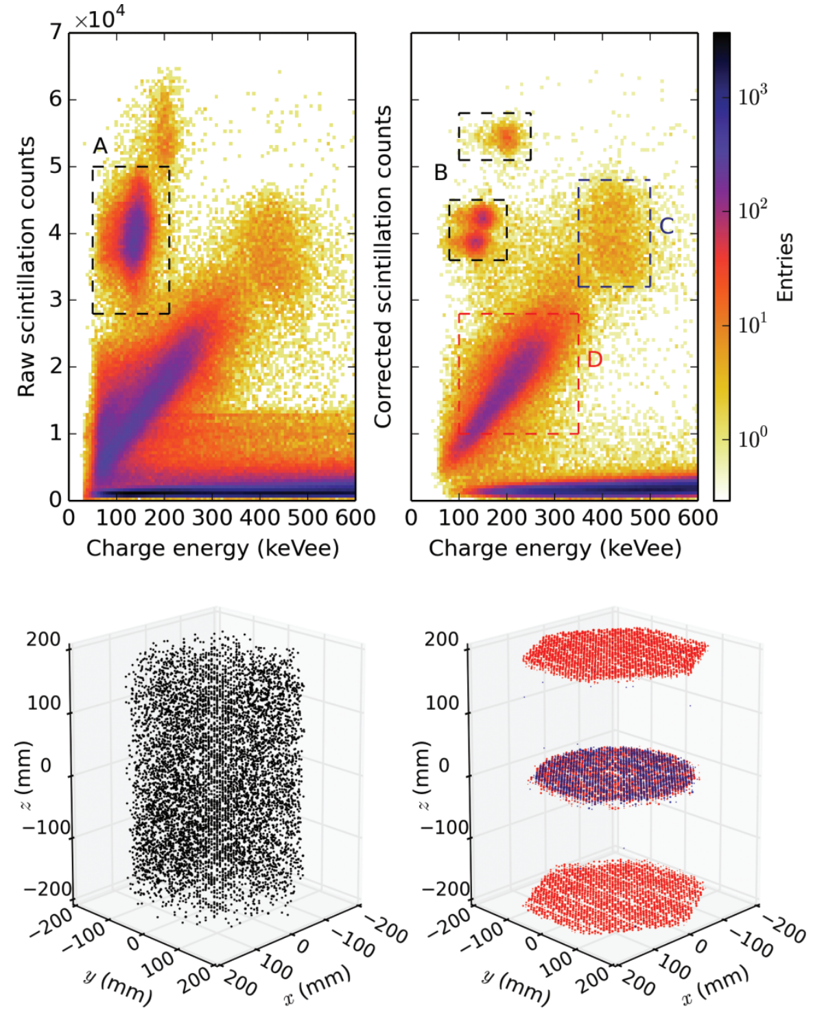
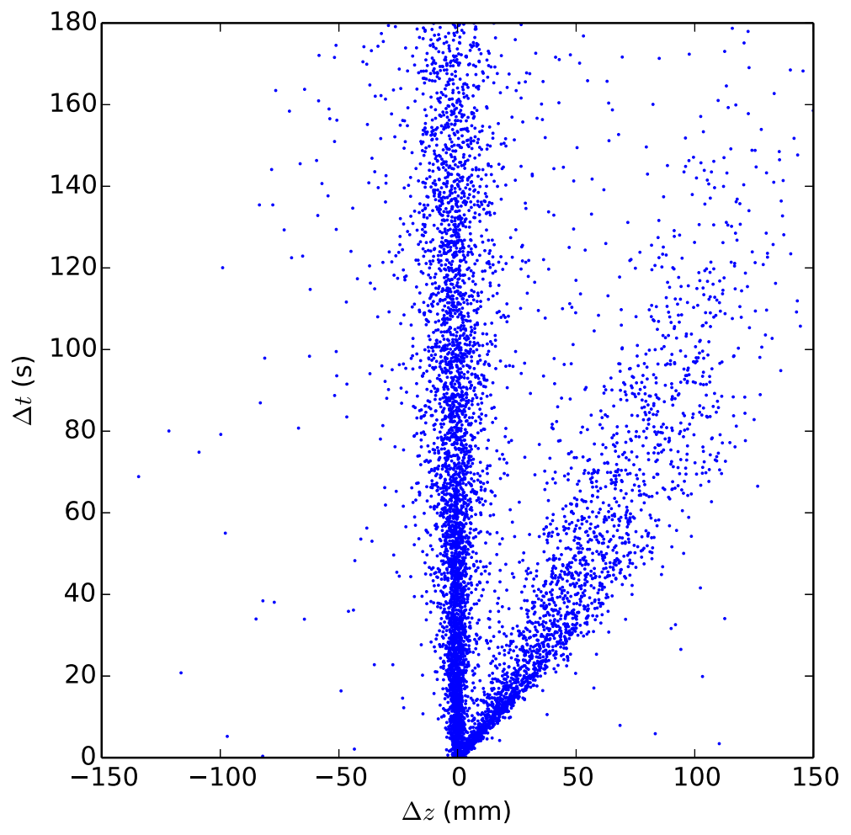
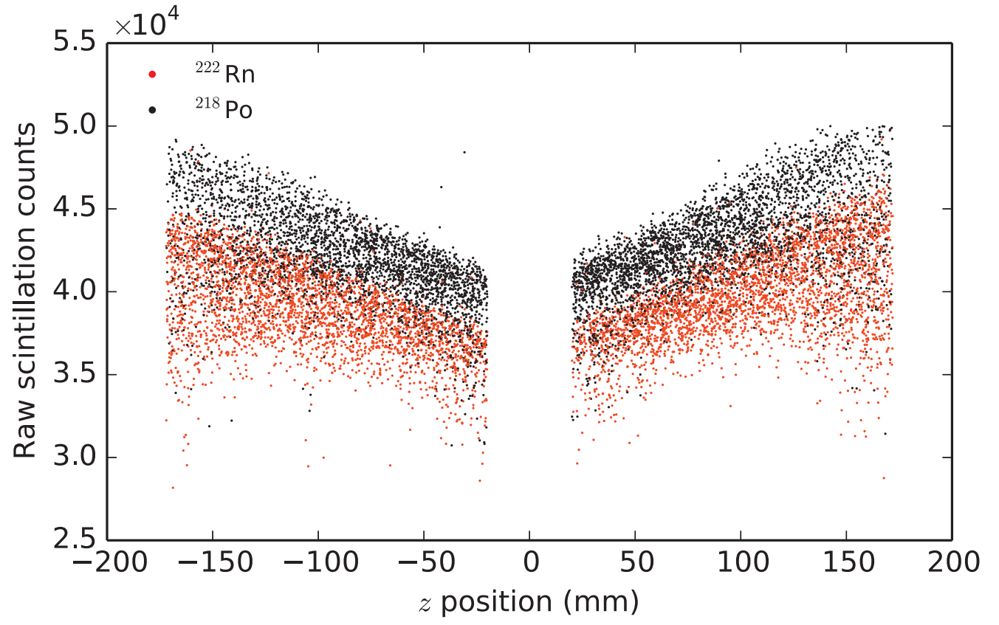
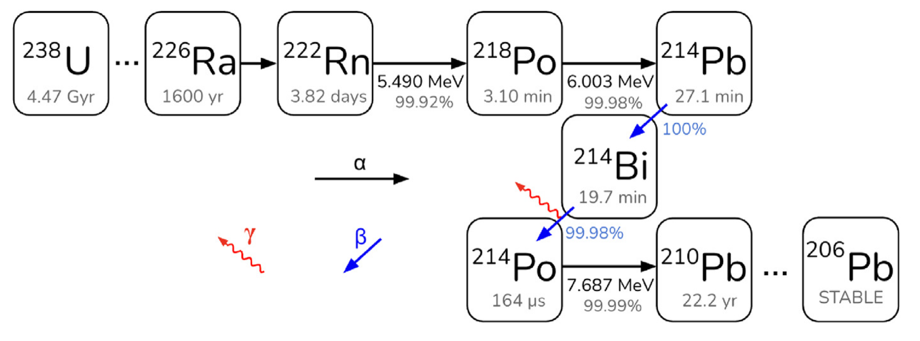
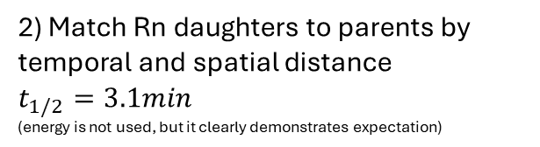
EXO200 – Behavior of radon progeny in LXe TPC
²¹⁴Po
²¹⁸Po
Rn
α-decays
β-decays
2) Match Rn daughters to parents by temporal and spatial distance
$$t_{1/2}=3.1min$$
(energy is not used, but it clearly demonstrates expectation)
3) Observe two populations : ions and neutrals resulting from α-decay.
4) Deduce β-decay ion fraction from remaining population of ²¹⁴Po
EXO-200 found:
α-decay ion fraction = 50%
β-decay ion fraction = 76%
(http://dx.doi.org/10.1103/PhysRevC.92.045504)
1) Find α-decays in EXO-200 data

Slide 4
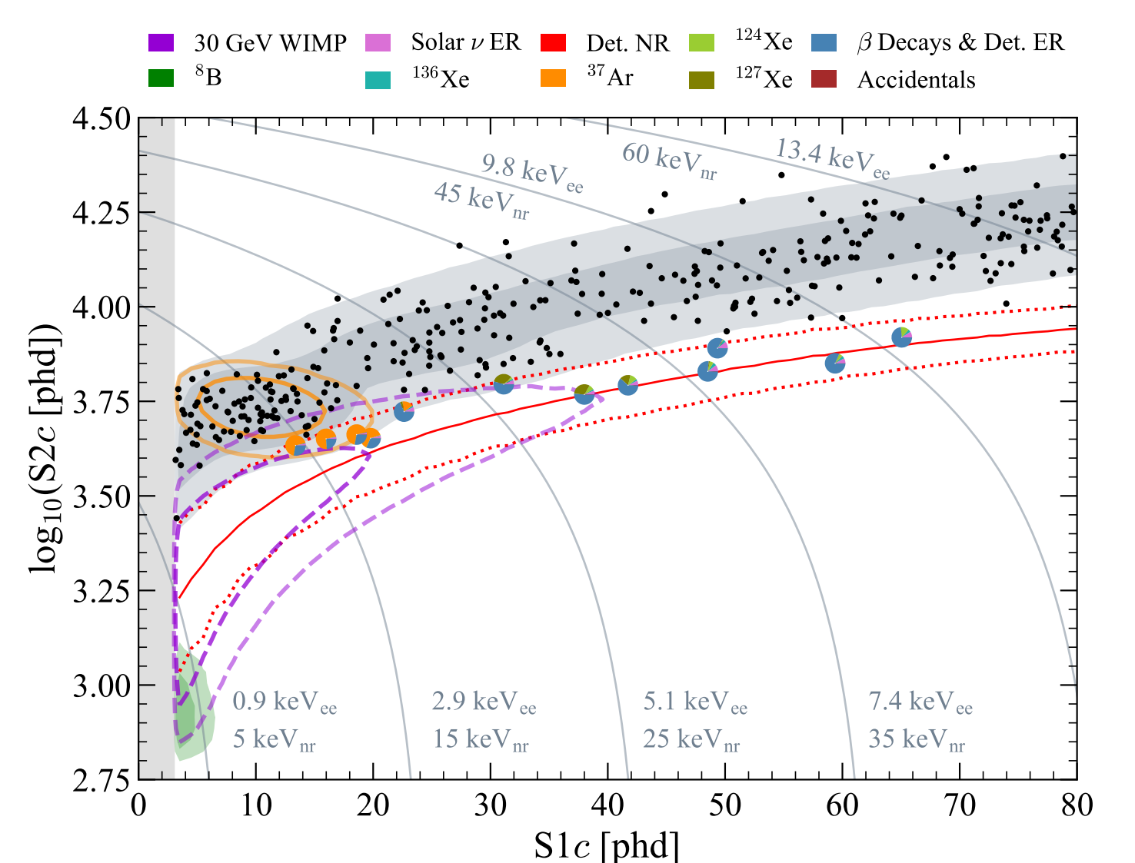
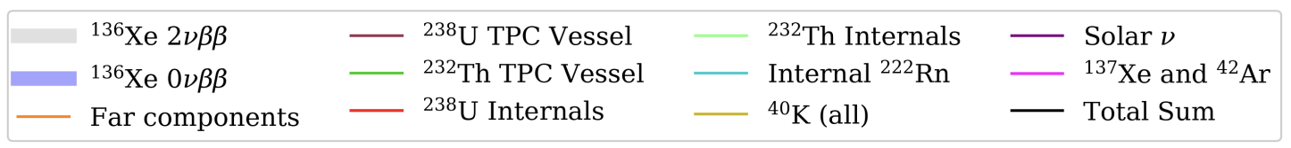
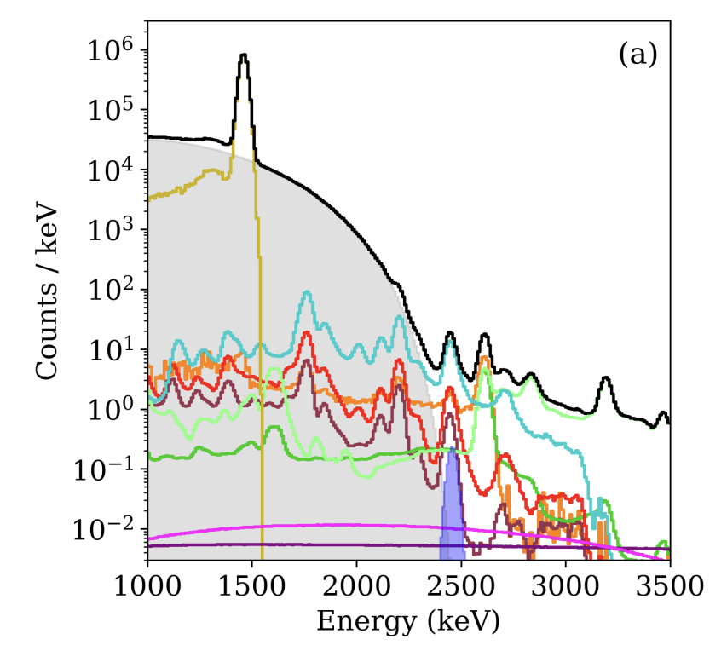


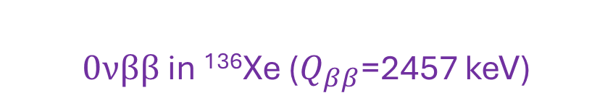
(radiological) BG in order of impact in next-gen experiments
$0νββ$ in ¹³⁶Xe ($Q_{ββ}$=2457 keV)
WIMPS in LXe
²¹⁴Bi ($γ$, 2448 keV, 1.5%)
²⁰⁸Tl ($γ$, 2614 keV, 100%)
¹³⁷Xe ($β−$ 4173 keV)
…
²¹⁴Pb ($β−$ 12% “naked beta”)
⁸⁵Kr ($β−$ 99% “naked beta”)
$ν$-ER
…
LZ Analysis
https://doi.org/10.1103/PhysRevD.108.012010

Slide 5




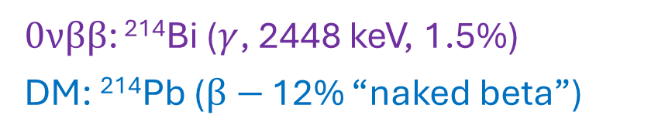
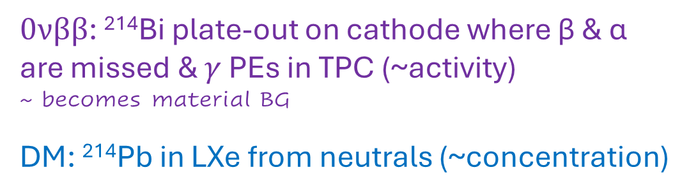
²²²Rn in LXe TPC backgrounds
Can we tag >>50% on cathode?
$0νββ$: ²¹⁴Bi ($γ$, 2448 keV, 1.5%)
DM: ²¹⁴Pb ($β−$ 12% “naked beta”)
T_{1/2}=164μs
222
α
+
z (drift)
γ
Rn
1-α
1-z
²¹⁰Pb
α
+
z
1-α
1-z
Plates out on cathode
β
α
β
+
z
²¹⁴Bi
²¹⁴Po
1-β
1-z
Neutrals remaining in LXe
β
+
z
1-β
$0νββ$: ²¹⁴Bi plate-out on cathode where β & α are missed & $γ$ PEs in TPC (~activity)
~ becomes material BG
DM: ²¹⁴Pb in LXe from neutrals (~concentration)

Slide 6
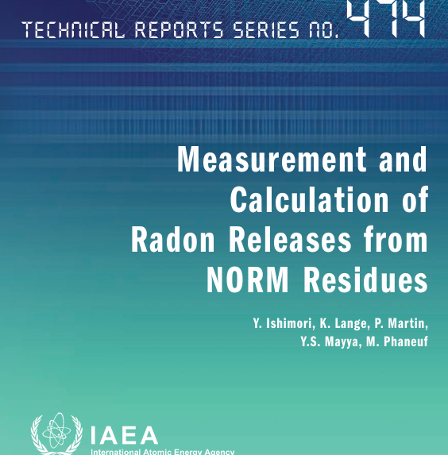
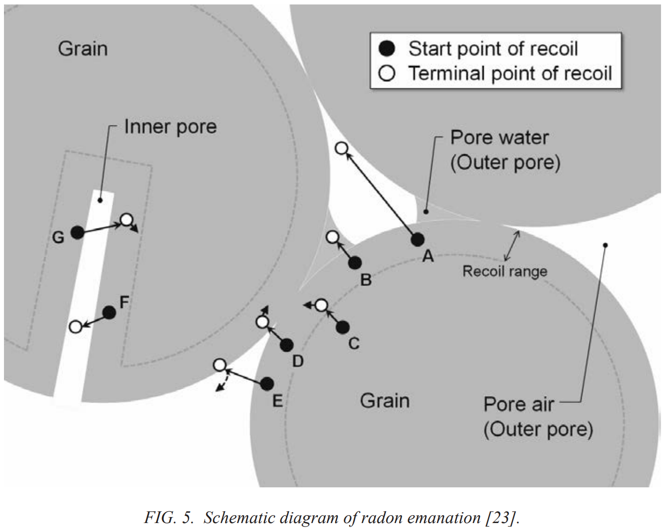
Radon Origin
Manufacturing pure materials changes concentration
  ²²⁶Ra supported – not necessarily in equilibrium with ²³⁸U
²²⁶Ra decays and ²²²Rn daughter escapes via
  Nuclear recoil
  Diffusion/Permeation
Rn readily dissolves in Xe & carried into TPC
Work to link Rn-emanation to Material-Assay should continue but can it be predictive?
Rate of release is Emanation

Slide 7
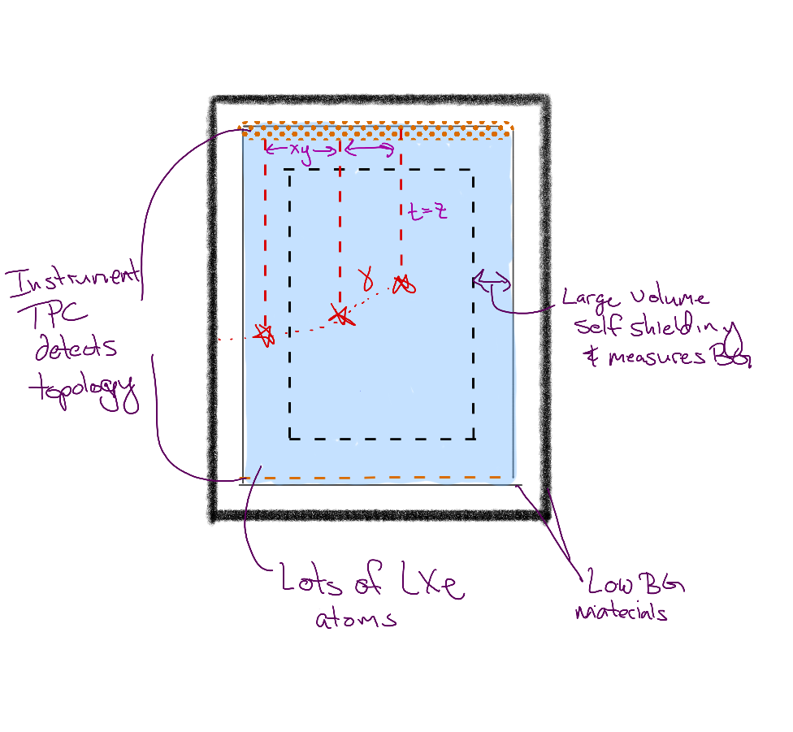
TPC Detector Concept
Making these materials low BG is very advanced:
Tools, Methods, Resources
(see Isaac’s & Richard’s Talk)

Slide 8
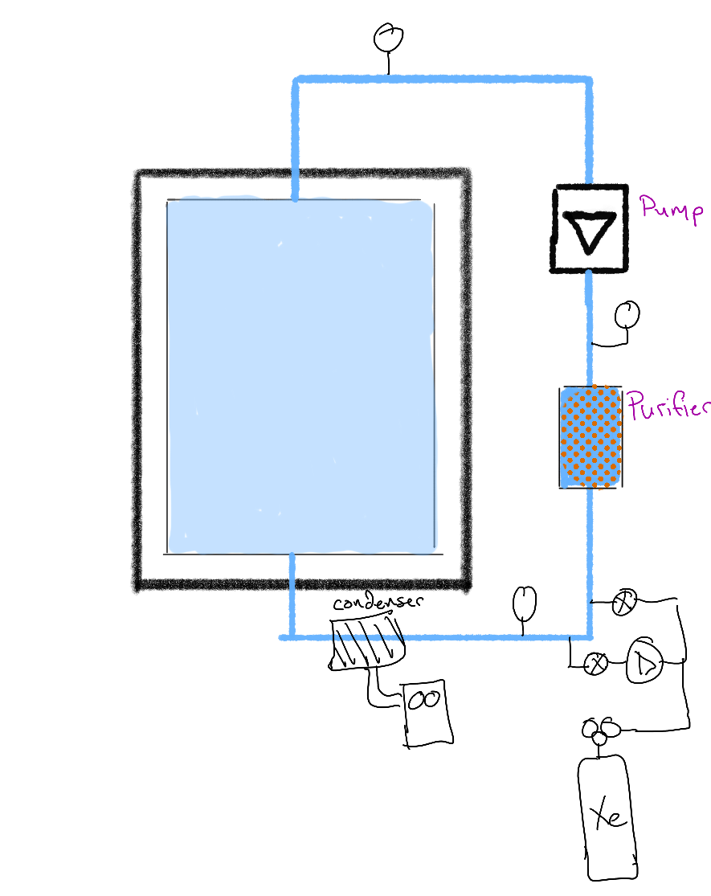
TPC Detector Concept
Because Rn is a noble gas that dissolves in LXe:
< 1.2 mBq nEXO
--or--
< 0.1 mBq/kg
in XLZD
< 8 mBq* (in 80T)
*Other design choices can impact bottom line: churn rate, distillation, etc

Slide 9
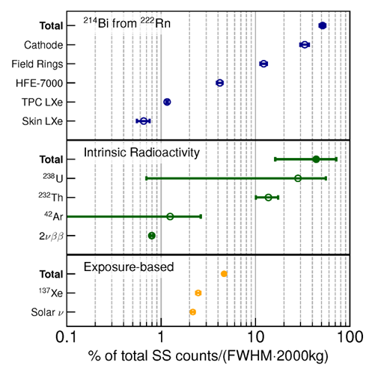
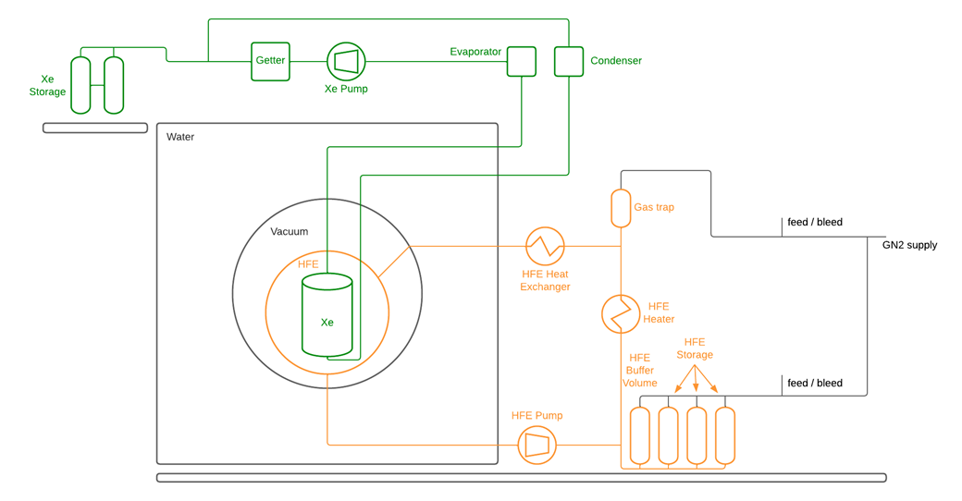
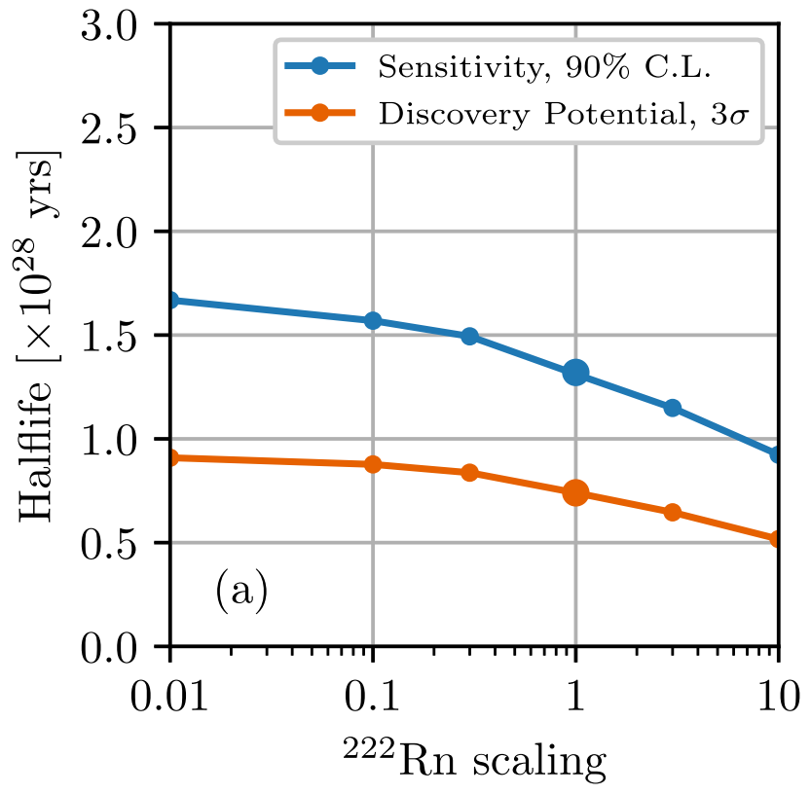
nEXO Radon Background Goals
Xe: 1.26mBq (600 atom) 48% of the BG
HFE 3.8 mBq (1800 atoms) 4.6% of the BG
Water: Rn to be a negligible background (< 0.1 ppt U, < 0.1 ppt Th)
Xe System

Slide 10
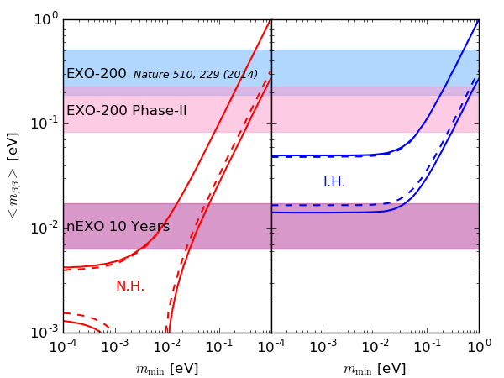
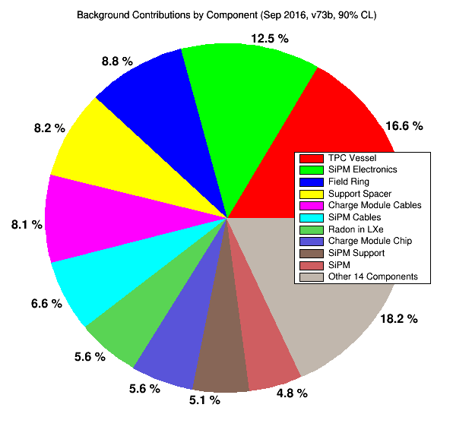
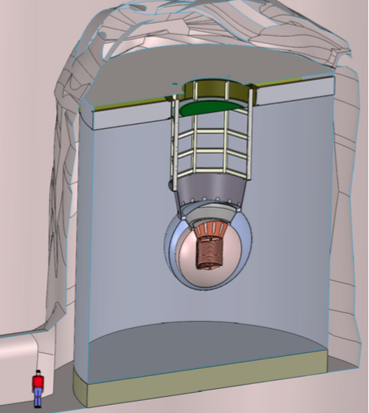
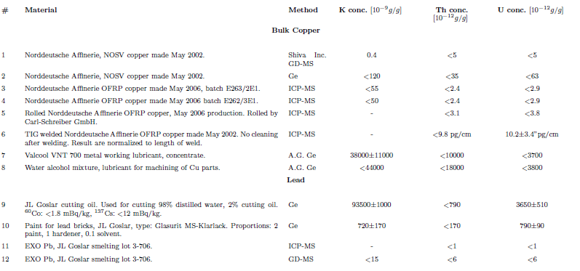
Iterative Design Process
Background budget
Material assays
Monte Carlo simulations
Detector design
Physics sensitivity
Need to provide assays with enough resolution to give feedback to design
Material assays capable of providing data on the solder flux
(**with assumptions**)

Slide 11
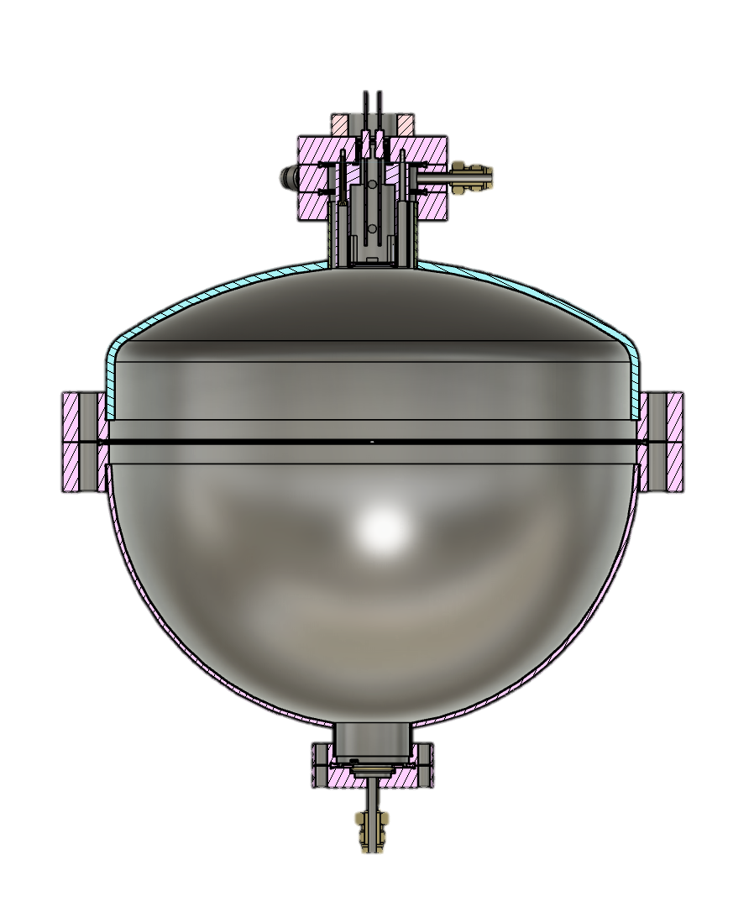
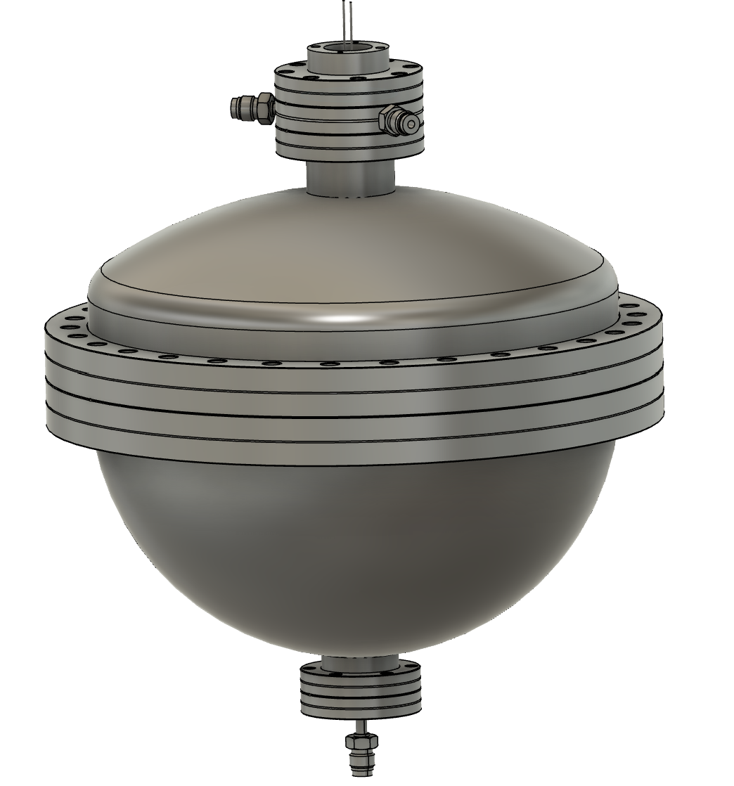
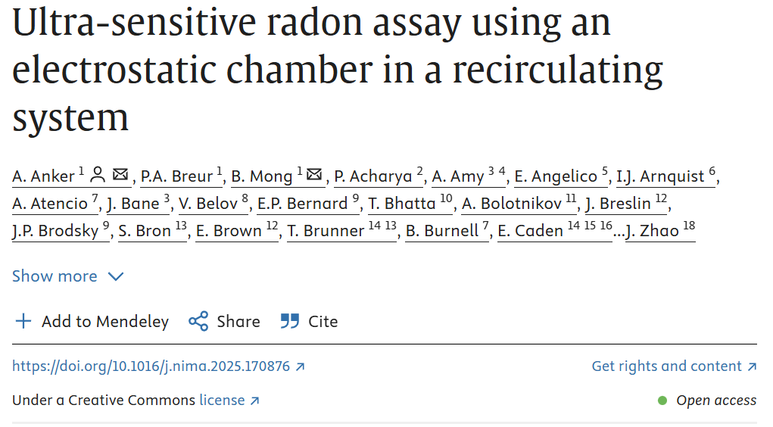
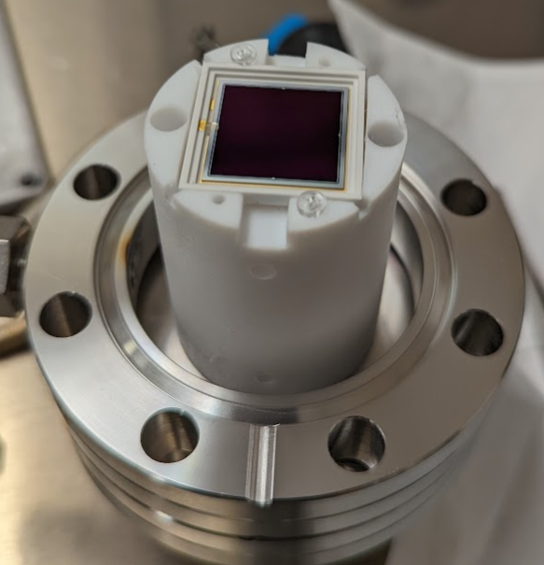
ElectroStatic Counter (ESC)
Based on SNO water assay system
https://doi.org/10.1016/S0168-9002(98)01230-3
Charge Sensitive Amplifier + DAQ
Principle of Operation:
Rn decays in counter volume
Daughters tend to be +ions (>80% in gas)
SiDiode biased to collect +ions (>80%)
Subsequent decays in chain on SiDiode create signal (50%)
SiDiode @ -1000V
²¹⁸Po⁺
SLAC systems use 100% UHV components

Slide 12
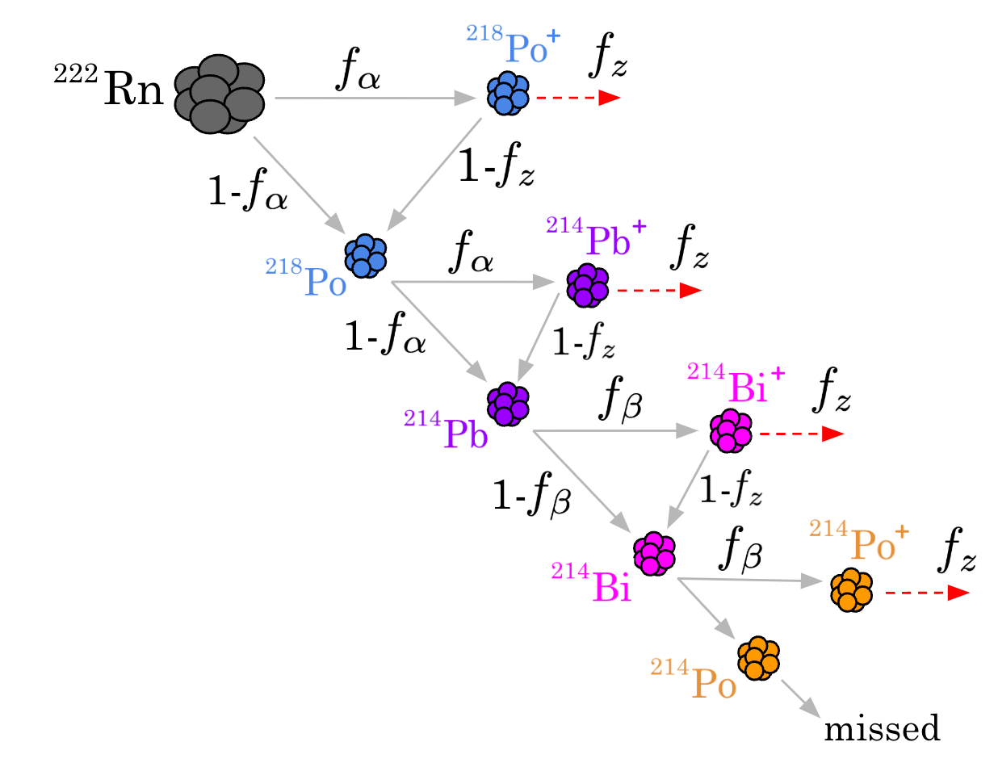
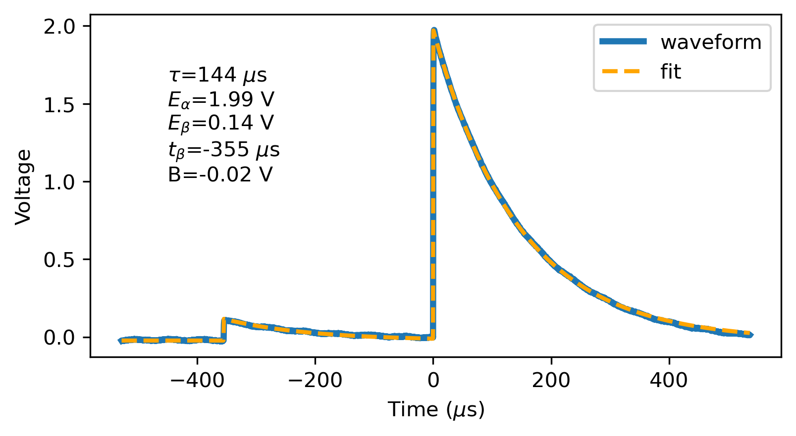
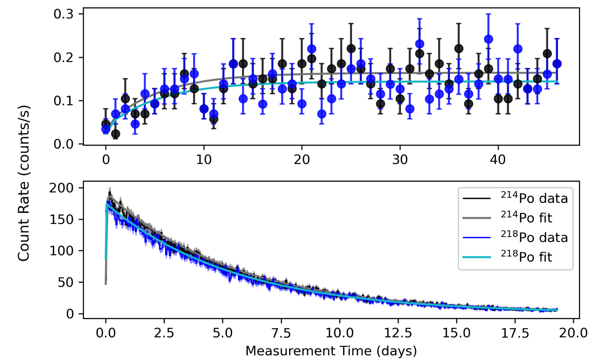
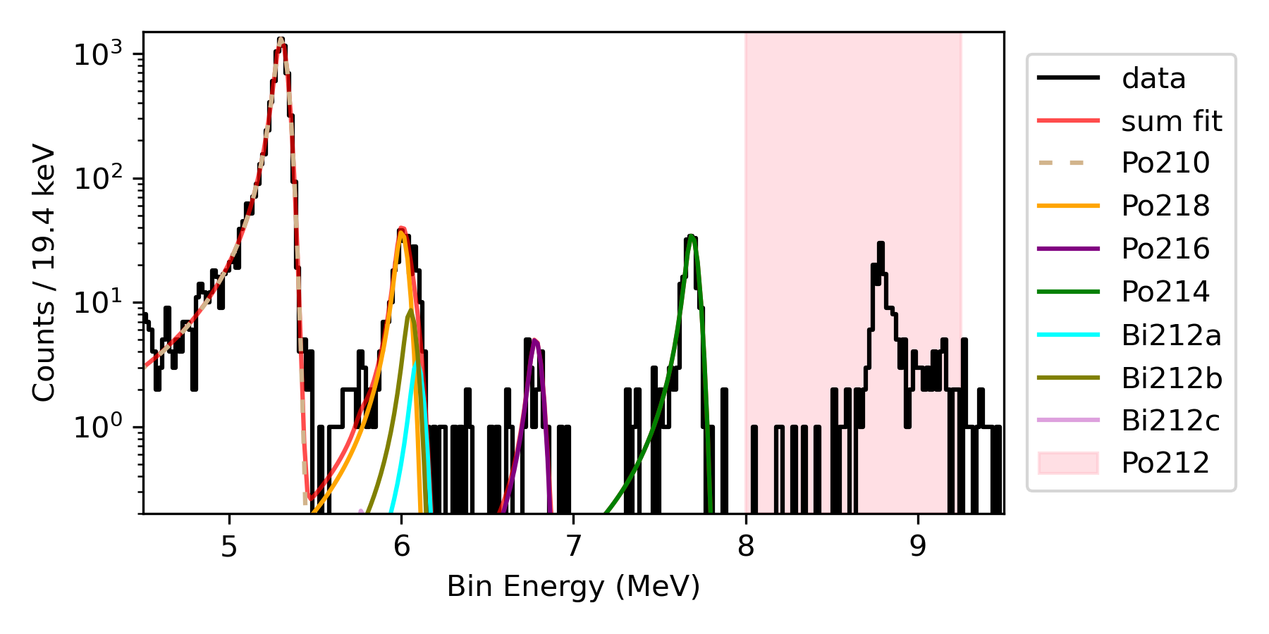
ESC Analysis
DAQ
BiPo signal
Collected on diode
²¹⁸Po⁺
Growth
Depending on how it’s used, measure growth or decay of Rn-progeny
Decay

Slide 13
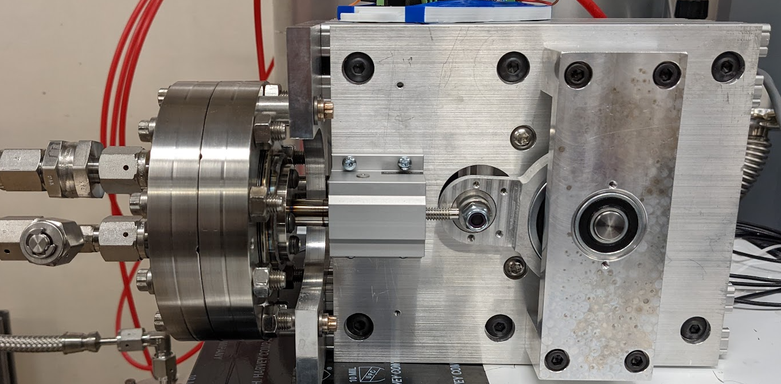
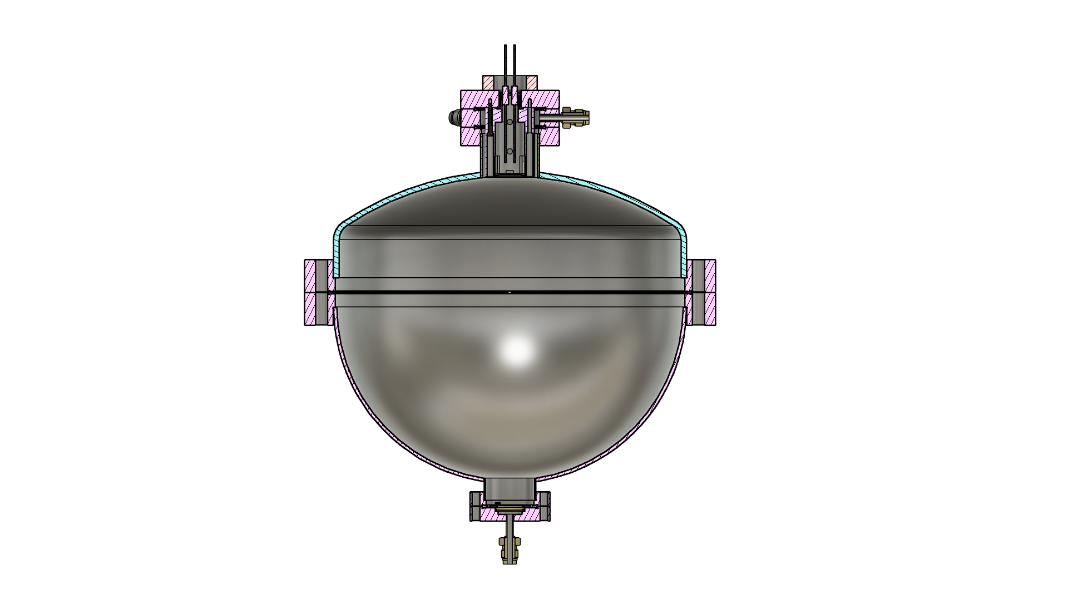
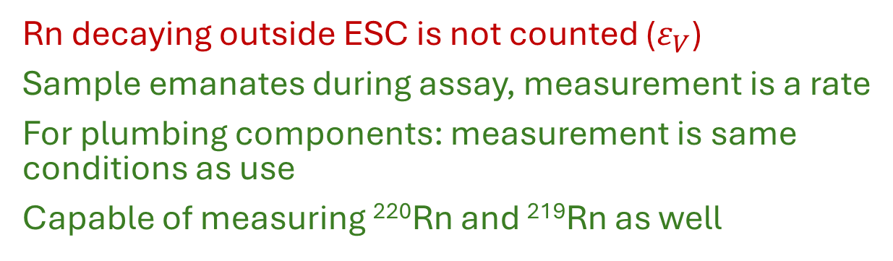
Recirculation Assay System
Custom Low Rn UHV pump
Process:
Sample placed in a closed loop with ESC filled w/ carrier gas (Ar or N2)
Rn continuously emanates from sample building up to steady state
Gas is recirculated to transport Rn to ESC
Pump
Sample
Rn decaying outside ESC is not counted ($ε_{V}$)
Sample emanates during assay, measurement is a rate
For plumbing components: measurement is same conditions as use
Capable of measuring ²²⁰Rn and ²¹⁹Rn as well
Gas Filter →
Time (days)

Slide 14
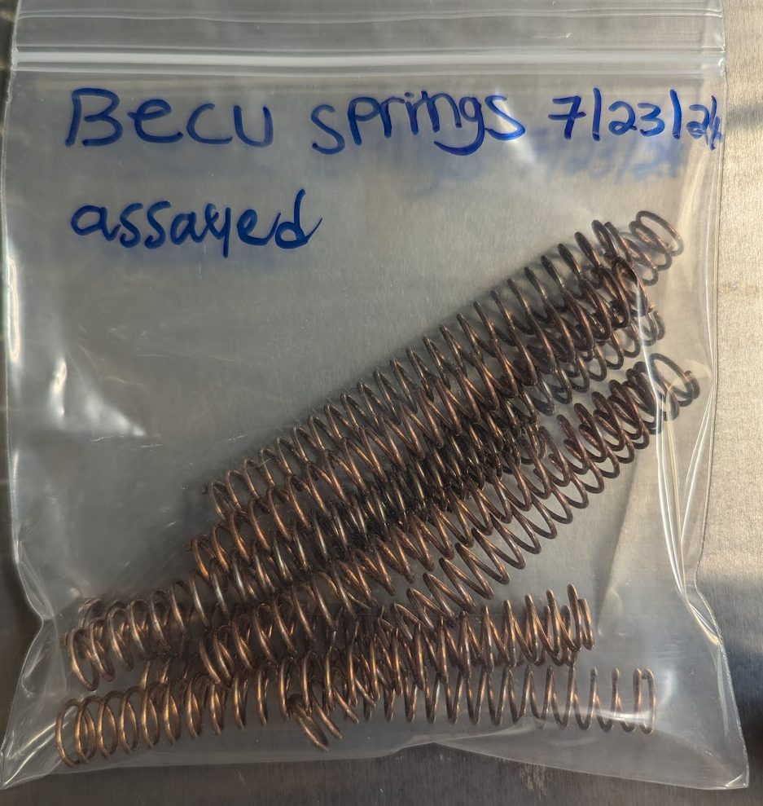
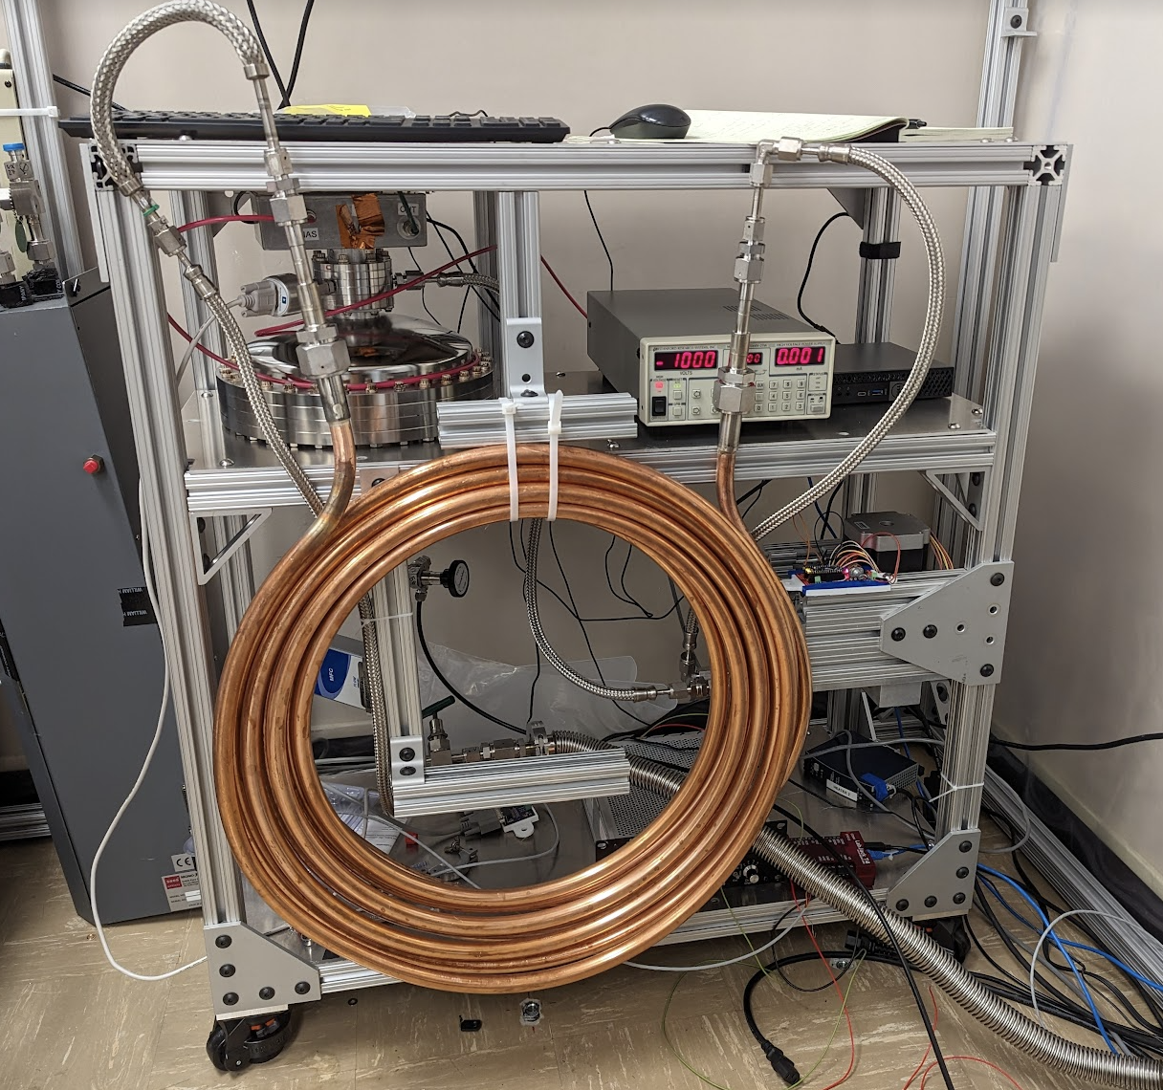
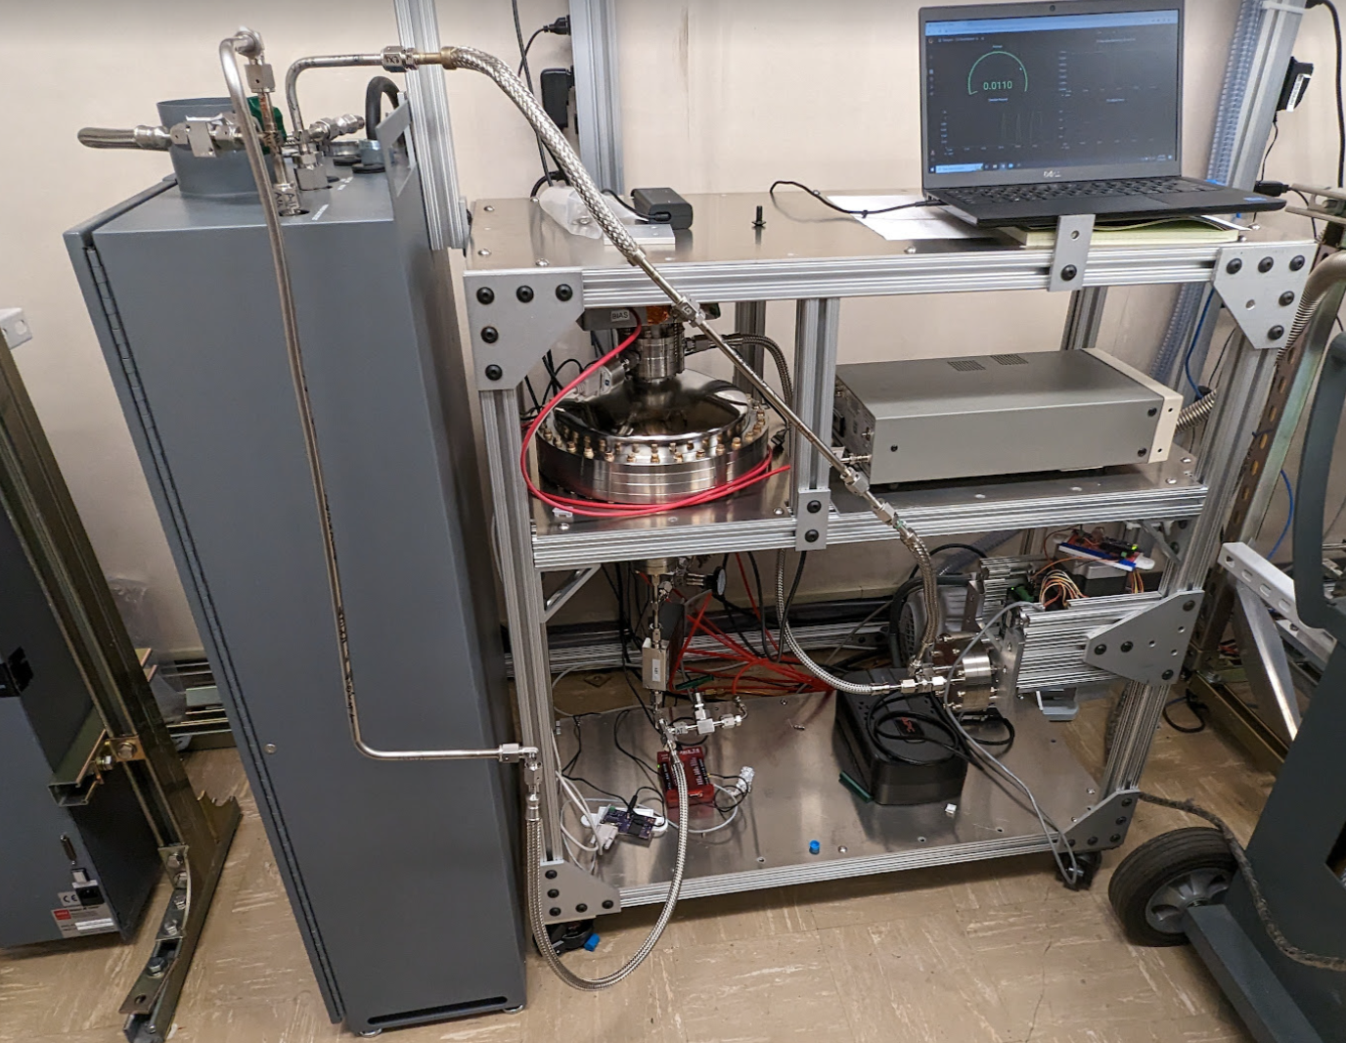
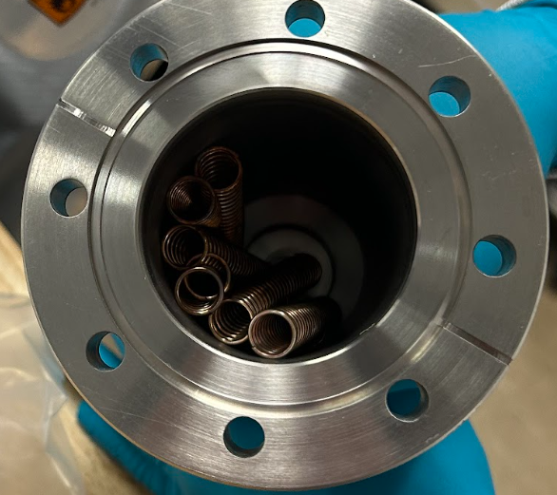
Examples of Recirculation Assays
Dielectric Science Cable
SAES PS4-MT50 (~4.5kg)
Recirculation Pump
  Sample+BG = 183 ± 17 µBq
  BG = 141 ± 19 µBq
  Sample = 42 ± 26 µBq
nEXO HV Cable Sample
~10 meters
2.60 ± 2.71µBq/m
COLD Rn222 Emanation = 111.36 +- 37.73 µBq
HOT Rn222 Emanation = 321.12 +- 44.64 µBq

Slide 15
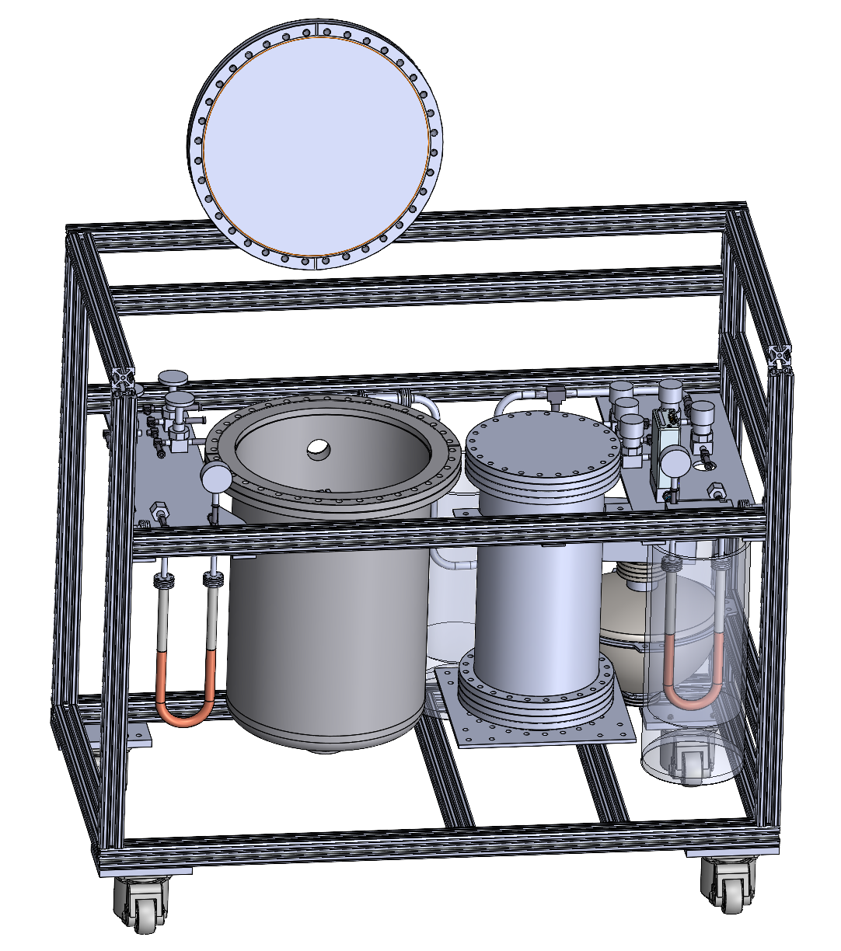
Trap and Transfer Technique
Lucas cells & proportional counters work similarly
Carrier
Gas
Process:
Emanate
Cool & trap
Warm trap
& transfer
Measure
Sample
Pump
32L
12.5” ID
13L
7.8” ID
LN2
Trap
Trap & transfer concentrates all Rn in ESC → larger samples
Rn is not supported by sample → measuring a fixed (decaying) number of Rn atoms

Slide 16
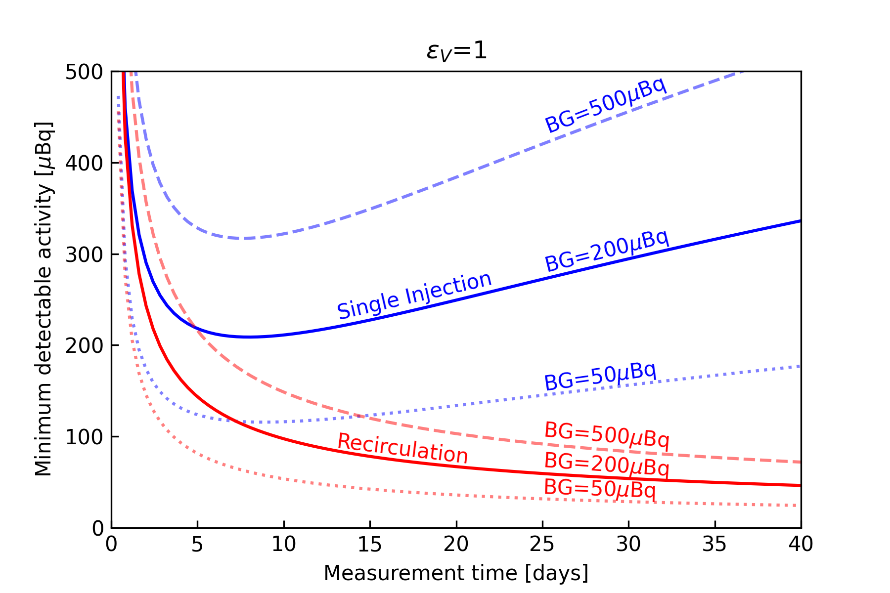
Comparing ESC Assay Techniques
Recirculation
Injection
Trap & Transfer
Recirculation
Pump
(4.3 dpd)
Sample
Pump
Sample
Idea/Plot stolen from Stefan Bruenner (XENON1T) Ph.D. Thesis
https://doi.org/10.11588/heidok.00023261
Trap

Slide 17
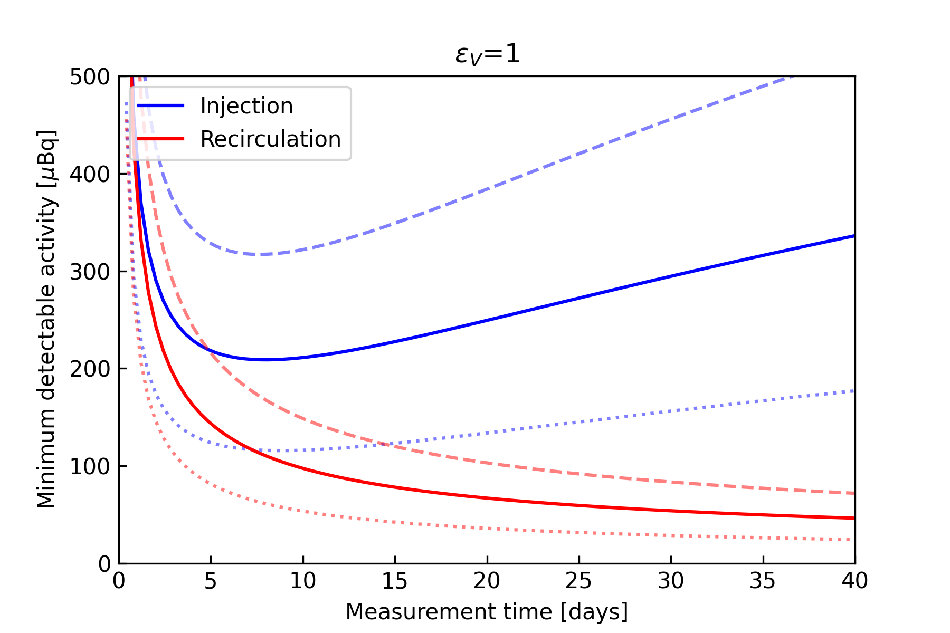
Comparing Assay Techniques
Trap & Transfer
Recirculation
Pump
Sample
Pump
Sample
Trap

Slide 18
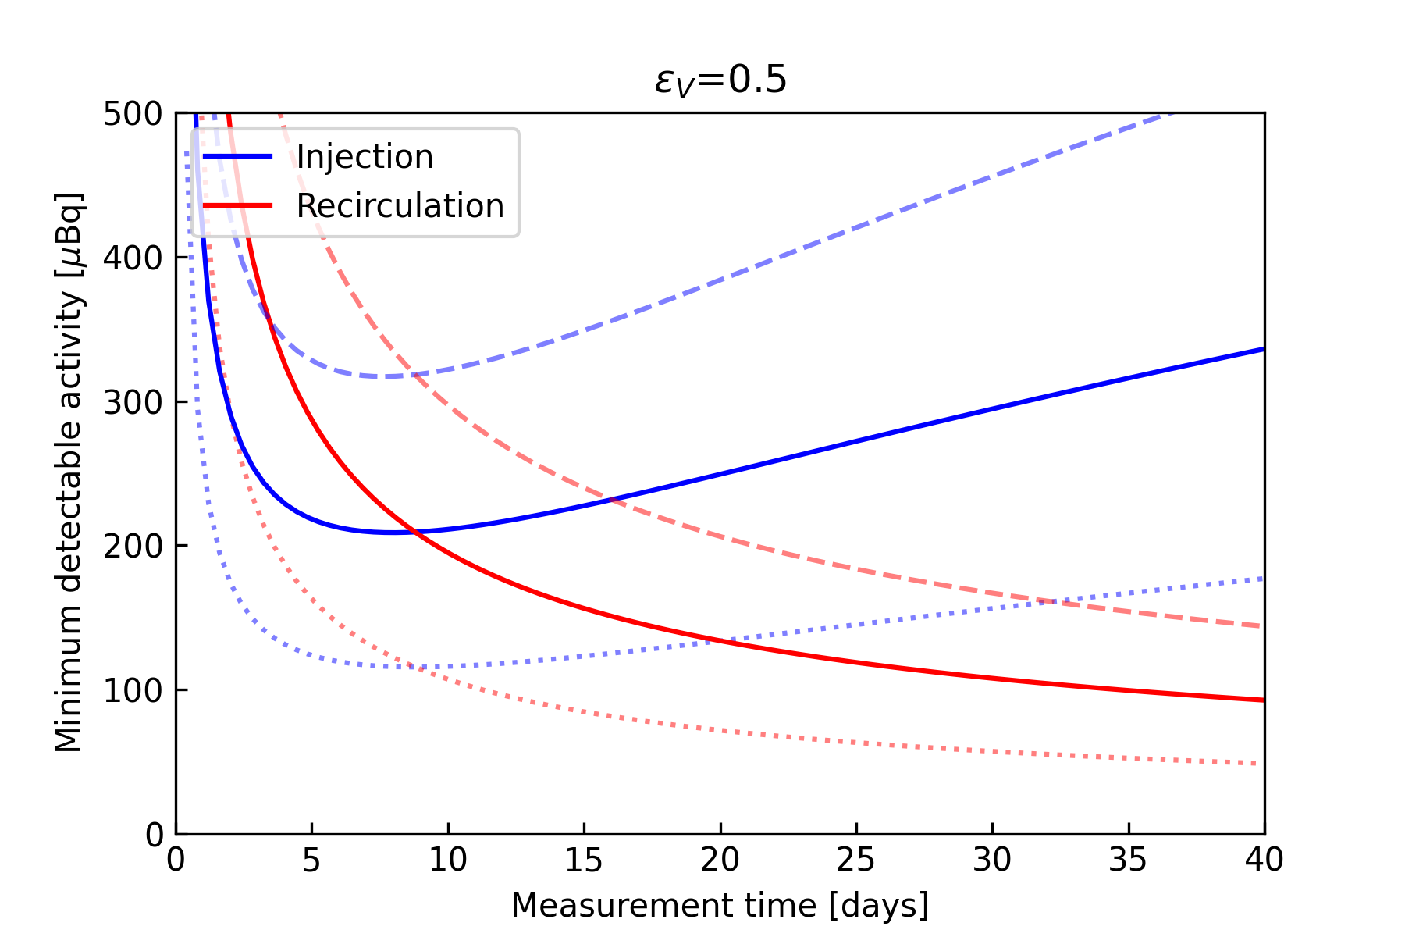
Comparing Assay Techniques
Trap & Transfer
Recirculation
Pump
Sample
Pump
Sample
Trap

Slide 19
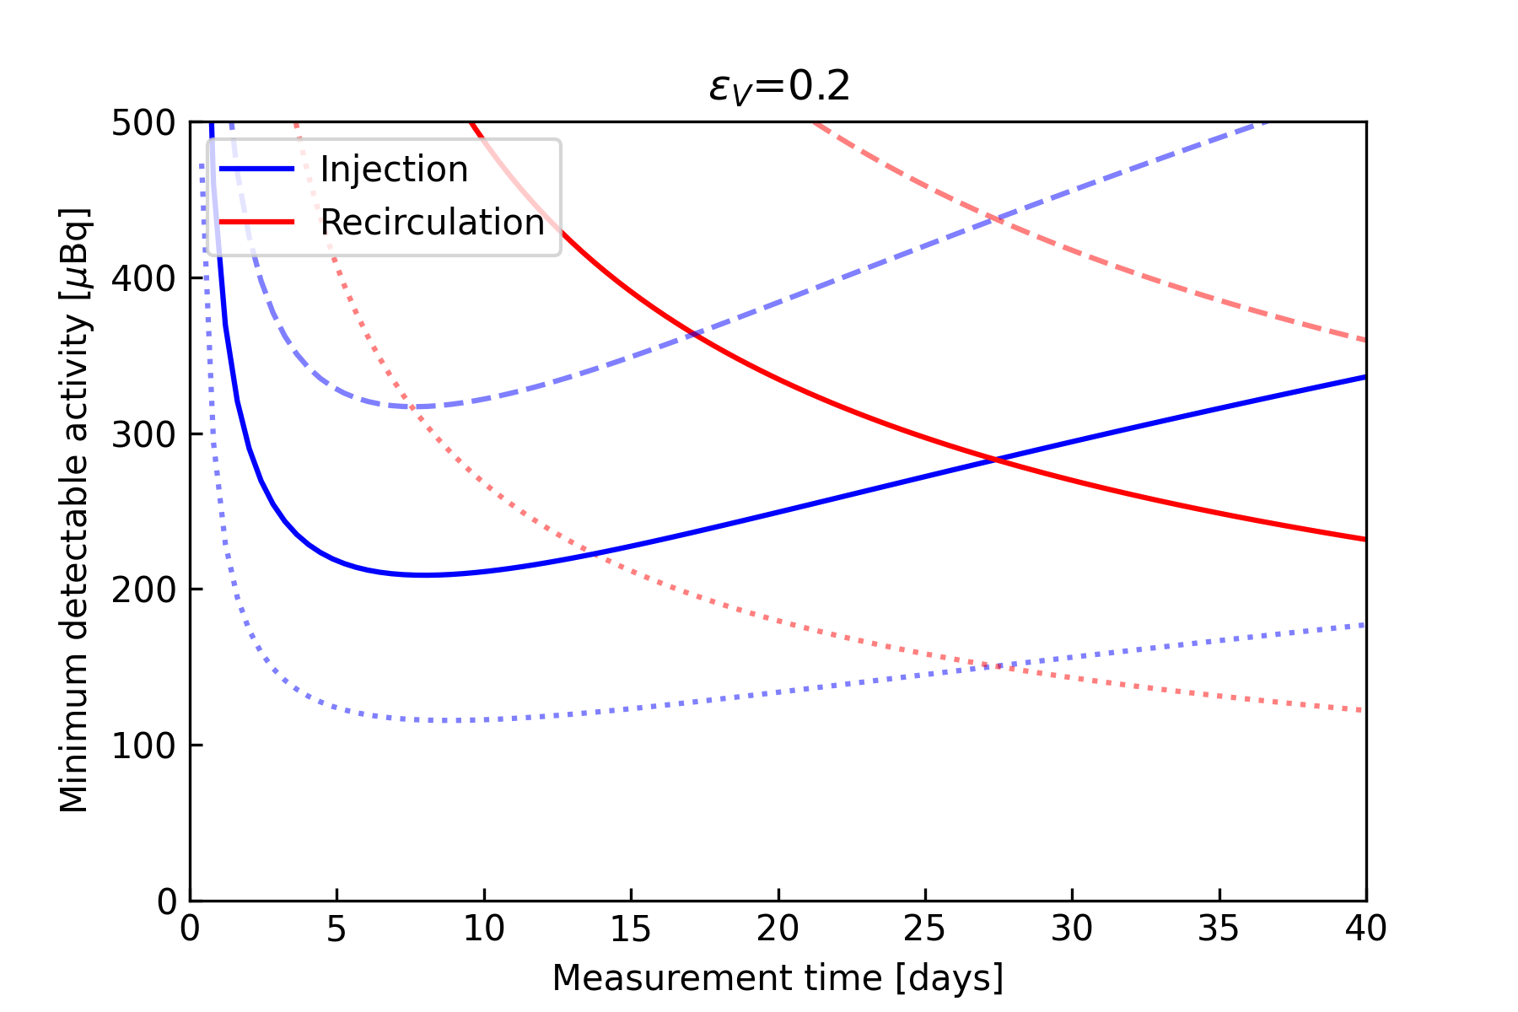
Comparing Assay Techniques
Trap & Transfer
Recirculation
Pump
Sample
Pump
Sample
Trap

Slide 20
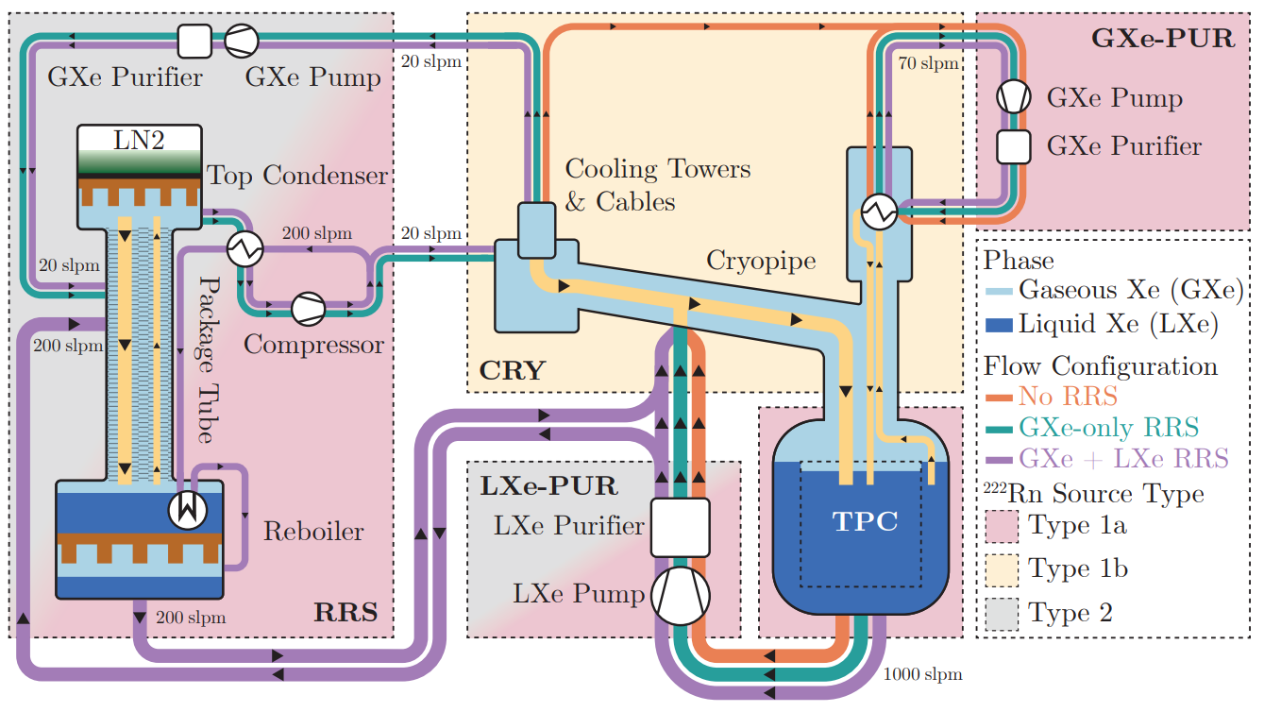
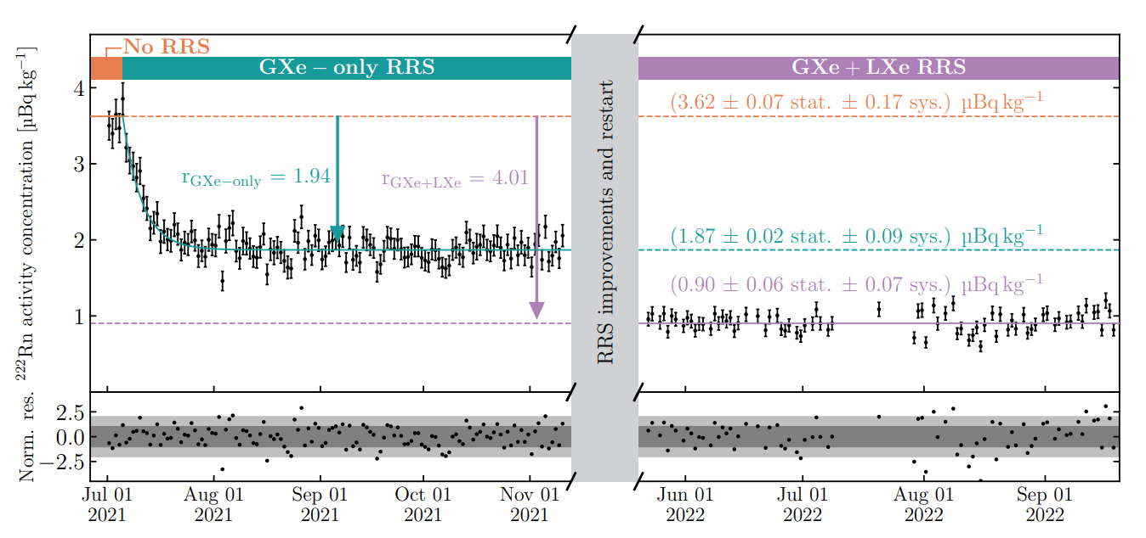
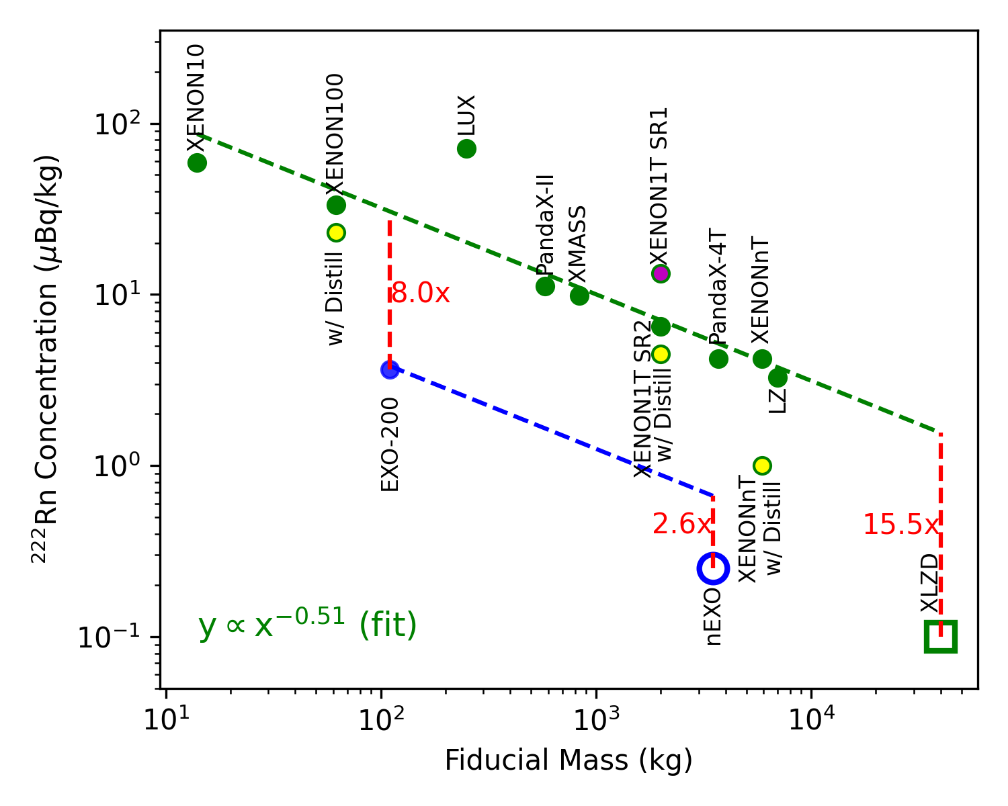
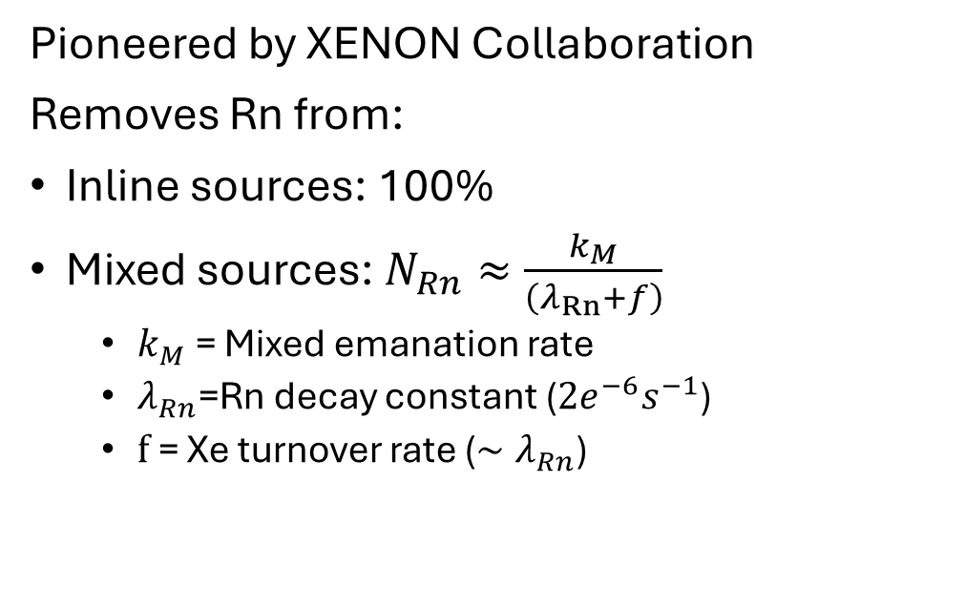
Xe:Rn Distillation
XENONnT distillation system
Pioneered by XENON Collaboration
Removes Rn from:
Inline sources: 100%
Mixed sources: $N_{Rn}≈\frac{k_{M}}{\left(λ_{Rn}+f\right)}$
  $k_{M}$ = Mixed emanation rate
  $λ_{Rn}$=Rn decay constant ($2e^{−6}s^{−1}$)
  $f$ = Xe turnover rate (${∼λ}_{Rn}$)
https://arxiv.org/abs/2502.04209
Effective!

Slide 21

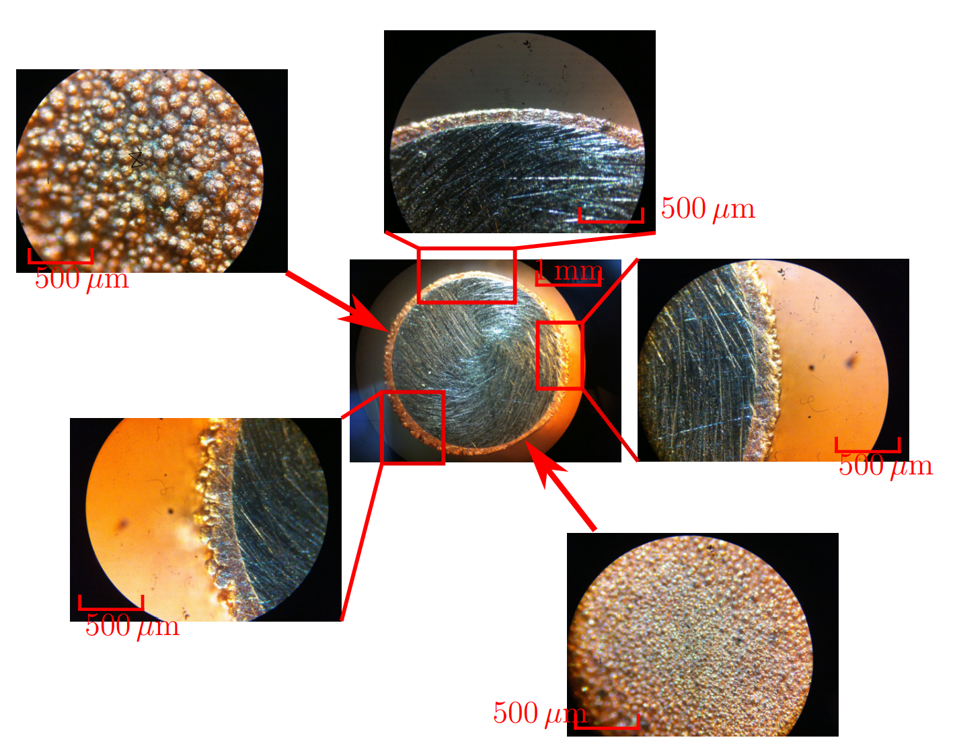
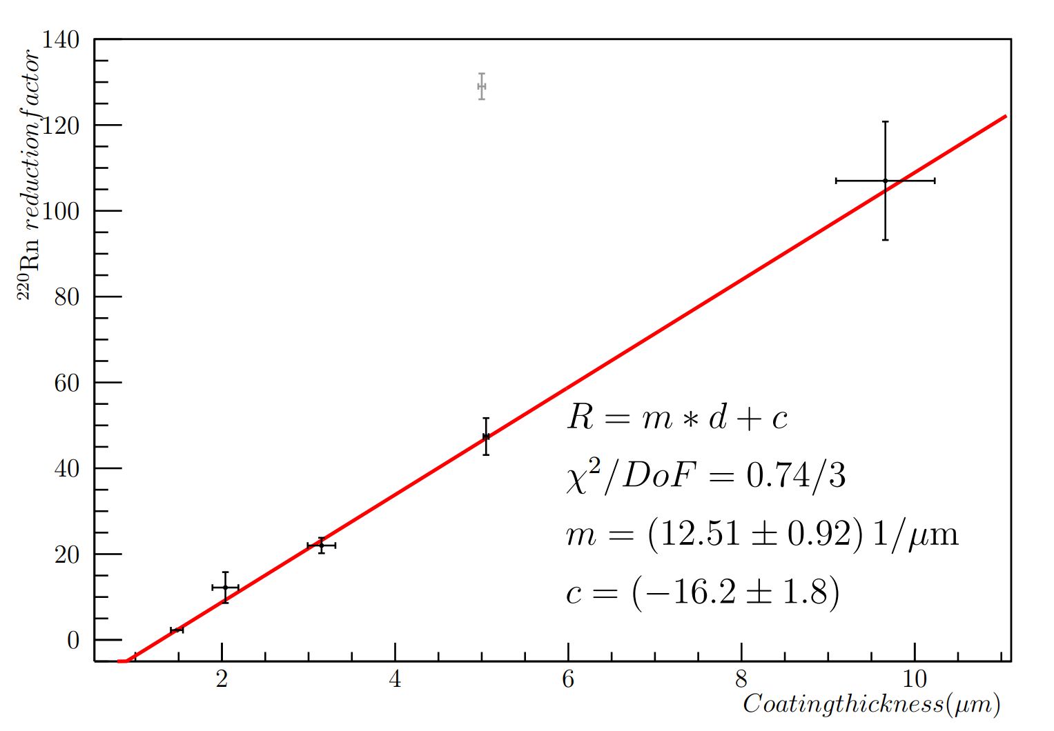


Coating Surfaces (Copper and Epoxy)
100 X →
https://doi.org/10.1016/j.nima.2025.170771
Rn Reduction factor
10 μm →
Coating Thickness (um)
Jörg, Florian. Investigation of coating-based radon barriers and studies towards their applicability in liquid xenon detectors. Diss. Ruprecht-Karls-Universität Heidelberg, 2017.
https://indico.cern.ch/event/1199289/contributions/5449632/attachments/2703469/4692729/simgen_taup_2023.pdf
Need to demonstrate wont impact TPC:
High Voltage, Xe Purity, etc (ongoing)

Slide 22


Hard work enabled by sensitive Rn assay
http://deap3600.ca/Contents/presentations/DEAP-3600CAP2012Ward.pdf
DEAP systematically studied orbital welds
  0.1 - 0.18 µBq/weld before treatment
  0 µBq/weld after treatment
    10% Citric acid 60C for 30 min
    Ultrasonic with UPW
    (Citric Passivation)
Constructed items (pumps, transfer lines, vessels) tend to be order of magnitude above raw-materials! Why?
R&D into clean construction paramount!
Need to do the lab work

Slide 23


Conclusions
nEXO 0νββ Sensitivity
Rn is expected to be largest BG in nEXO and XLZD
  Effort should be commensurate?
Sensitive assay instruments needed to meet the challenge
  Recirculation for small, inline, or plumbed components
  Trap & Transfer for large, bulky, raw materials
Needs:
  R&D into lowering Rn levels of constructed parts
  More collab between DM and 0vBB experiments
  Increase tagging efficiency of Bi-Po on cathode?

Slide 24
BACKUP

Slide 25


Purifiers
LZ uses a PS5-MGT50 (15kg) 1076 atoms
  Nominal Option
  Too high ΔP for nEXO, will need custom unit w/ lower impedance
XENON1T found a good PS4-MT50 (4kg) at ~114 atoms
  Designed for 75 SLPM of Xe only
  Aggressive: this may work in closed loop system, R&D required to demonstrate purity can be achieved
XENONnT is using 3kg of ST707 in LXe recirculation ~114 atoms
R&D on Zr and Cu purifiers speculative

Slide 26


Xenon Pump
nEXO baseline is Celerotron
  No data on Rn or Xe use
  R&D model is inappropriate for analysis
XENONnT/Münster/EXO-200 pump nearly meets specs and has Rn assay data
  As is 143 atoms
Can this be improved?
  SA estimates is ~14 atoms at 80 uBq/m2
* I will address buffer volumes with stainless steel later

Slide 27



Heat Exchanger(s)
A large 2-phase plate HX (or multiple in series) will be used to perform much of the cryo-work
LZ chose to use a commercial plate HX (Xylem BP422-80) ~250 atoms for their passive HX
  Could be reduced 5x by HNO3 as seen by XENON (50 atoms)?
Custom SS HX from 10 uBq/m2 SS at 8m2 is
38 atoms (aggressive)
Trim coolers is also needed
  LZ FNAL custom build was assayed: 90 atoms (nominal)
  EXO200 style: Cu tube 1” @20m at 1.7uBq/m2 = 1 atom (aggressive)
  Xe:LN2 condenser on XENONnT 1.3 mBq (600 atoms)

Slide 28


HV Cable & Stuff
LZ assayed the exact cable we plan to use, the Xe wetted length is assumed 10m in nEXO, 247 atoms
  How is LXe recirculated in HV conduit? Dead end or recirculated?
  Does not include any UHMWPE components that are needed.
  LZ assayed standoffs, cone, etc: 88 atoms
nEXO purchased cable is much lower in Rn, why?

Slide 29

Transfer Lines (Stainless Steel Tubing/Vessels)
A number of assays point to non-trivial emanations from SS: cryogenic lines, gas panels, buffer volumes, instruments (~8m2)
  LZ Xe transfer lines: 106 atoms
  LZ recirculation panel: 352 atoms
  XENONnT vacuum insulated pipe: 104 atoms
  XENONnT pump buffer volumes: 562 atoms
  XENONnT distillation column: 809 atoms
  XENONnT/DEAP SS assay 316L tubing (consistently ~80uBq/m2 best cases).
    I estimate ~8m2 of plumbing in nEXO = 305 atoms (nominal)
  If we use best case LowBG SS plate could be 38 atoms (aggressive)
    GERDA (Zuzel) measured 10 uBq/m2
    XENON1T measured 9 uBq/m2 for SS used in Sulzer packing material
Need to search for lower BG 1” SS pressure rated tube
  Making custom SS tubing that meets TSSA sounds really daunting but maybe necessary?!?

Slide 30

One crazy idea I proposed

Slide 31

Bottoms estimate up point design
Plumbing based on v59 of the P&ID maintained by TPCs
It is quite like EXO-200 except:
High SA Passive plate HX (or two)
  LZ HX is ~8m2
Longer runs (through water tank) biasing SA towards SS tubing
  Estimate ~8m2

Slide 32


XENONnT Schematic
21mBq
0.3mBq
3.6mBq
1.2+0.24 mBq
1.48 mBq
2.5 mBq
9.3mBq
0.24mBq
1.6mBq

Slide 33

LZ System Diagram

Slide 34



SLAC ESC “S1”
SLAC Bellows Pump
100% metal, UHV
USB Scope DAQ
Electropolished UHV ESC
Improved Electronics
Recirc pump
SlowControl DAQ
Press, Flow, Temp
Charge Amplifier and BIAS circuit

Slide 35


ESC Calibration - Backup
Evacuate Pylon source
Emanate N Rn atoms (wait)
Transfer Rn atoms through source w/ Ar/N2 to fill ESC to 1Bar
Count Rn atoms: $ε_{tot}=\frac{Count}{N}$
Efficiency product of:
  Ionization fraction of daughters in gas
  Ion collection on diode
  Solid angle of diode (50%)
  ESC $ε_{tot}=[0.3 − 0.4]$

