Slide 1
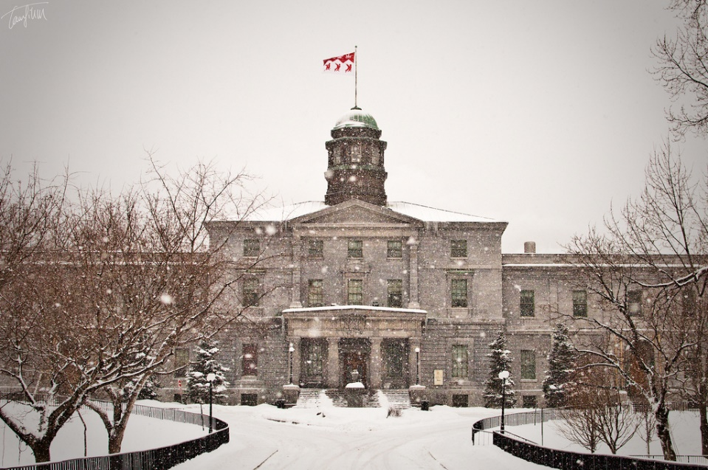
Welcome
Workshop on 0νββ search in Xe
Montreal, November 12-14, 2025

Slide 2
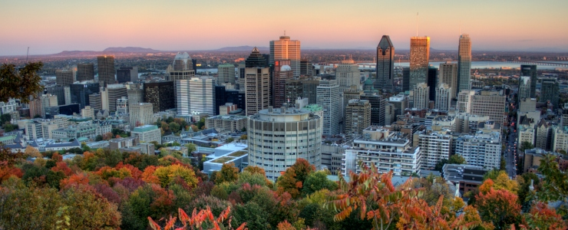
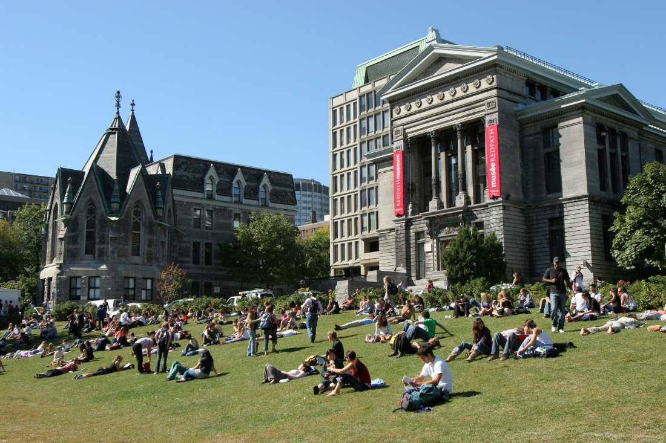
Land Acknowledgement
McGill University is on land which has long served as a site of meeting and exchange amongst Indigenous peoples, including the Haudenosaunee and Anishinabeg nations. We acknowledge and thank the diverse Indigenous peoples whose presence marks this territory on which peoples of the world now gather.

Slide 3






SPONSORS

Slide 4
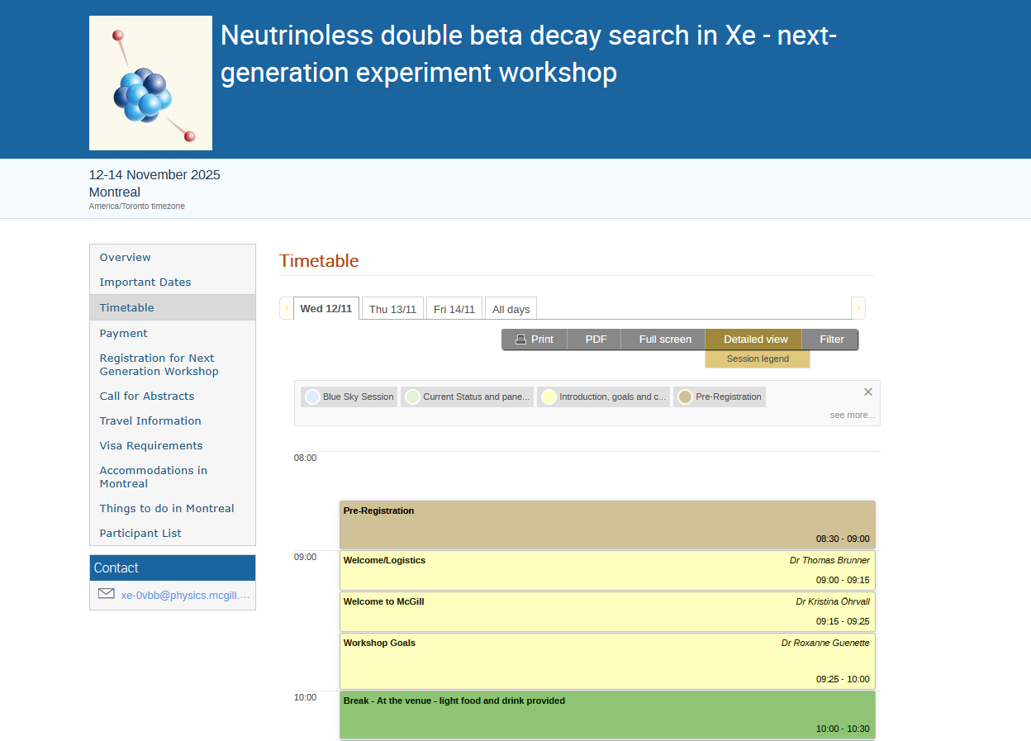
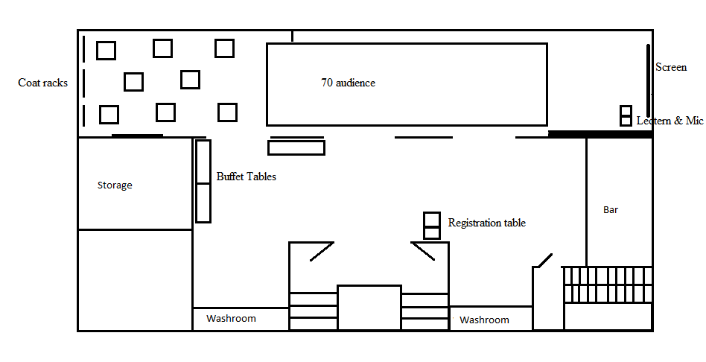
Logistics 1
Please upload your talks to indico ahead of time.
Please stick to your time.
Coffee and lunch will be served outside the ball room.
We have scheduled long lunch breaks for extensive discussions.

Slide 5
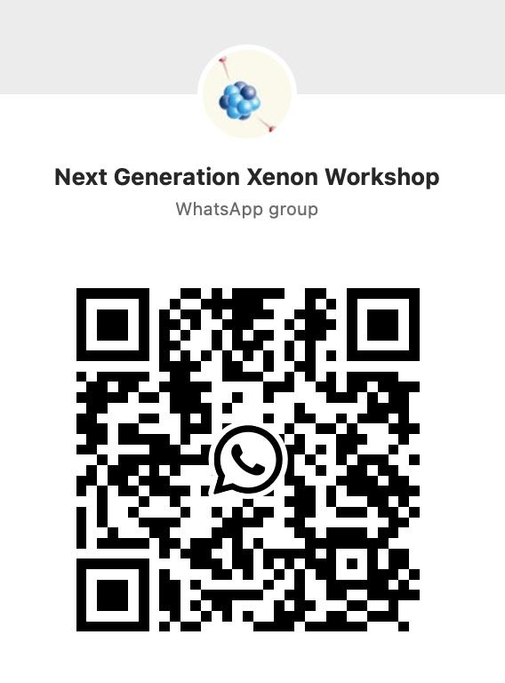
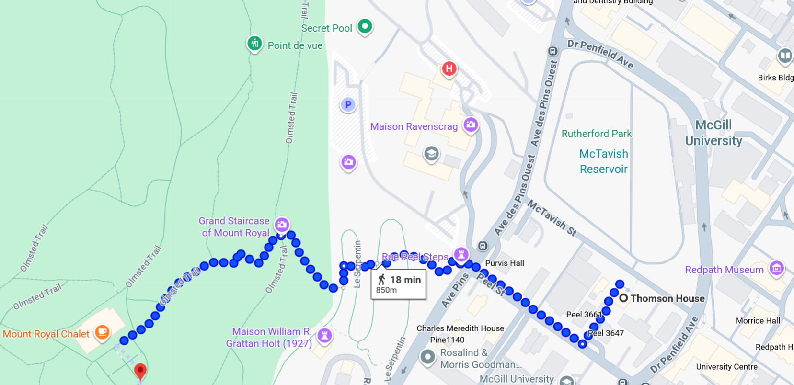
Logistics 2
WhatsApp group to coordinate socializing.
If you want to stretch your feet during the lunch break, weather permitting it is a nice walk UP to the Mont Royal Chalet.
For fancy coffee, I recommend Dispatch Coffee and Huble Lion.

Slide 6
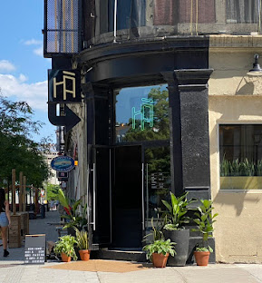
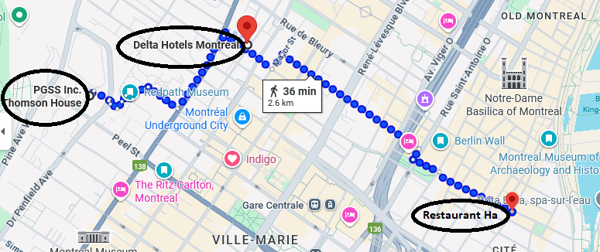
Logistics for Workshop Dinner
Workshop dinner tonight at restaurant HA, 600 William St, Montreal, Quebec H3C 1N6.
Please make your way to the HA after the last session of the day.
We will start with welcome drinks at 7 pm.

Slide 7
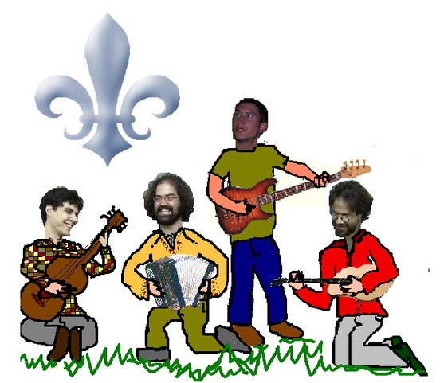
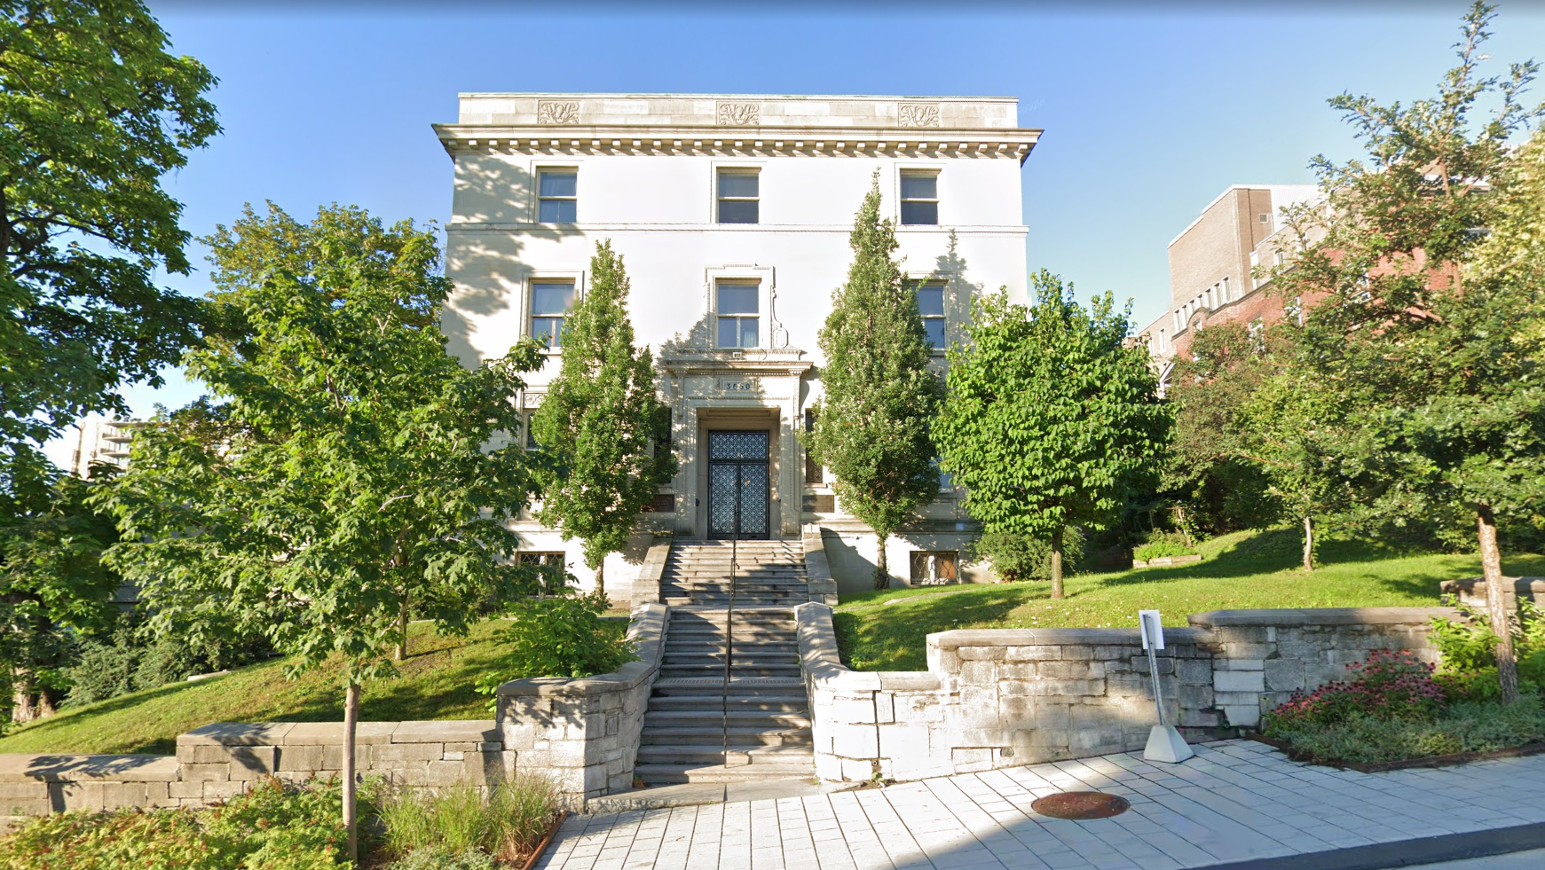
Reception on Thursday
Reception at the Thomson house restaurant (ground floor) on Thursday.
With the band Les Restants d’Cabane.
Cash bar (credit card OK).

Slide 8
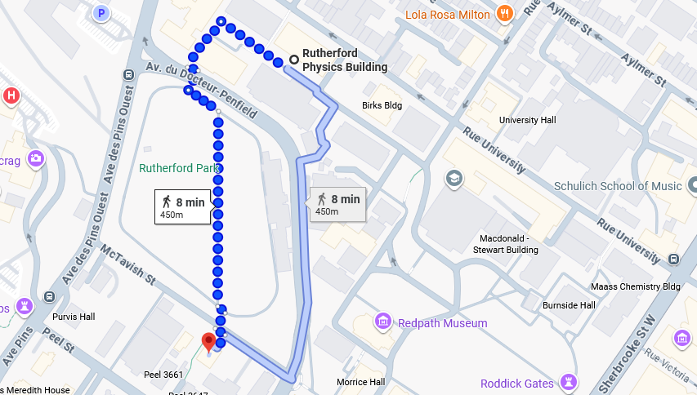
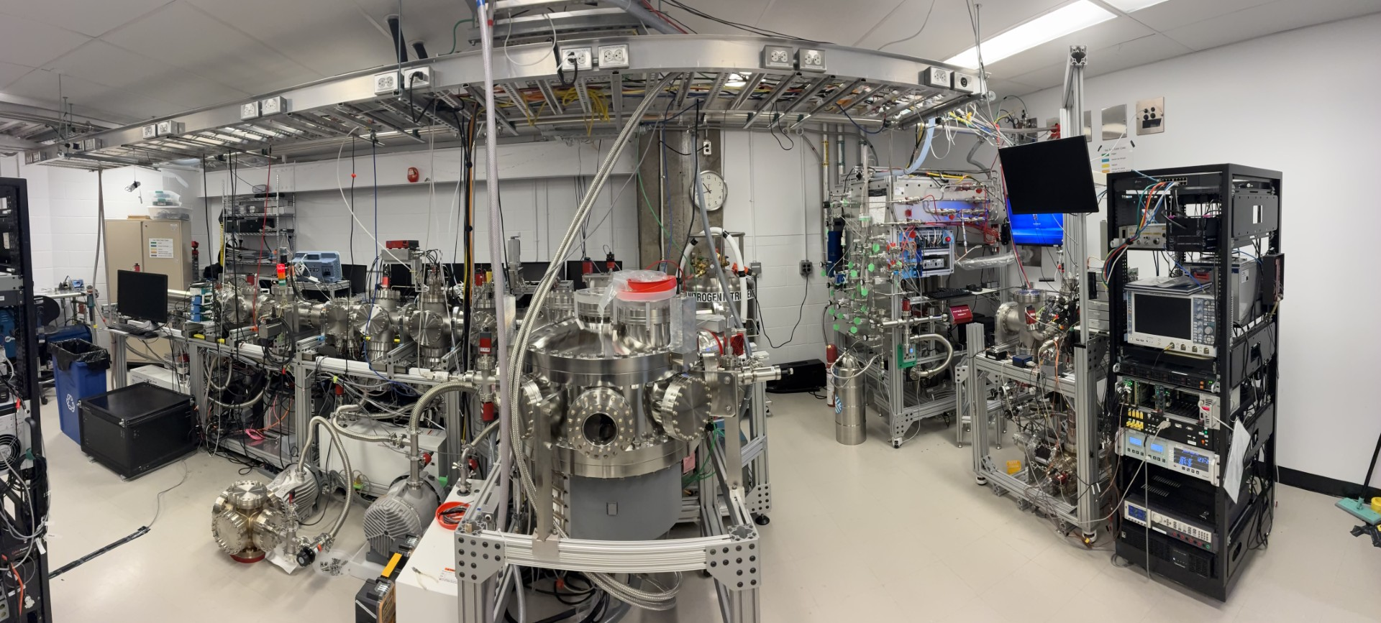
Lab tours
3600 University Street
Entrance on side away from street!
Meet in the lobby of Rutherford Bld.
Thursday morning 8am
Friday 14-ish
If you run a bit late, go to the basement to room 018 and ring the bell.

Slide 9
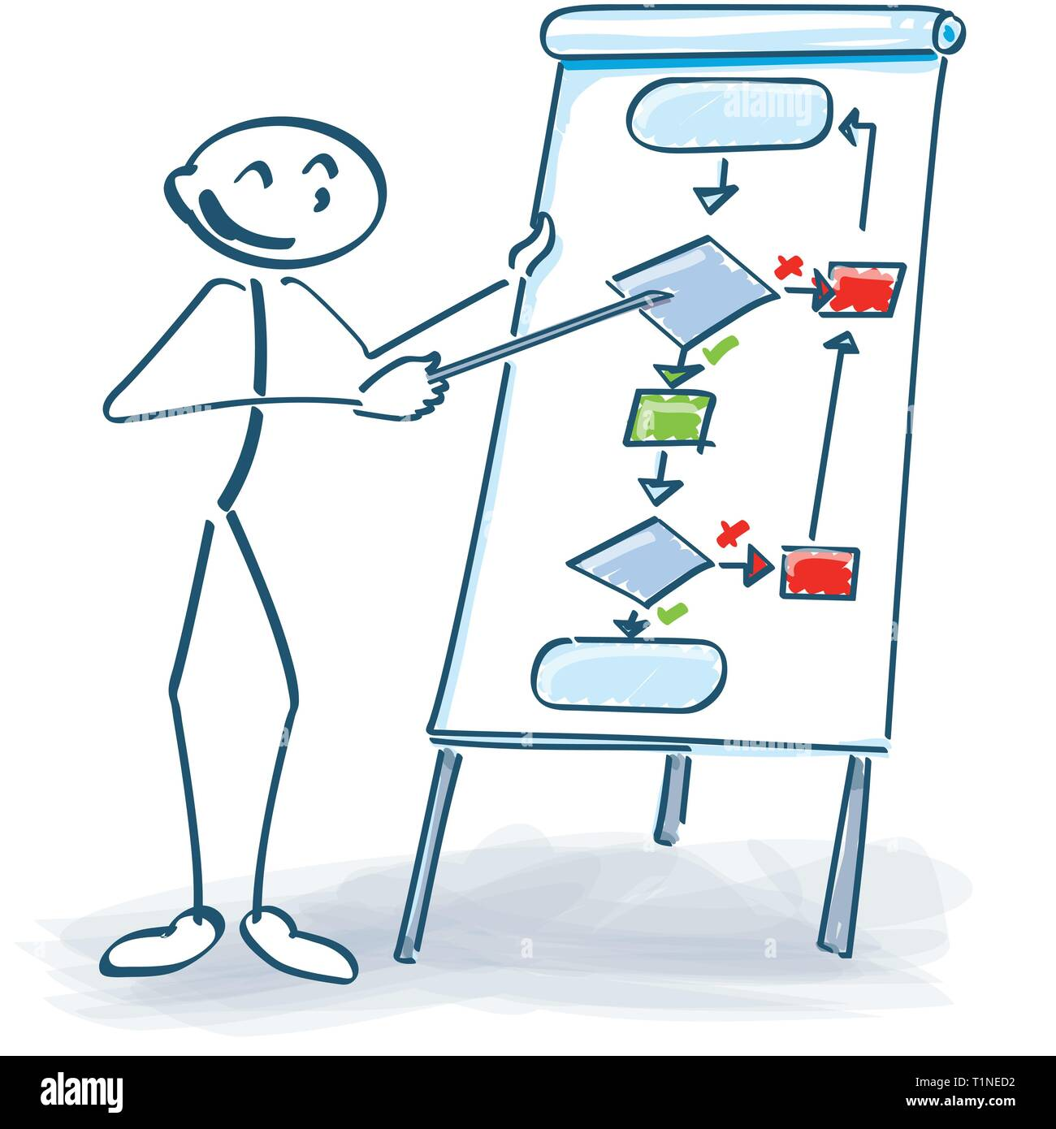
Idea collection and sketch boarding
For discussions, idea sketching, we have flip charts at the back of the room.

Slide 10

Thanks to the organizing committee: TB, Roxanne Guenette, Mike Heffner, Ben Jones, Justo Martin-Albo, Fran Spidle.
Thanks to the students that are helping this week.
Thank you all for participating in this workshop!
Thank you for sharing your opinions and ideas.
Thank you for open, respectful discussions.
I am really looking forward to this workshop and I am excited that so many of you could make it to Montreal!

Slide 11
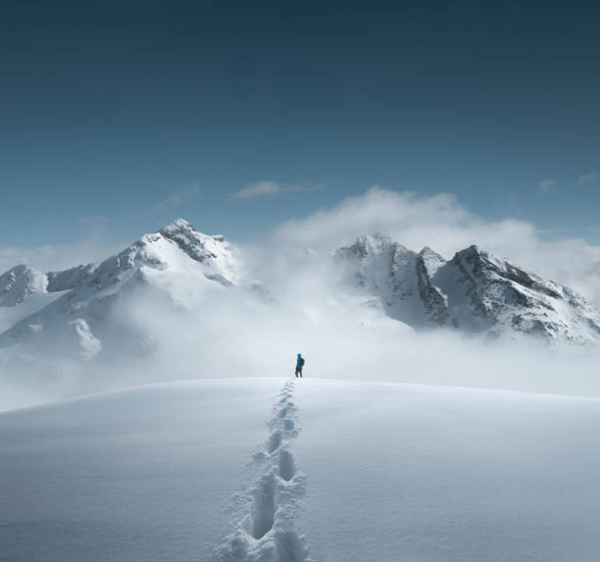
10²⁸
10³⁰

