Slide 1
Ab Initio Calculations of Electric Dipole Moments in Light Nuclei
Paul Froese
Supervisor: Petr Navrátil

Slide 2
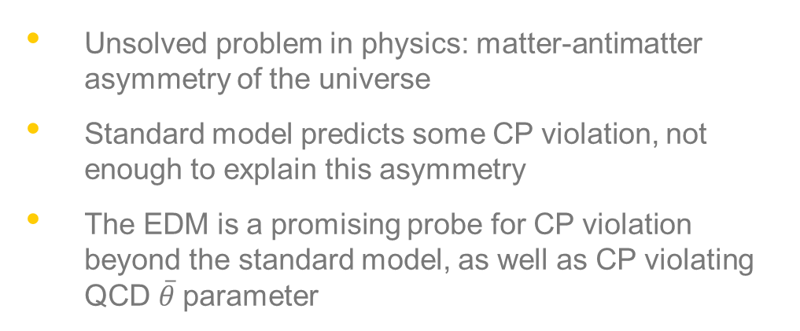
Why investigate the Electric Dipole Moment (EDM)?
Unsolved problem in physics: matter-antimatter asymmetry of the universe
Standard model predicts some CP violation, not enough to explain this asymmetry
The EDM is a promising probe for CP violation beyond the standard model, as well as CP violating QCD $\overline{θ}$parameter

Slide 3
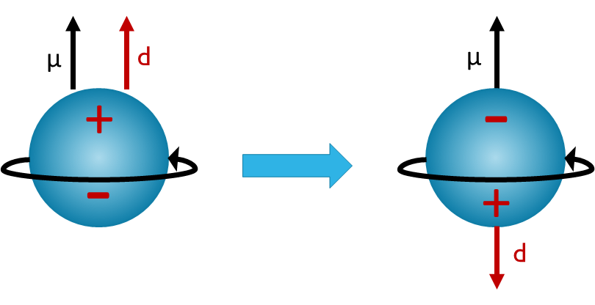
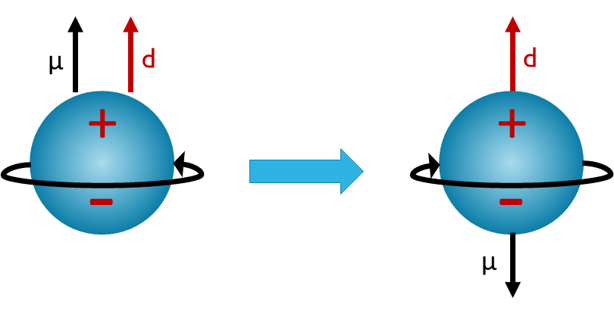
CP violation and the EDM
A non-zero EDM of any finite system requires P and T violation, which implies CP violation through the CPT theorem
Consider the neutron:
Under a Parity (P) Transformation:
Under a Time-reversal (T) Transformation:

Slide 4
CP violation and the EDM
Problem with neutron EDM: very small
Alternative: Nuclear EDM
Nuclear structure can enhance the EDM
Nuclear EDMs can be measured in storage rings (CERN feasibility study: arXiv:1912.07881)
To understand the nuclear EDM, nuclear structure effects must be understood

Slide 5
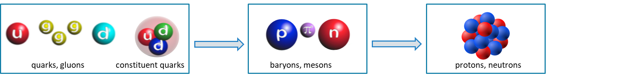



No Core Shell Model
Ab-initio theory
Based on first principles
All nucleons are active (no-core)
Chiral nucleon-nucleon and three-nucleon interactions are the only input
Quantum Chromodynamics
(QCD)
Chiral Effective Field
Theory
Current ab initio nuclear theory

Slide 6
No Core Shell Model
Harmonic oscillator basis expansion
Filled HO shells match magic nuclei (up to ⁴⁰Ca)
Equivalent description in relative coordinate and Slater determinant basis
Dependence on frequency and N_{max}

Slide 7
NCSM binding energies of light nuclei from chiral NN+3N forces
Quite reasonable description of binding energies across the nuclear charts becomes feasible
Hamiltonian fully determined in A=2 and A=3,4 systems
  Nucleon–nucleon scattering, deuteron properties, ³H and ⁴He binding energy, ³H half life
NN N³LO (Entem-Machleidt 2003)
3N N²LO w local/non-local regulator
  Hamiltonian also performs well for medium mass nuclei

Slide 8
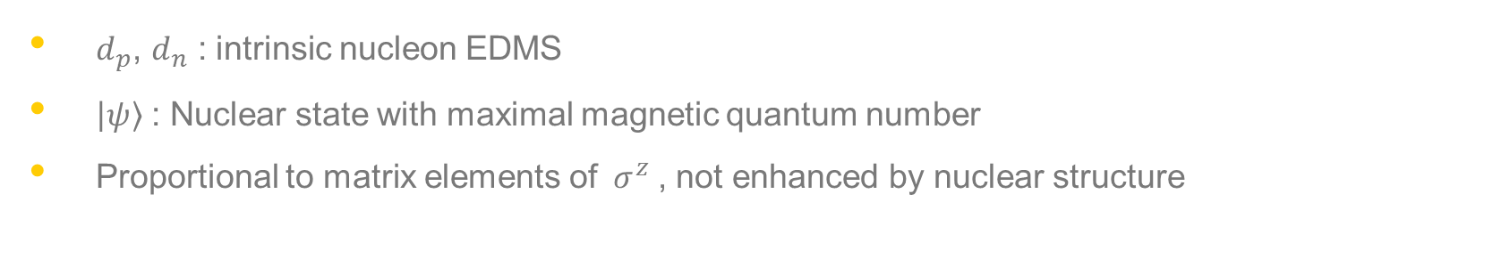
Formalism
One-body contribution from nucleon EDMs easily evaluated
$$D^{(1)}=\left\langle ψ\right|\sum_{i=1}^{A}{\frac{1}{2}\left[\left(d_{p}+d_{n}\right)−\left(d_{p}−d_{n}\right)τ_{i}^{z}\right]σ_{i}^{z}|ψ⟩}$$
$d_{p}$, $d_{n}$ : intrinsic nucleon EDMS
$\left|ψ\right\rangle$ : Nuclear state with maximal magnetic quantum number
Proportional to matrix elements of$σ^{z}$, not enhanced by nuclear structure

Slide 9
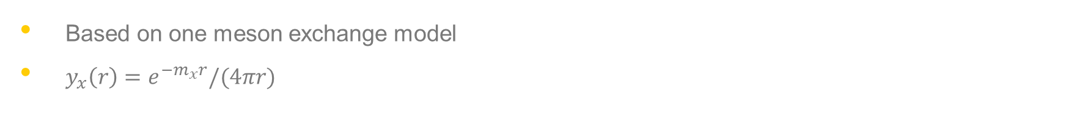
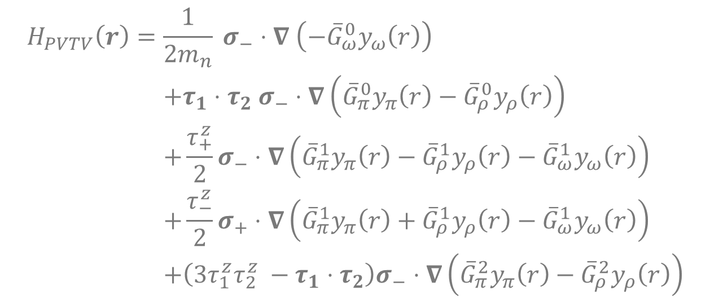
Formalism
Parity and time-reversal violation introduced through Hamiltonian H_{PVTV} :
$$\begin{aligned}H_{PVTV}\left(r\right)=&\frac{1}{2m_{n}} σ_{−}⋅∇ \left(−{\overline{G}}_{ω}^{0}y_{ω}\left(r\right)\right) \\ &+τ_{1}⋅τ_{2} σ_{−}⋅∇\left({\overline{G}}_{π}^{0}y_{π}\left(r\right)−{\overline{G}}_{ρ}^{0}y_{ρ}\left(r\right)\right) \\ &+\frac{τ_{+}^{z}}{2}σ_{−}⋅∇\left({\overline{G}}_{π}^{1}y_{π}\left(r\right)−{\overline{G}}_{ρ}^{1}y_{ρ}\left(r\right)−{\overline{G}}_{ω}^{1}y_{ω}\left(r\right)\right) \\ &+\frac{τ_{−}^{z}}{2}σ_{+}⋅∇\left({\overline{G}}_{π}^{1}y_{π}\left(r\right)+{\overline{G}}_{ρ}^{1}y_{ρ}\left(r\right)−{\overline{G}}_{ω}^{1}y_{ω}\left(r\right)\right) \\ &+\left(3τ_{1}^{z}τ_{2}^{z} −τ_{1}⋅τ_{2}\right)σ_{−}⋅∇\left({\overline{G}}_{π}^{2}y_{π}\left(r\right)−{\overline{G}}_{ρ}^{2}y_{ρ}\left(r\right)\right)\end{aligned}$$
Based on one meson exchange model
$y_{x}\left(r\right)=e^{−m_{x}r}/(4πr)$

Slide 10
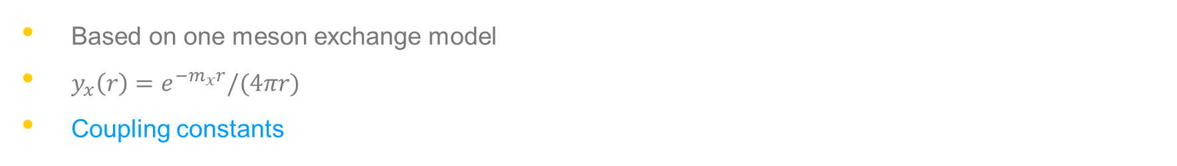
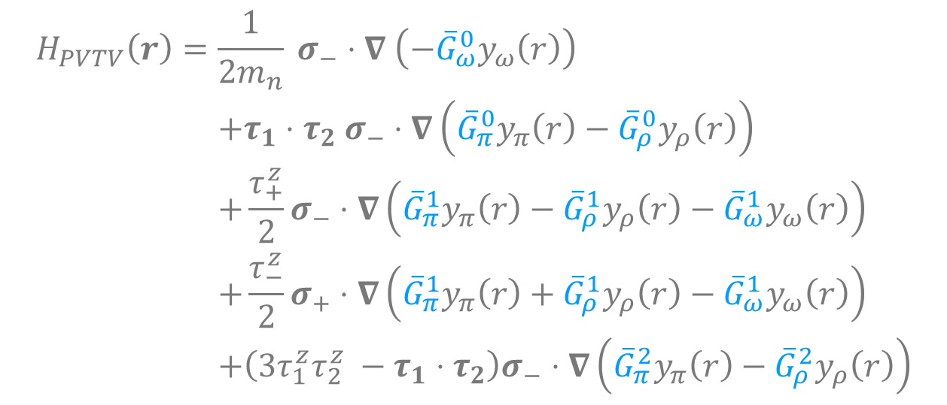
Formalism
Parity and time-reversal violation introduced through Hamiltonian H_{PVTV} :
$$\begin{aligned}H_{PVTV}\left(r\right)=&\frac{1}{2m_{n}} σ_{−}⋅∇ \left(−{\overline{G}}_{ω}^{0}y_{ω}\left(r\right)\right) \\ &+τ_{1}⋅τ_{2} σ_{−}⋅∇\left({\overline{G}}_{π}^{0}y_{π}\left(r\right)−{\overline{G}}_{ρ}^{0}y_{ρ}\left(r\right)\right) \\ &+\frac{τ_{+}^{z}}{2}σ_{−}⋅∇\left({\overline{G}}_{π}^{1}y_{π}\left(r\right)−{\overline{G}}_{ρ}^{1}y_{ρ}\left(r\right)−{\overline{G}}_{ω}^{1}y_{ω}\left(r\right)\right) \\ &+\frac{τ_{−}^{z}}{2}σ_{+}⋅∇\left({\overline{G}}_{π}^{1}y_{π}\left(r\right)+{\overline{G}}_{ρ}^{1}y_{ρ}\left(r\right)−{\overline{G}}_{ω}^{1}y_{ω}\left(r\right)\right) \\ &+\left(3τ_{1}^{z}τ_{2}^{z} −τ_{1}⋅τ_{2}\right)σ_{−}⋅∇\left({\overline{G}}_{π}^{2}y_{π}\left(r\right)−{\overline{G}}_{ρ}^{2}y_{ρ}\left(r\right)\right)\end{aligned}$$
Based on one meson exchange model
$y_{x}\left(r\right)=e^{−m_{x}r}/(4πr)$
Coupling constants

Slide 11

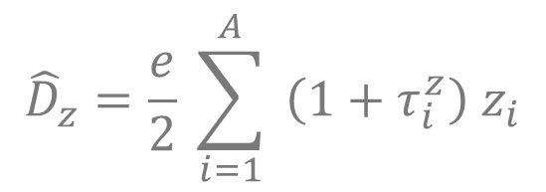



Formalism
H_{PVTV} introduces parity admixture in the ground state (perturbation theory):
$$\left|0\right\rangle$$
$$\left|0\right\rangle + \left|\tilde{0}\right\rangle$$
$$\left|\tilde{0}\right\rangle =\sum_{n≠0}{\frac{1}{E_{0}−E_{n}}\left|n\right\rangle \left\langle n\right|H_{PVTV}\left|0\right\rangle }$$
Nuclear EDM is dominated by polarization contribution:
$${\hat{D}}_{z}=\frac{e}{2} \sum_{i=1}^{A}{ \left(1+τ_{i}^{z}\right){ z}_{i}}$$
$$D^{(pol)}=\left\langle 0\right|{\hat{D}}_{z}\left|\tilde{0}\right\rangle +c.c.$$

Slide 12
Formalism
H_{PVTV} introduces parity admixture in the ground state (perturbation theory):
$$\left|0\right\rangle$$
$$\left|0\right\rangle + \left|\tilde{0}\right\rangle$$
$$\left|\tilde{0}\right\rangle =\sum_{n≠0}{\frac{1}{E_{0}−E_{n}}\left|n\right\rangle \left\langle n\right|H_{PVTV}\left|0\right\rangle }$$
Low lying states of opposite parity can lead to enhancement!
Nuclear EDM is dominated by polarization contribution:
$${\hat{D}}_{z}=\frac{e}{2} \sum_{i=1}^{A}{ \left(1+τ_{i}^{z}\right){ z}_{i}}$$
$$D^{(pol)}=\left\langle 0\right|{\hat{D}}_{z}\left|\tilde{0}\right\rangle +c.c.$$

Slide 13
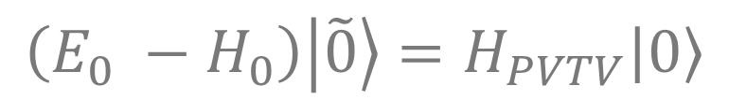
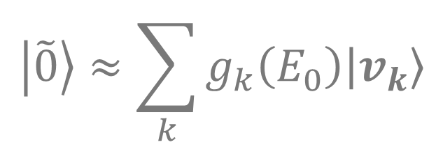

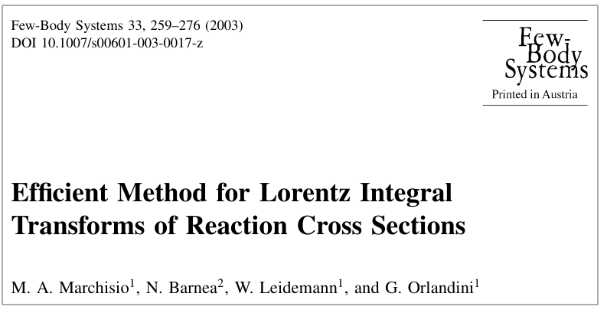
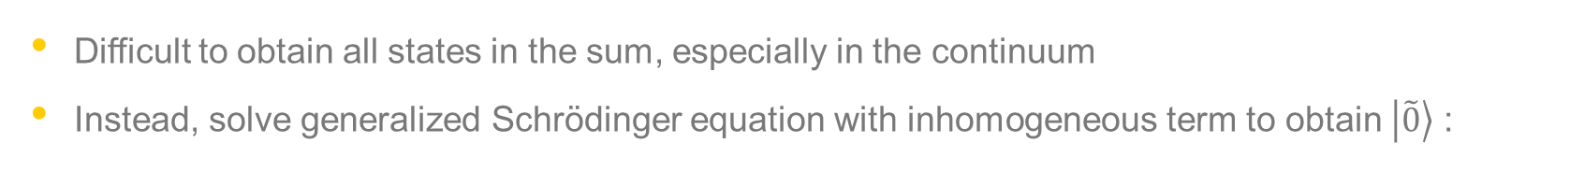
Formalism
Difficult to obtain all states in the sum, especially in the continuum
Instead, solve generalized Schrödinger equation with inhomogeneous term to obtain $\left|\tilde{0}\right\rangle$ :
To invert, we use the Lanczos continued fractions method:

Slide 14
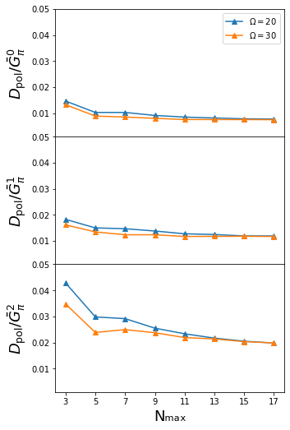
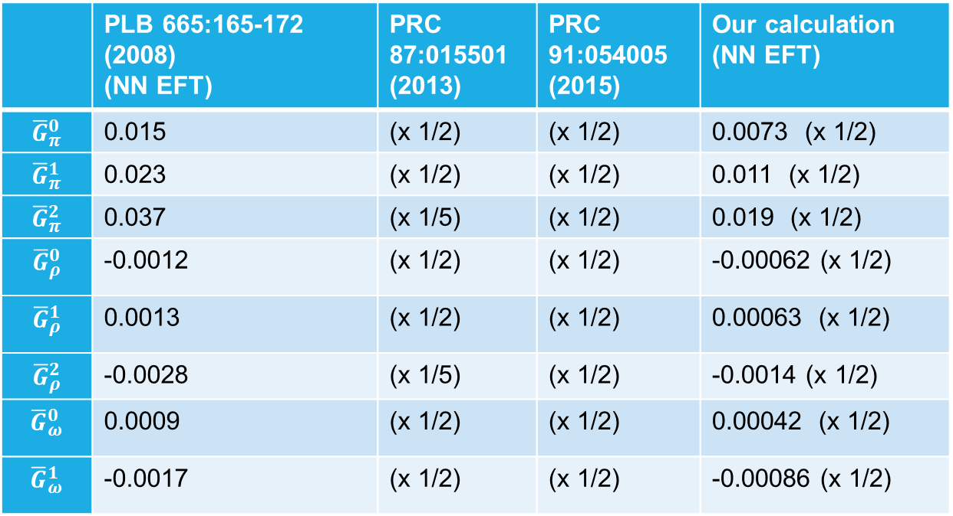
³He Benchmark Calculation
Discrepancy between calculations?
N_{max} convergence for ³He
 | PLB 665:165-172 (2008) (NN EFT) | PRC 87:015501 (2013) | PRC 91:054005 (2015) | Our calculation (NN EFT)
$${\overline{G}}_{π}^{0}$$ | 0.015 | (x 1/2) | (x 1/2) | 0.0073 (x 1/2)
$${\overline{G}}_{π}^{1}$$ | 0.023 | (x 1/2) | (x 1/2) | 0.011 (x 1/2)
$${\overline{G}}_{π}^{2}$$ | 0.037 | (x 1/5) | (x 1/2) | 0.019 (x 1/2)
$${\overline{G}}_{ρ}^{0}$$ | -0.0012 | (x 1/2) | (x 1/2) | -0.00062 (x 1/2)
$${\overline{G}}_{ρ}^{1}$$ | 0.0013 | (x 1/2) | (x 1/2) | 0.00063 (x 1/2)
$${\overline{G}}_{ρ}^{2}$$ | -0.0028 | (x 1/5) | (x 1/2) | -0.0014 (x 1/2)
$${\overline{G}}_{ω}^{0}$$ | 0.0009 | (x 1/2) | (x 1/2) | 0.00042 (x 1/2)
$${\overline{G}}_{ω}^{1}$$ | -0.0017 | (x 1/2) | (x 1/2) | -0.00086 (x 1/2)
N³LO NN
Our results confirm those of Yamanaka and Hiyama, PRC 91:054005 (2015)
Our results confirm those of Yamanaka and Hiyama, PRC 91:054005 (2015)

Slide 15
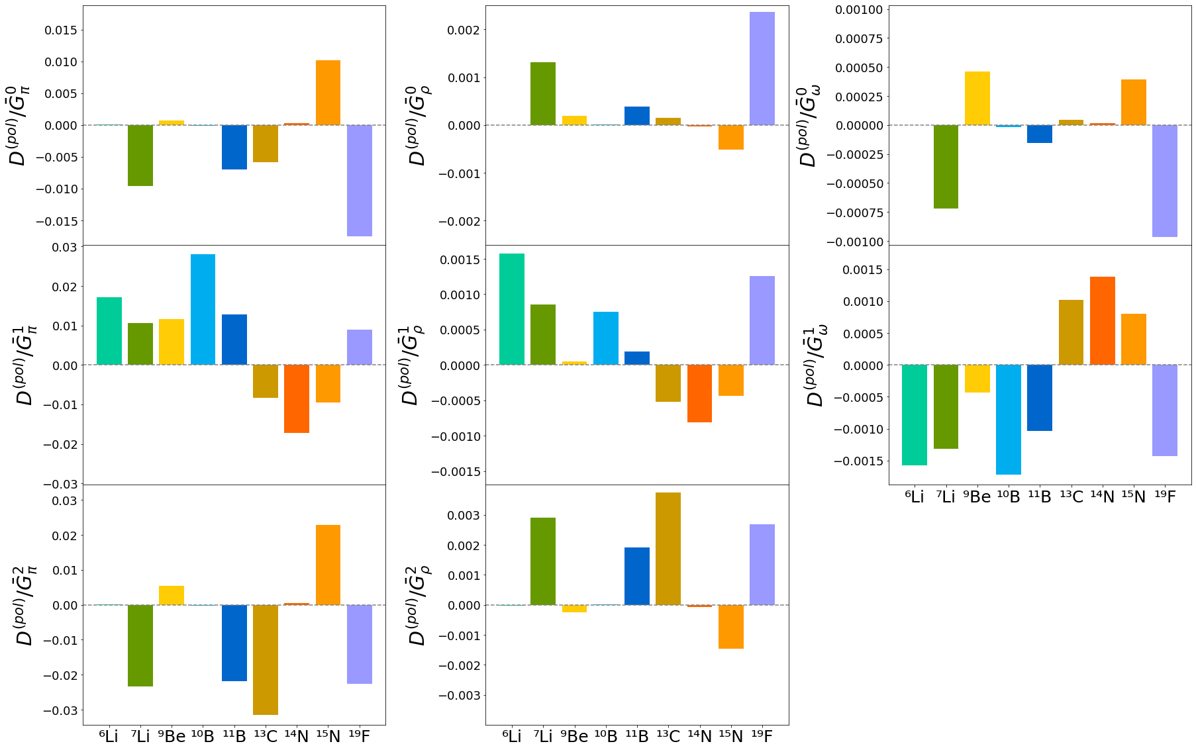
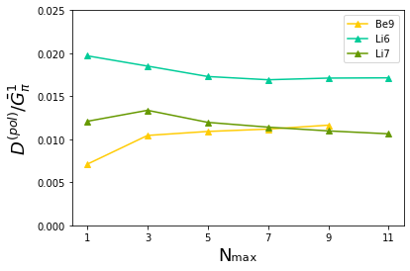
Results: Calculated EDMS of selected stable nuclei
Examples of N_{max} convergence

Slide 16
Summary
Outlook
Hoping to provide an estimate of the ¹¹Be EDM
¹¹Be has low lying states of opposite parity, but ground state is an extended halo state, making it difficult to use NCSM
The nuclear electric dipole moment is a promising way to test fundamental symmetries
Nuclear structure can enhance the EDM
Different nuclei can be used to probe different terms of the parity violating interaction
Theoretical calculations of EDMs allow us to suggest promising candidates for planned experiments in storage rings

