Slide 1
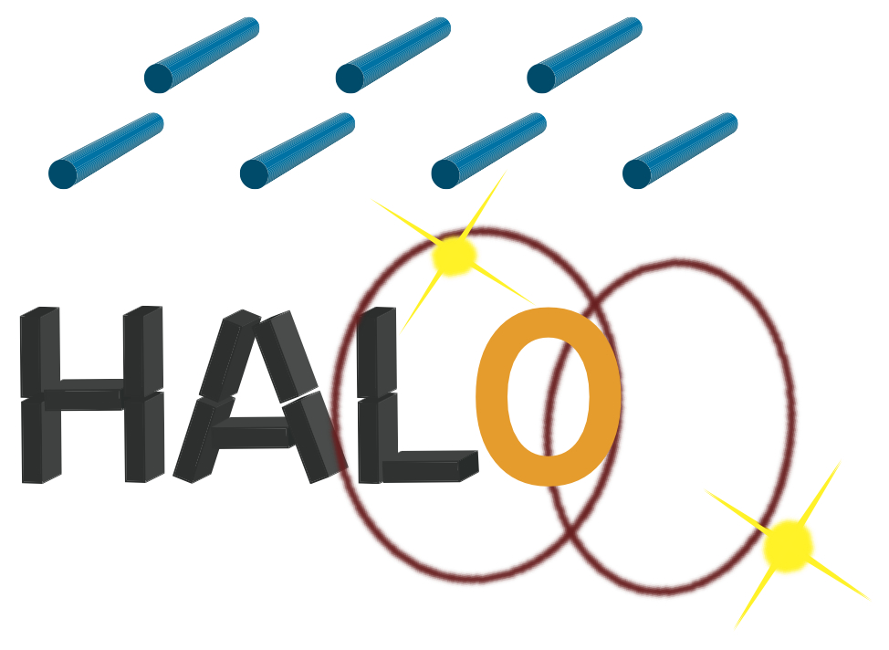
SNEWS 2.0 Implementation for HALO, HALO-1kT and SNO+.
Remington Hill
Contact Info: rhill2@laurentian.ca
Supervisor: Dr. Clarence Virtue
4th Year B.Sc. Specialization in Physics
Laurentian University
Multi-Messenger Workshop, McGill University
January 30th, 2020

Slide 2
Outline
Helium and Lead Observatory (HALO) & HALO-1kT
SuperNova Early Warning System (SNEWS)
Pointing with neutrino detectors
Implementation in HALO/HALO-1kT and SNO+
Conclusion & Future Plans

Slide 3
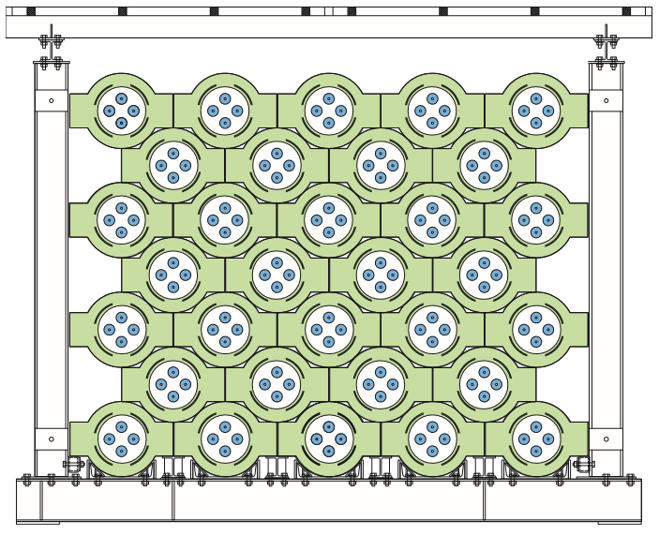
Helium and Lead Observatory (HALO)
Courtesy of Justin Vasel
Design Principles
Low maintenance
Long lifetime
One of two dedicated supernova detectors.
Completed construction in May 2012, joined SNEWS in Oct. 2015.
Compliment sensitivity to other neutrino detectors (SNO+, SuperK, etc).
Schematic diagram of HALO.

Slide 4
HALO-1kT
$n$ efficiency ~ 53%
R&D is funded. With candidate location at Gran Sasso National Laboratory, Italy.
HALO’s bigger brother. 79 tonnes of Pb in HALO, 1 kiloton in HALO-1kT.
$n$ efficiency ~ 28%
4.45 m
Improvements upon base design
2.4 m
Sensitivity
$n$ Capture Eff.
Shielding
HALO and HALO-1kT side by side comparison. The model of HALO-1kT is a Geant4 model, rather than a schematic diagram.

Slide 5
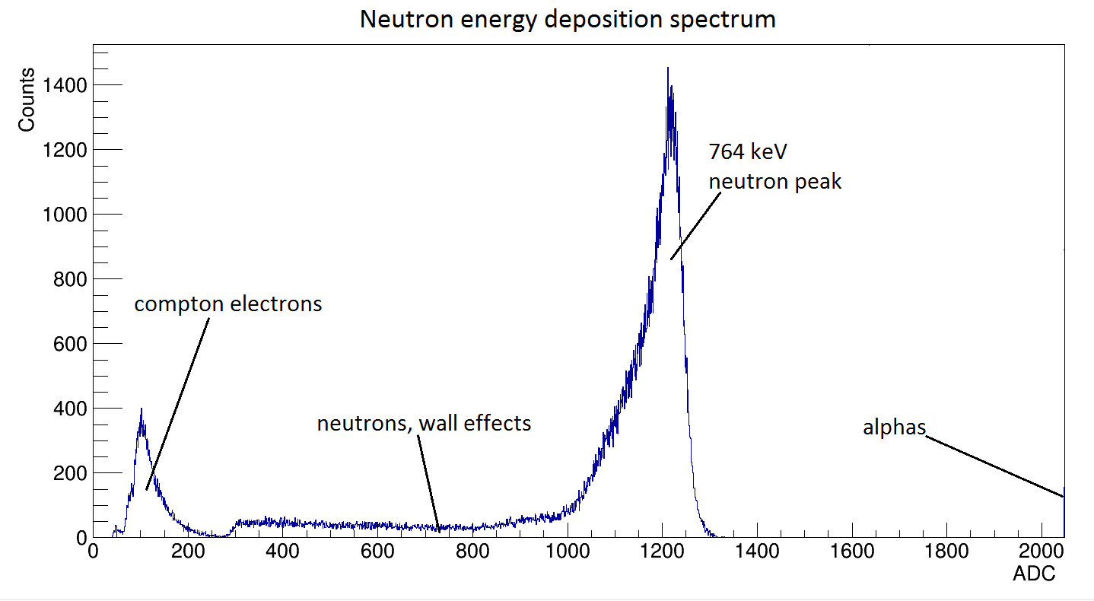
Neutrino Interactions (in HALO)
Charged Current (CC)
$ν_{e}+$^{A}Pb $→$^{A}Bi* $+ e^{−}$
^{A}Bi* $→$^{(A-1),(A-2)}Bi $+ \left(1,2\right)n+γ$
Neutral Current (NC)
$ν_{x}+$^{A}Pb $→$^{A}Pb* $+ ν_{x}$
^{A}Pb* $→$^{(A-1),(A-2)}Pb $+ \left(1,2\right)n+γ$
Neutron Detection
$n+$³He $→t+p+764 keV$
t
n
³He
p
Proportional Counter Cross Section (components and tracks not to scale).
Spectra taken from neutron proportional counter.

Slide 6
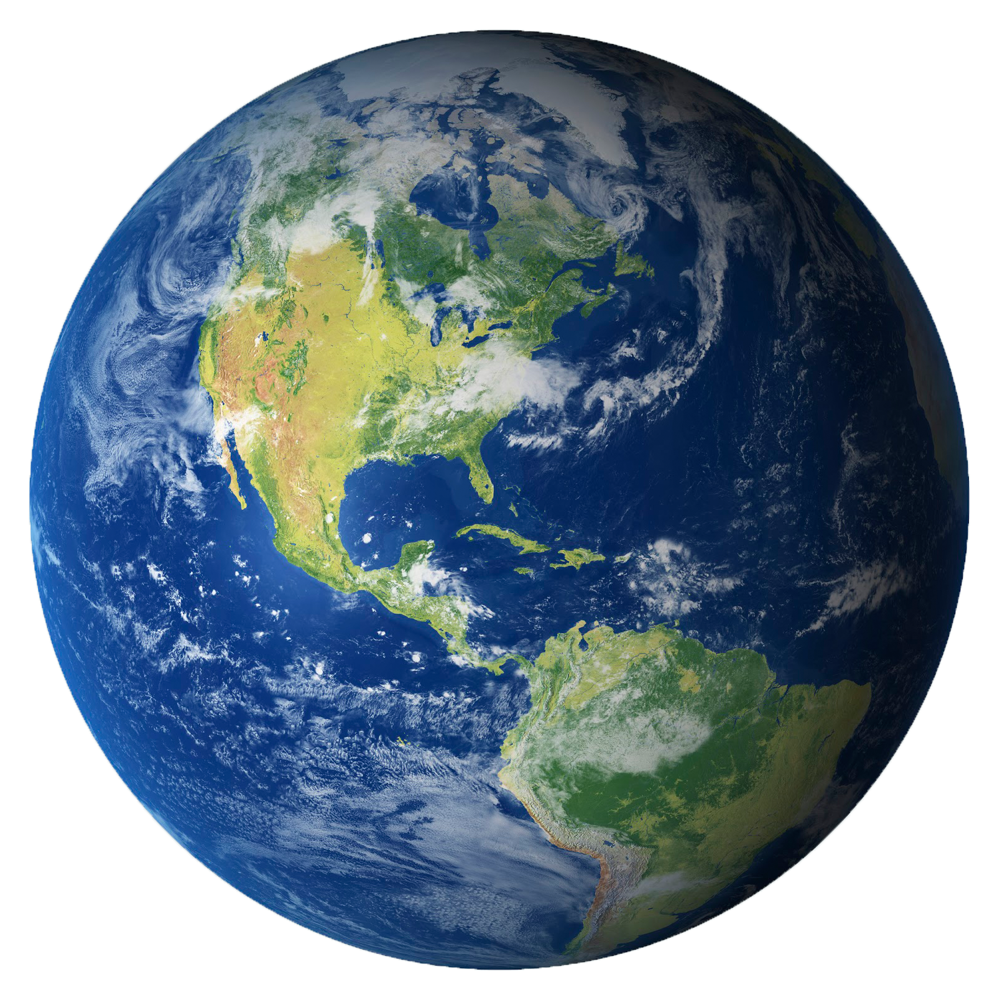
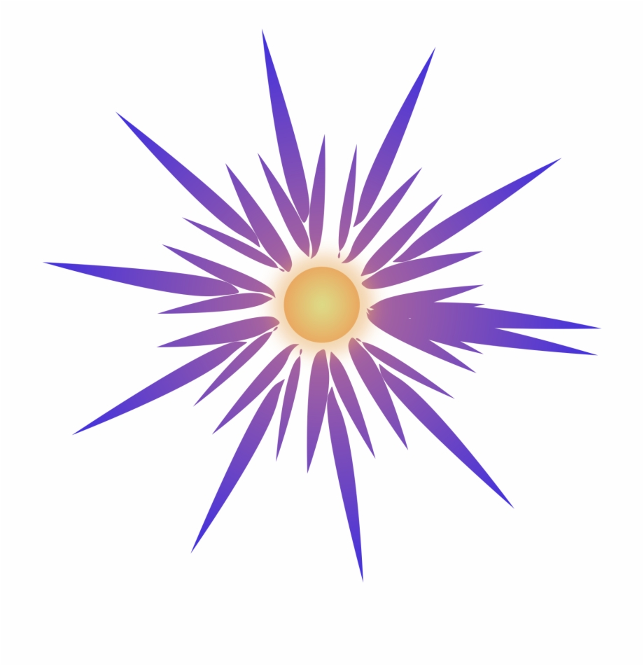
SNEWS 2.0
Neutrino detectors (not accurate representation).
$ν_{e},\overline{ν_{e}}, ν_{x}$ Wavefront
SNEWS formed in the late 90’s, operating since 2005.
Purpose is to coordinate response to $ν$signal (from multiple detectors).
Principles of SNEWS, 3 P’s.
Prompt
Pointing
Positive
$$Δr$$
Based off success of SNEWS, improvements and changes have been made for SNEWS 2.0.
Representation of neutrino wave front arriving at different points on the globe (can be used for timing and triangulation!).
Successful SNEWS 2.0 Workshop at Laurentian University in June.

Slide 7
SNEWS 2.0 “Itinerary”
Current plans for SNEWS 2.0:
Increase information communicated to SNEWS servers from each experiment (currently only the time of the burst is sent).
Supply multiple SN models for Monte-Carlo analysis.
Each experiment would then preform their t_{o} analysis and communicate this to SNEWS.
Courtesy of [9]

Slide 8
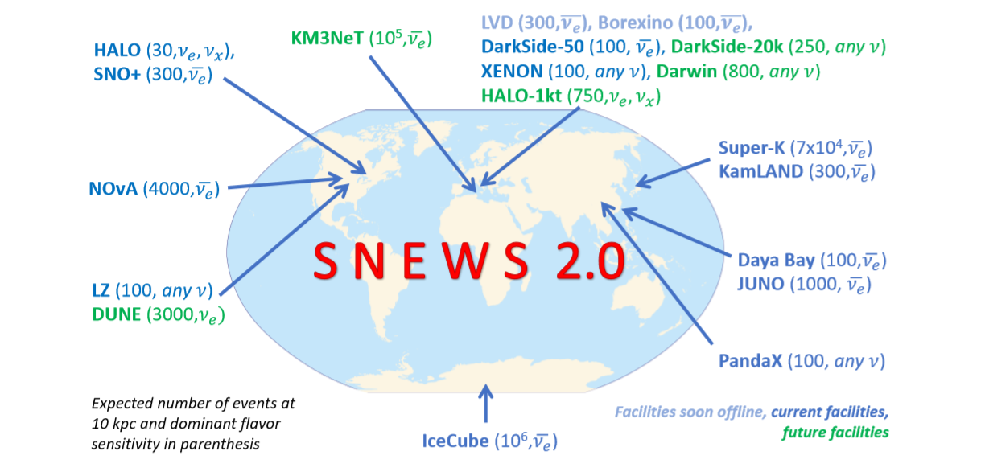
Promising Results (on triangulation)
See N. B. Linzer & K. Scholberg’s paper on triangulation with next generation neutrino detectors (arXiv:1909.03151v1).
Early results are promising, their method should reduce search area to a few percent of the sky.
A triangulation method such a this is less practical for HALO-1kT, as such will use the entire light curve.
For example, HALO-1kT expects ~ 50 events for the Garching model of an electron-capture SN.
Important to note that the results from Linzer’s paper does not include all neutrino detectors, only next generation.

Slide 9
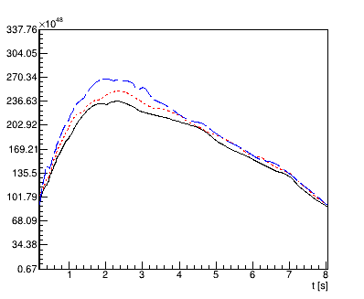
4th Year Research Project
Relative low neutrino flux of this model acts as a conservative baseline for communication of t_{o} (for HALO-1kT).
How effectively can we communicate t_{o} of the neutrino wave front to SNEWS 2.0?
What is the magnitude of this uncertainty?
This is flux and detector dependant, currently using the Garching model of an electron-capture SN [3] (8.8 M at 10 kpc).
For my 4th year project this involves HALO-1kT, but will extend for HALO and SNO+ during my M.Sc.
Neutrino Luminosity as a function of time
( -- $ν_{e}$, -- $\overline{ν_{e}}$, -- $ν_{x}$)
L (ergs/sec)
☉
t_{o} of $ν$ wavefront

Slide 10
Methodology (SNOwGLoBES)
SuperNova Observatories with General Long Baseline Experiment Simulator.
Mean event rate calculator for supernova observatories.
Folds cross sections & $ν$ fluxes to obtain interaction rates.
Handles time-dependant fluxes very well.
Allows for interaction rates as a function of time.
Can parameterize a detectors response to a SN as a function of time.
Current configurations supported are water, argon, liquid scintillator and lead.
SNOwGLoBES provides energy distribution of $ν$ and event rate per 0.5 MeV.
$E_{ν}$ (MeV) | Event Rate per 0.5 MeV
0.748 | 0
. | .
. | .
99.75 | 9.47e-26
Example of expected events from the Garching electron-capture SN at 10 kpc in HALO-1kT for one of the interaction channels.

Slide 11
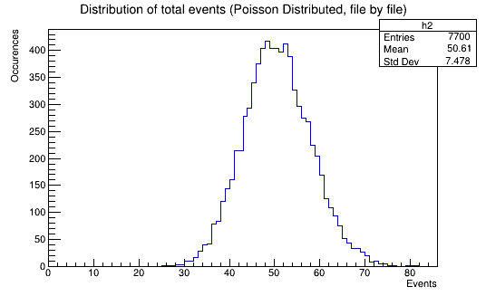
Methodology (Poisson Fluctuations)
SNOwGLoBES provides energy distribution of $ν$ and event rate per 0.5 MeV.
Distribution of total neutrons created
$E_{ν}$ (MeV) | Event Rate per 0.5 MeV
0.748 | 0
. | .
. | .
99.75 | 9.47e-26
Poisson fluctuate each event rate per bin (per interaction) for all time bins.
Example of expected events from the Garching electron-capture SN at 10 kpc in HALO-1kT for one of the interaction channels.
The mean event rate for the Garching electron-capture SN at 10 kpc in HALO-1kT is 47 summed over all time bins. A small percentage of the total event rate produce 2n events.

Slide 12
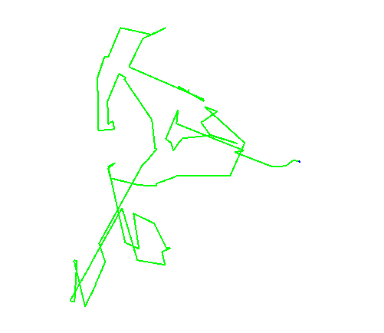
Methodology (Full Monte-Carlo)
Distribution of total neutrons created
Neutron events can ‘bounce’ around in the lead for ~ 5 $μs$.
From fluctuating event rates from SNOwGLoBES, pass initial neutron energy and time of production.
We assume neutrons produced in the lead are uniform throughout the detector volume.
From the MC you would extract the time of triton creation and form the a light curve. Repeated for an appropriate number of trials to then characterize the uncertainty on t_{o}.

Slide 13
Determining t_{o} (for HALO-1kT)
The full MC would be simulated $≫1$ times.
Enough to provide adequate representation of potential spread of t_{o}.
The mean cumulative counts (red) will have a distribution around it.
Shuffling this and using some statistical techniques provides the associated t_{o} with a upper/lower bound.
The distribution of counts is both model and detector dependant.
HALO and SNO+ would vary dependant on the interaction rates and prompt measure of the signal.
The models provided by SNEWS earlier would undergo similar treatment.
Normalized Total Counts
$$1$$
$$Δt$$
Example distribution

Slide 14
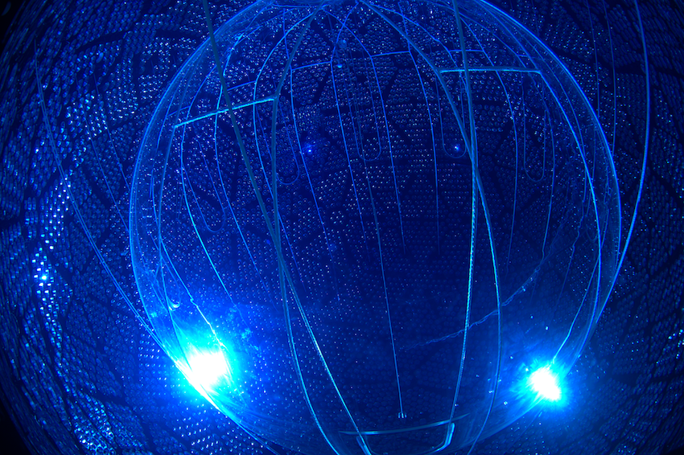
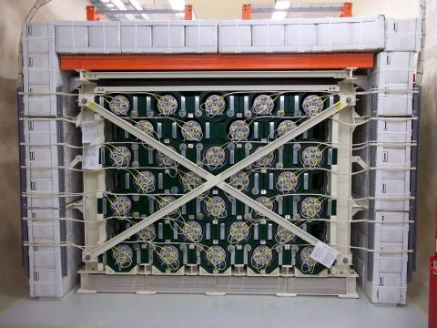
Conclusion
Development is underway on software packages for HALO-1kT and determining the experiments ability to communicate t₀ to the SNEWS servers.
Since this is dependant on the model, the current plan is to focus on the electron-capture SN, and await more from SNEWS.
Effective in May 2020, work will be underway for HALO, HALO-1kT and SNO+.
The process for analyzing t_{o} in HALO is similar to HALO-1kT, the largest difference being the total number of expected events.
SNO+ differs as it relies on the prompt capture of scintillation light, opposed to the slow thermalization of neutrons in the lead.
SNO+ (left) & HALO (right, prior to the front facing water shields placement).
Other avenues are being considered (i.e. the possibility of triangulation for failed SN that result in a black hole formation).

Slide 15
Thank you for listening! Questions?

Slide 16
References
[1] K. Zuber, HALO, a supernova neutrino observatory, Nuclear and Particle Physics Proceedings 265-266 (2015) 233-235.
[2] K. Scholberg, Supernova Neutrino Detection, Annu. Rev. Nucl. Part. Sci. 2012. 62:81-103.
[3] L. H$\ddot{u}$dephol, B. M$\ddot{u}$ller, H.-T. Janka, A. Marek and G. G. Raffelt, Neutrino signal of electron-capture supernovae from core collapse to cooling, arXiv:12.0260v3 [astro-ph.SR] 20 Feb 2011.
[4] J. Albert, A. Beck, et al, SNOwGLoBES: SuperNova Observatories with GLoBES. Internal technical document.
[5] S. Agostinelli, J. Allison, et al, Geant4 – a simulation toolkit, Nuclear Instruments and Methods in Physics Research A 506 (2003) 250-303.
[6] R. Brun, F. Rademakers, ROOT – An Object Oriented Data Analysis Framework, Proceedings AIHENP’96 Workshop, Lausanne, Sep. 1996, Nuclear Instruments & Methods in Physics Research A 389 (1997) 81-86.
[7] V. Brdar, M. Lindner, and X. J. Xu, Neutrino Astronomy with Supernova Neutrinos, arXiv:1802.02577v2 [hep-ph] 12 Apr 2018.
[8] N. B. Linzer, K. Scholberg. Triangulation Pointing to Core-Collapse Supernovae with Next-Generation Neutrino Detectors, arXiv:1909.03151v1 [astro-ph.IM] 7 Sept 2019.
[9] Internal SNEWS 2.0 National Science Foundation Proposal.
[10] Communications with Dr. Clarence Virtue.

