Slide 1
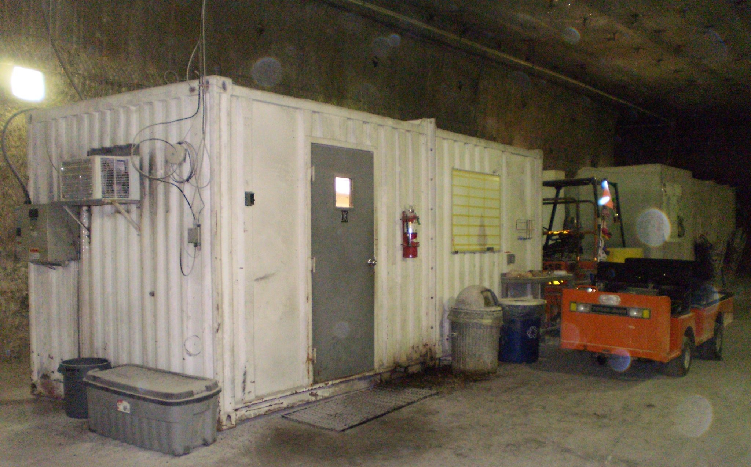

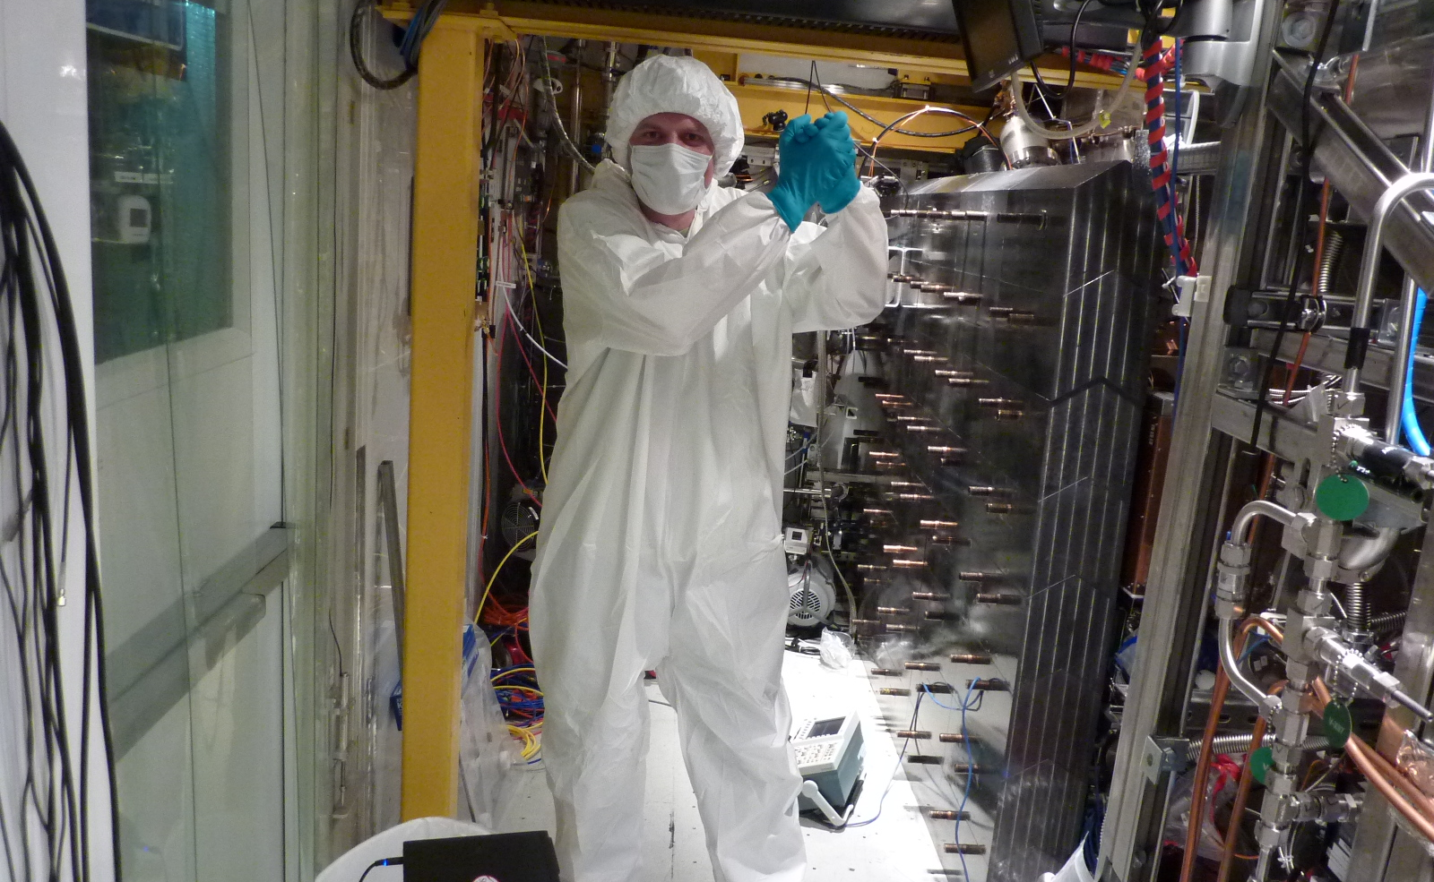
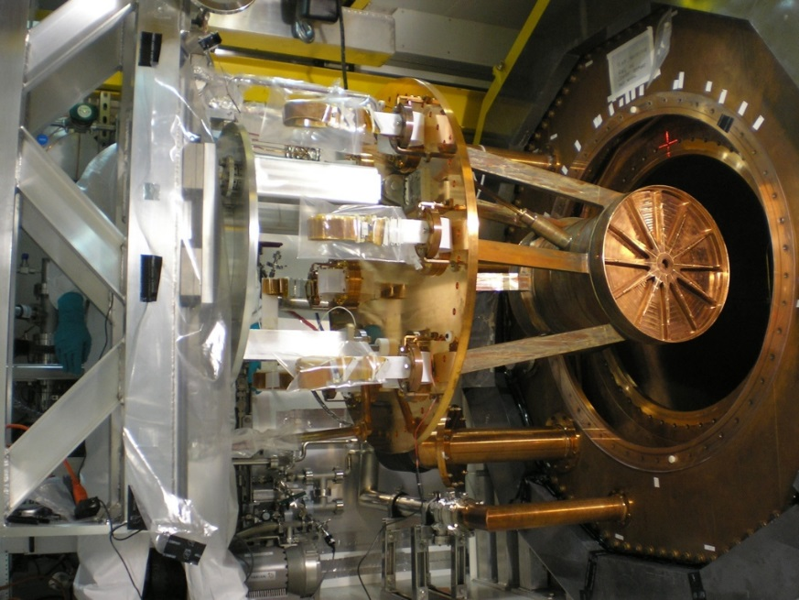
Hunting for Majorana neutrinos with nEXO
Thomas Brunner
McGill University and TRIUMF
Multi-Messenger Workshop
January 30, 2020

Slide 2
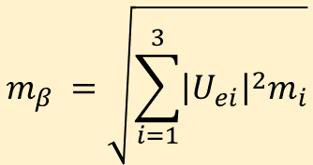
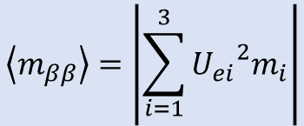
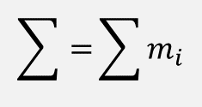
Neutrino mixing, mass, and 0νββ
In Quantum Mechanics there are 2 representations for our neutrinos if m_{ν} ≠ 0 :
“Weak interaction eigenstate”
this is the state of definite flavor: interactions couple to this state
“Mass eigenstate”
this is the state of definite energy:
propagation happens in this state
E_{i}=m_{i}c²
Evolve in time with m_{i} & E
Other measurables in ν mass
Effective ββ mass
m of ν_{e} from β endpoint
Observational Cosmology
$$\left\langle m_{ββ}\right\rangle =\left|\sum_{i=1}^{3}{{U_{ei}}^{2}m_{i}}\right|$$
$$m_{β} =\sqrt{\sum_{i=1}^{3}{{\left|U_{ei}\right|}^{2}m_{i}}}$$
Model independent
$$\sum{=}\sum{m_{i}}$$
virtual ν exchange
Notes:
Pontecorvo–Maki–Nakagawa–Sakata matrix

Slide 3
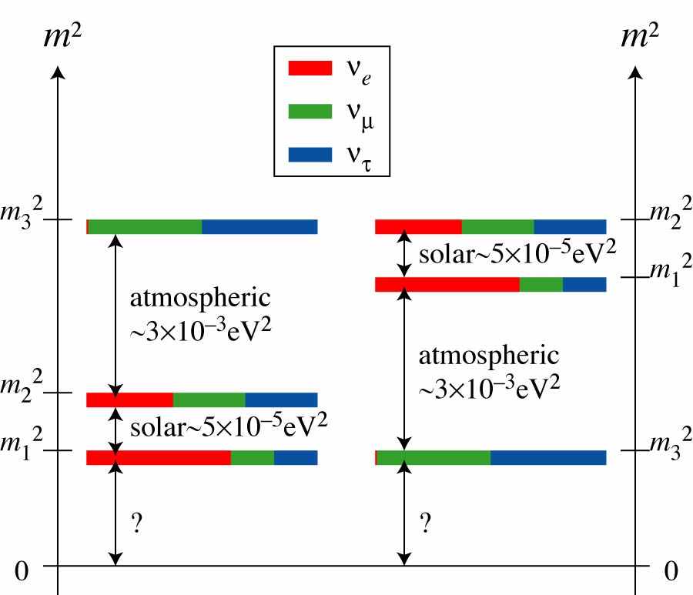
What we know about neutrinos
~20 eV
~1 eV
∑~0.25 eV
~0.1 eV
From tritium endpoint
(KATRIN)
solar ~ 7.6·10⁻⁵eV²
Time of flight from SN1987A
(PDG 2002)
~2.4·10⁻³ eV²
From 0νββ if ν is Majorana
~2.4·10⁻³ eV²
From Cosmology
solar ~ 7.6·10⁻⁵ eV²
Open questions in ν physics
What is the absolute mass scale?
Why is the neutrino mass so small?
What is the nature of the ν: Dirac or Majorana?
→ Search for 0νββ decay
Notes:
mixing angle measurement dominated by SK and SNO

Slide 4
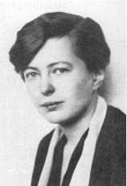
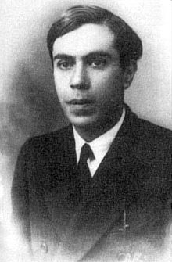
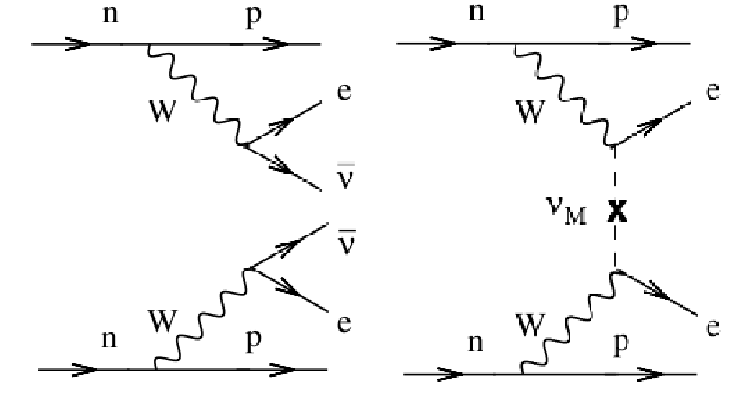


Double beta decay
The most promising approach to determine the nature of the neutrino!
Lepton number is violated in this decay!
M.Goeppert-Mayer, Phys. Rev. 48 (1935) 512
Ettore Majorana
2νββ
0νββ
$$∆L=2$$
This process can only occur for a Majorana neutrino!

Slide 5
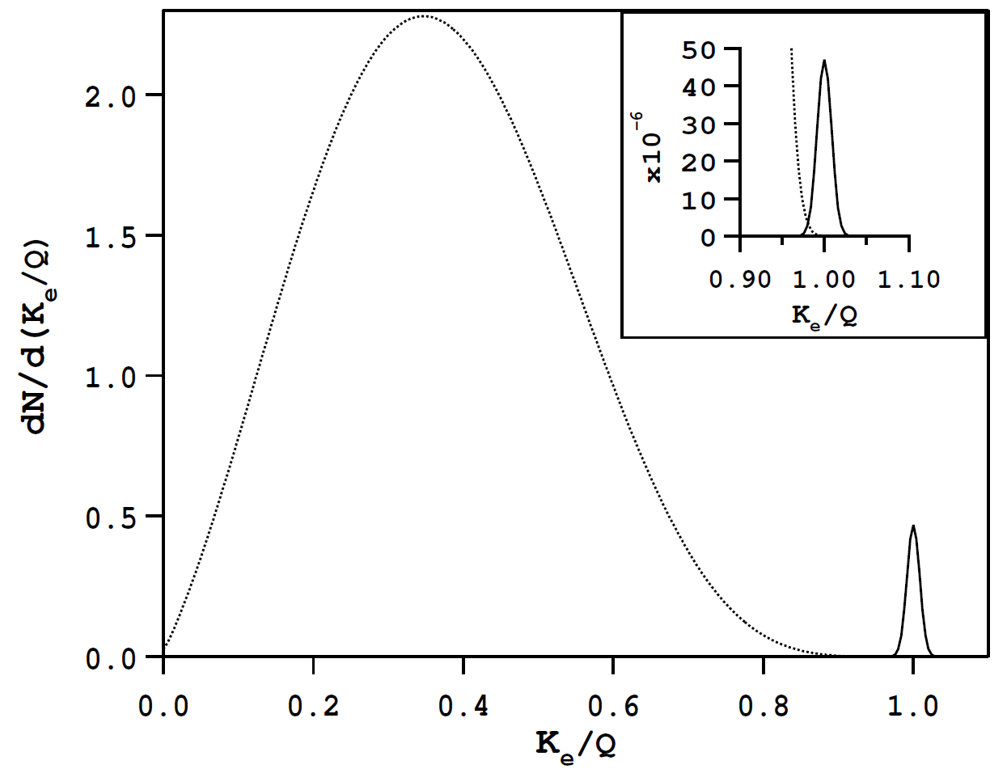
Neutrinoless double beta decay
[arXiv:hep-ph/0611243]
0νββ peak
(normalized to 10⁻⁶)
2νββ spectrum
(normalized to 1)
2νββ
0νββ
0νββ peak
(normalized to 10⁻²)
kinetic energy K_{e} of the two electrons
in units of kinematic endpoint (Q)
Smeared by the energy resolution
of the hypothetical detector

Slide 6
Neutrinoless double beta decay
[arXiv:hep-ph/0611243]
0νββ peak
(normalized to 10⁻⁶)
2νββ spectrum
(normalized to 1)
2νββ
0νββ
0νββ peak
(normalized to 10⁻²)
Nuclear Physics
G^{0ν} is a phase space factor
M^{0ν} is the nuclear matrix element
Effective Majorana mass:
(light neutrino exchange mechanism only)

Slide 7

Challenges of double-β decay experiments
Sensitivity on
ν
ε detection efficiency
A isotopic abundance
M active mass
T exposure
b background rate
ΔΕ energy resolution
T_{1/2}^{0ν} > 10²⁵ years !!
Need:
  high target mass
  high exposure
low background rate
good energy resolution
Natural radiation decay rates
A banana ~10 decays/s
A bicycle tire ~0.3 decays/s
1 l outdoor air ~1 decay/min
100 kg of ¹³⁶Xe (2ν) ~1 decay/10 min
0νββ decay >10000 x rarer than 2νββ
Age of universe 1.4 x 10¹⁰ years
Strength of liquid-Xe ββ detectors
7

Slide 8
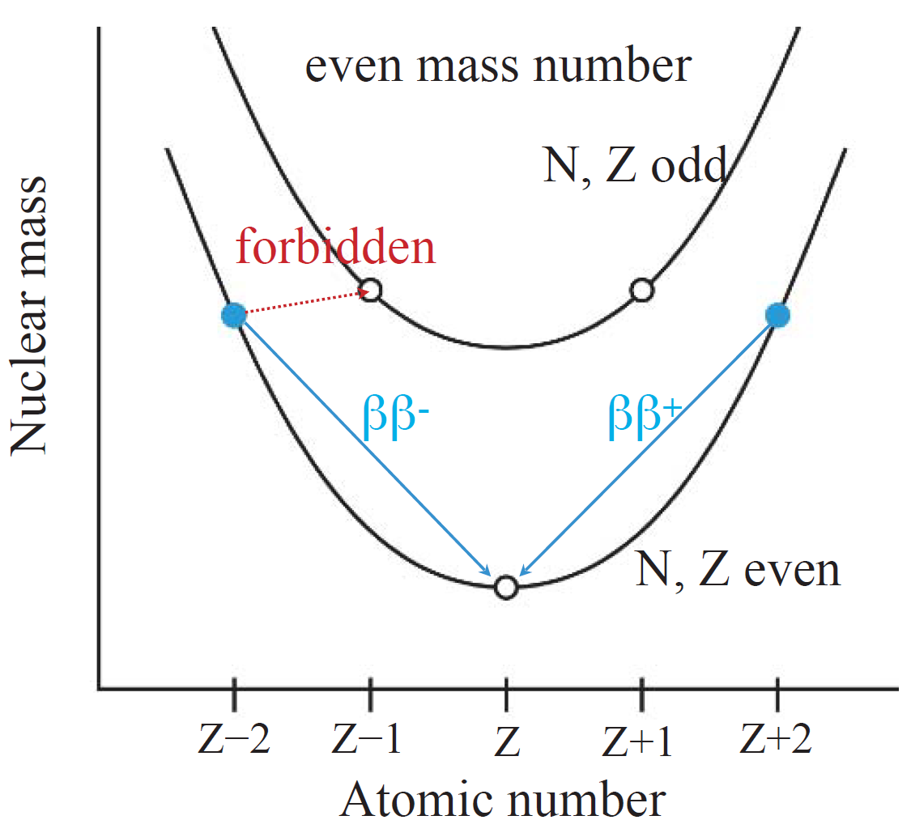

Double Beta Decay
35 2νββ nuclei found
Second-order weak nuclear process
First-­order beta decay is forbidden energetically or by spin → ββ is detectable
ββ-decay nuclei with Q > 2 MeV | Q (MeV) | Abund. (%)
⁴⁸Ca → ⁴⁸Ti | 4.271 | 0.187
⁷⁶Ge → ⁷⁶Se | 2.040 | 7.8
⁸²Se → ⁸²Kr | 2.995 | 9.2
⁹⁶Zr → ⁹⁶Ru | 3.350 | 2.8
¹⁰⁰Mo → ¹⁰⁰Ru | 3.034 | 9.7
¹¹⁰Pd → ¹¹⁰Cd | 2.013 | 11.8
¹¹⁶Cd → ¹¹⁶Sn | 2.802 | 7.5
¹²⁴Sn → ¹²⁴Te | 2.228 | 5.8
¹³⁰Te → ¹³⁰Xe | 2.528 | 34.2
¹³⁶Xe → ¹³⁶Ba | 2.479 | 8.9
¹⁵⁰Nd → ¹⁵⁰Sm | 3.367 | 5.6
(A,Z) → (A,Z+2) + 2e⁻ +2$\overline{ν}$_{e}
Legend
CUORE, SNO+
EXO-200 and nEXO
October 15, 2019

Slide 9

Searching for 0νββ in ¹³⁶Xe with liquid Xe TPC
Cathode
Liquid-Xe Time Projection Chamber (TPC)
Xe is used both as the source and detection medium.
Monolithic detector structure, excellent background rejection capabilities.
Cryogenic electronics in LXe (at ~168 K).
Detection of scintillation light and secondary charges.
  2D read out of secondary charges at segmented anode.
  Full 3D event reconstruction using also scintillation light:
    Energy reconstruction
    Position reconstruction
    Event Multiplicity
Scintillation
$$\vec{E}$$
e-
e-
e-
e-
e-
e-
e-
e-
e-
Ionization
e-
e-
e-
e-
Segmented Anode

Slide 10


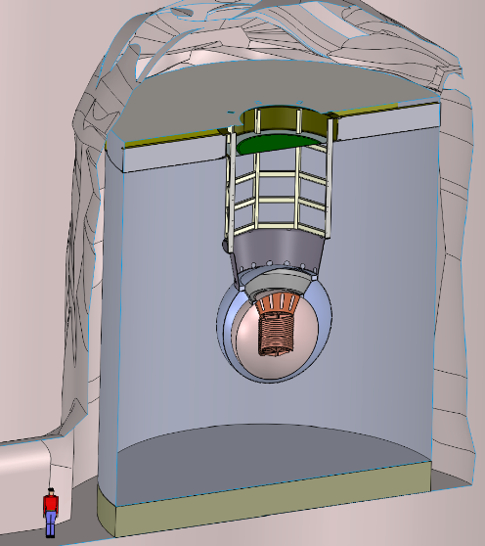
Searching for 0νββ in ¹³⁶Xe
Phased approach:
Easy to enrich: 8.9% natural abundance but can be enriched relatively easily (better than growing crystals)
Can be purified continuously, and reused
High Q_{ββ} (2458 keV): higher than most naturally occurring backgrounds
Minimal cosmogenic activation: no long-life radioactive isotopes
Energy resolution: improves using scintillation and charge anti-correlation
LXe self shielding
Background can be potentially reduced by Ba⁺⁺ tagging
EXO-200: ~175kg liquid-Xe TPC, finished 2018
2. nEXO: future 5-ton liquid Xe TPC with Ba tagging upgrade option (SNOLAB cryopit)

Slide 11
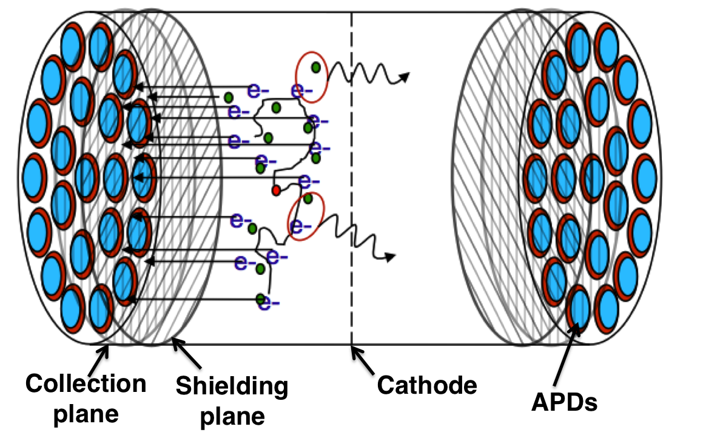

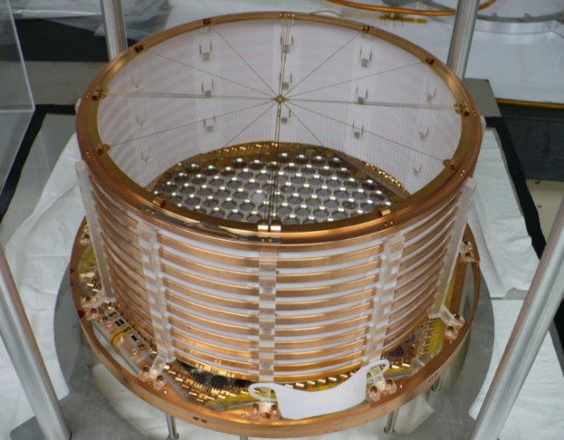
EXO-200 Detector
EXO-200 has searched for 0νββ of ¹³⁶Xe to ¹³⁶Ba
~175kg Liquid Xenon (LXe) Time Projection Chamber (TPC)
Located at Waste Isolation Pilot Plant (WIPP) in Carlsbad, NM, USA
Two identical back to back TPCs made from radio-pure copper with transparent cathode
Energy measured using two signals
  Ionization signal drifted to crossed wire planes
  Scintillation (175nm) collected by APD

Slide 12
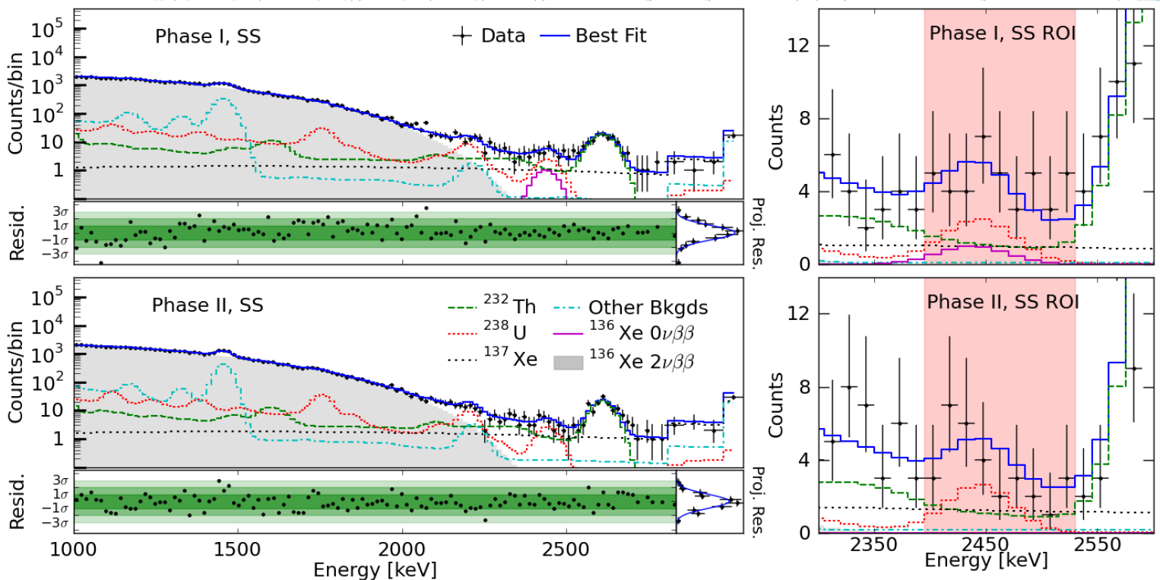
Final EXO-200 Results
Slide from: M. Jewell
September, 2019
TAUP2019, Toyama, Japan
Phys. Rev. Lett. 123, 161802 (2019)
arXiv 1906.02723
No statistically significant 0νββ signal observed

Slide 13
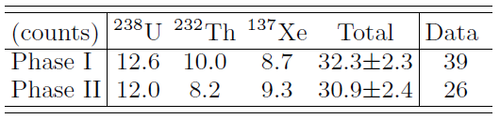
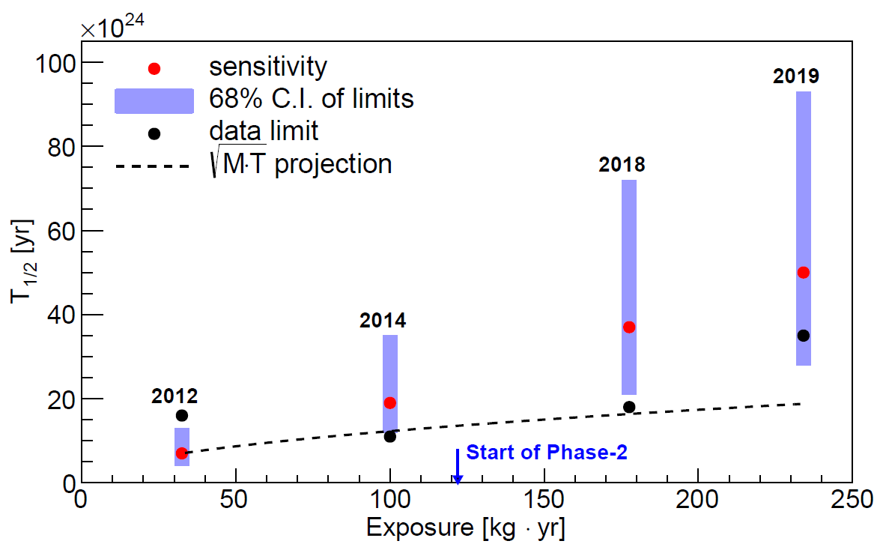
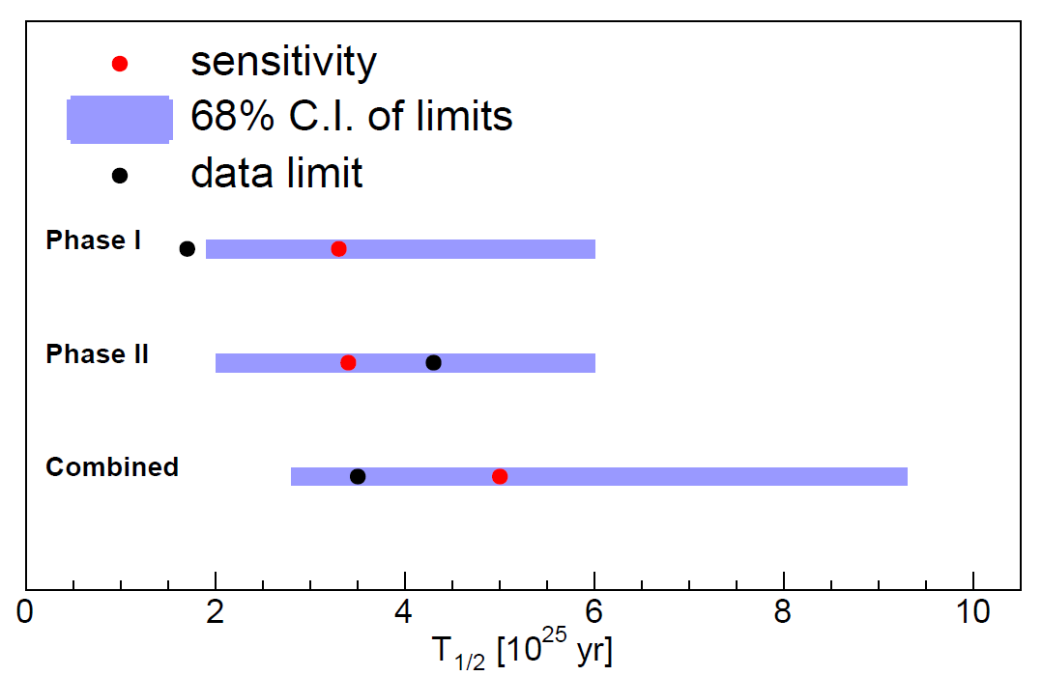


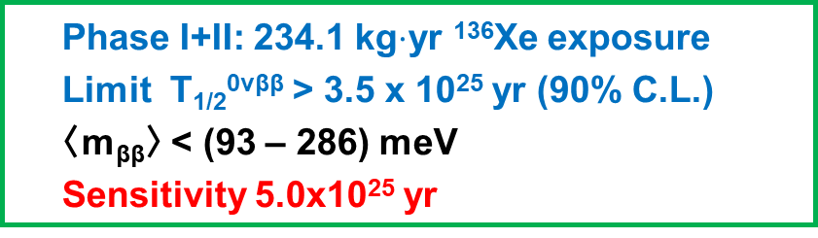
Latest EXO-200 Results
Slide from: Gaosong Li
Jun 7, 2019
WIN2019, Bari, Italy
Background contribution to $Q±2σ$
No statistical significant signal observed
Phase I+II: 234.1 kg$⋅$yr ¹³⁶Xe exposure
Limit T_{1/2}^{0νββ} > 3.5 x 10²⁵ yr (90% C.L.)
〈m_{ββ}〉 < (93 – 286) meV
Sensitivity 5.0x10²⁵ yr
EXO-200 $0νββ$ search results
2012: Phys.Rev.Lett. 109 (2012) 032505
2014: Nature 510 (2014) 229-234
2018: Phys. Rev. Lett. 120, 072701 (2018)
2019: Phys. Rev. Lett. 123, 161802 (2019)

Slide 14
EXO-200 publications to date (0νββ & exotic searches)
G.Anton, et al., “Measurement of the scintillation and ionization response of liquid xenon at MeV energies in the EXO-200 experiment” arXiv:1908.04128.
G. Anton et al. “Search for Neutrinoless Double-Beta Decay with the Complete EXO-200 Dataset” PRL 123 (2019) 161802
S. Delaquis et al. "Deep Neural Networks for Energy and Position Reconstruction in EXO-200" JINST 13 (2018) P08023
J.B. Albert et al. "Search for nucleon decays with EXO-200" PRD 97 (2018) 072007
J.B. Albert et al. "Search for 0νββ Decay with the Upgraded EXO-200 Detector" PRL 120 (2018) 072701
D.S. Leonard et al. "Trace radioactive impurities in final construction materials for EXO-200” NIMA 871 (2017) 169
J.B. Albert et al. "Searches for Double Beta Decay of ¹³⁴Xe with EXO-200” PRD 96 (2017) 092001
J.B. Albert et al. "Measurement of the Drift Velocity and Transverse Diffusion of Electrons in Liquid Xenon with the EXO-200 Detector" PRC 95 (2017) 025502
C.G. Davis et al. "An Optimal Energy Estimator to Reduce Correlated Noise for the EXO-200 Light Readout” JINST 11 (2016) P07015
J.B. Albert et al. "Cosmogenic Backgrounds to 0νββ in EXO-200” J. Cosmol. Astropart. Phys. 4 (2016) 029
J.B. Albert et al. "First Search for Lorentz and CPT Violation in ββ Decay with EXO-200” PRD 93 (2016) 072001
J.B. Albert et al. "Search for 2νββ decay of ¹³⁶Xe to the 0₁⁺ excited state of ¹³⁶Ba with EXO-200” PRC 93 (2016) 035501
J.B. Albert et al. "Measurements of the ion fraction and mobility of α and β decay products in LXe using EXO-200” PRC 92 (2015) 045504.
J.B. Albert et al. "Investigation of radioactivity-induced backgrounds in EXO-200” PRC 92 (2015) 015503
J.B. Albert, et al. "Search for Majoron-emitting modes of ββ decay of ¹³⁶Xe with EXO-200” PRD 90 (2014) 092004
J.B. Albert, et al. "Search for Majorana neutrinos with the first two years of EXO-200 data” Nature 510 (2014) 229
J.B. Albert, et al. "An improved measurement of the 2νββ half-life of ¹³⁶Xe with EXO-200” PRC 89 (2014) 015502
M. Auger, et al. "Search for Neutrinoless ββ Decay in ¹³⁶Xe with EXO-200” PRL 109 (2012) 032505
M. Auger, et al. "The EXO-200 detector, part I: Detector design and construction” J. Inst 7 (2012) P05010
A. Dobi, et al. "Xenon purity analysis for EXO-200 via mass spectrometry” NIM A 675 (2012) 40
N. Ackerman, et al. "Observation of Two-Neutrino ββ Decay in Xe-136 with EXO-200” PRL 107 (2011) 212501
A. Dobi, et al. "A Xenon Gas Purity Monitor for EXO" NIM A 659 (2011) 215
F. LePort, et al. "A magnetically-driven piston pump for ultra-clean applications" Rev. Sci. Inst. 82 (2011) 105114
R. Neilson, et al. "Characterization of large area APDs for the EXO-200 detector" NIM A 608 (2009) 6875
D. Leonard, et al. "Systematic study of trace radioactive impurities in candidate construction materials for EXO-200" Nucl. Ins. Meth. A 591 (2008) 490

Slide 15
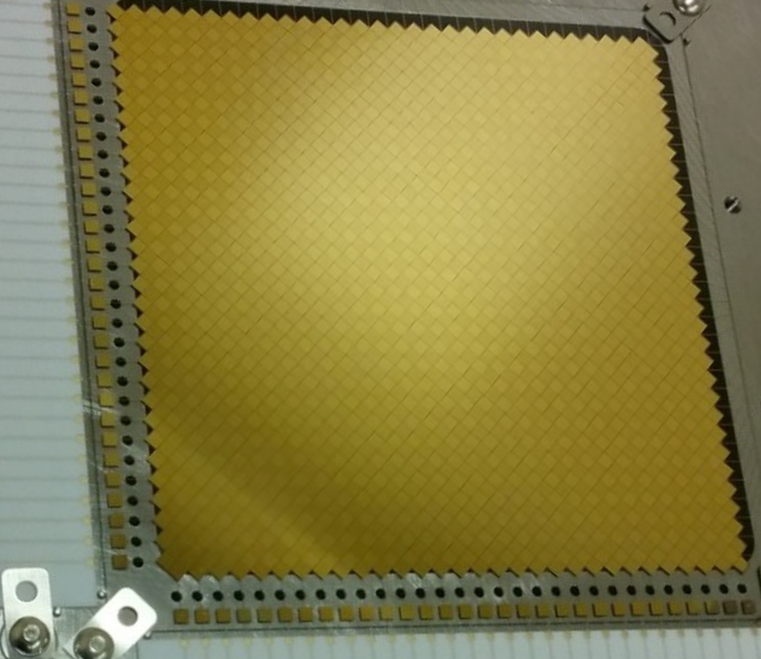

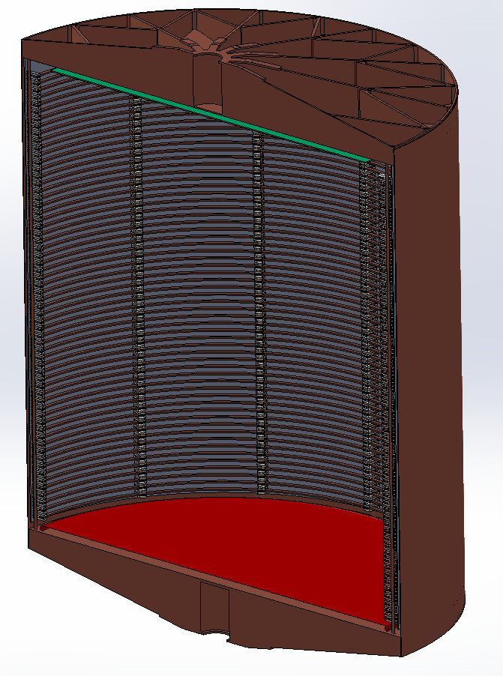
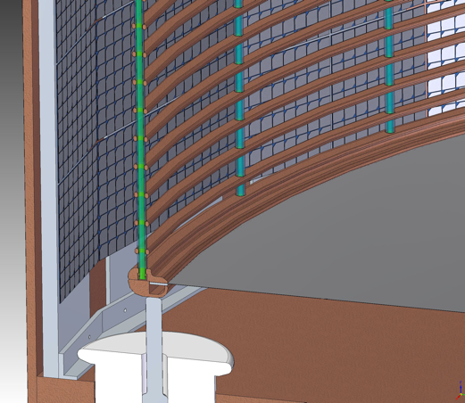
The nEXO detector
Next-generation neutrinoless double beta decay detector
5 t liquid xenon TPC similar to EXO-200 (50x the size)
SiPM for 175nm scintillation light detection, ~5m² SiPM array in LXe
Tiles for charge read out
3D event reconstruction
Combine charge and light readout. Goal → σ/E of 1% at Q-value.
1.7 ktonnes water shield → Outer Detector
Study other physics searches we can do with nEXO
Picture: 10 x 10 cm² tile prototype
JINST 13, P01006 (2018)
Tile simulation: arXiv:1907.07512.
charge readout pads (anode)
See talk by S. Al Kharusi
Field shaping rings
Cathode
14 m
130
cm
SiPM ‘staves’ covering the barrel
Ø13 m
nEXO pre-CDR, arXiv:1805.11142
nEXO TPC
nEXO at the SNOLAB Cryopit

Slide 16
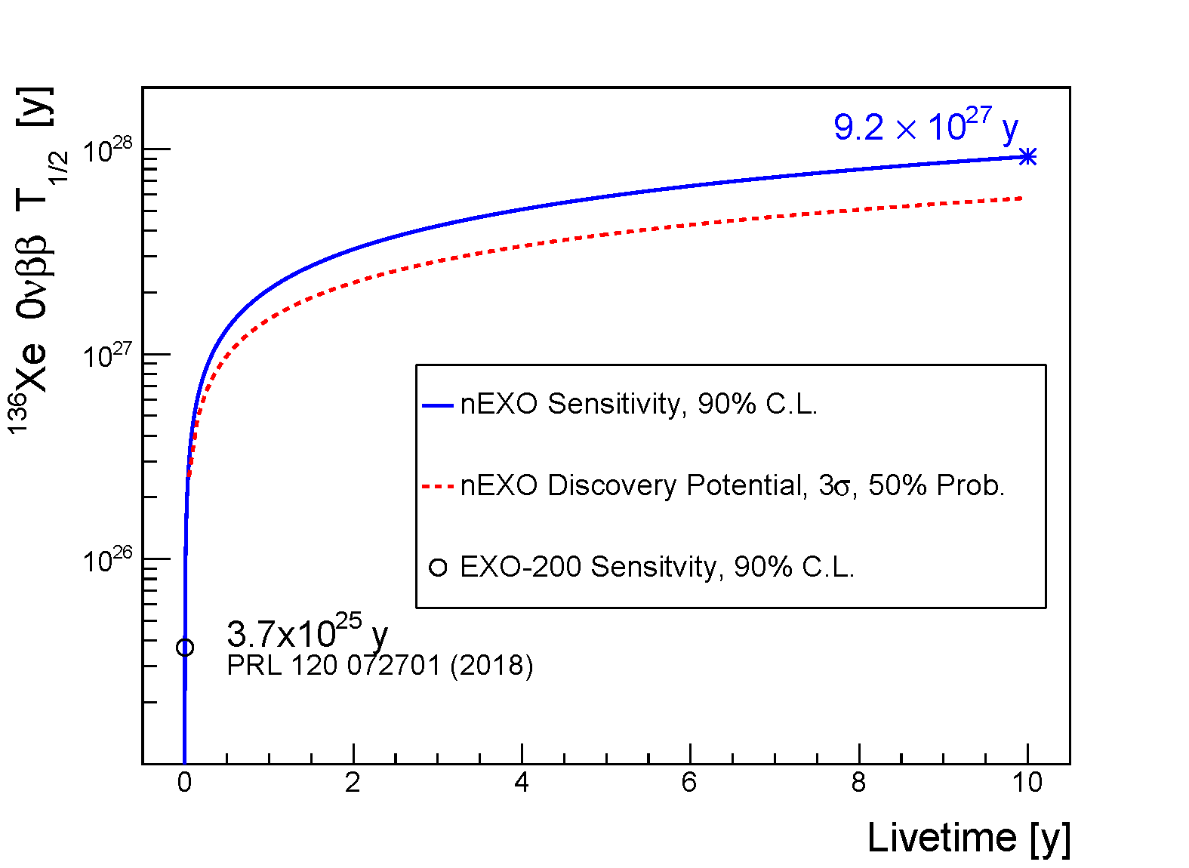
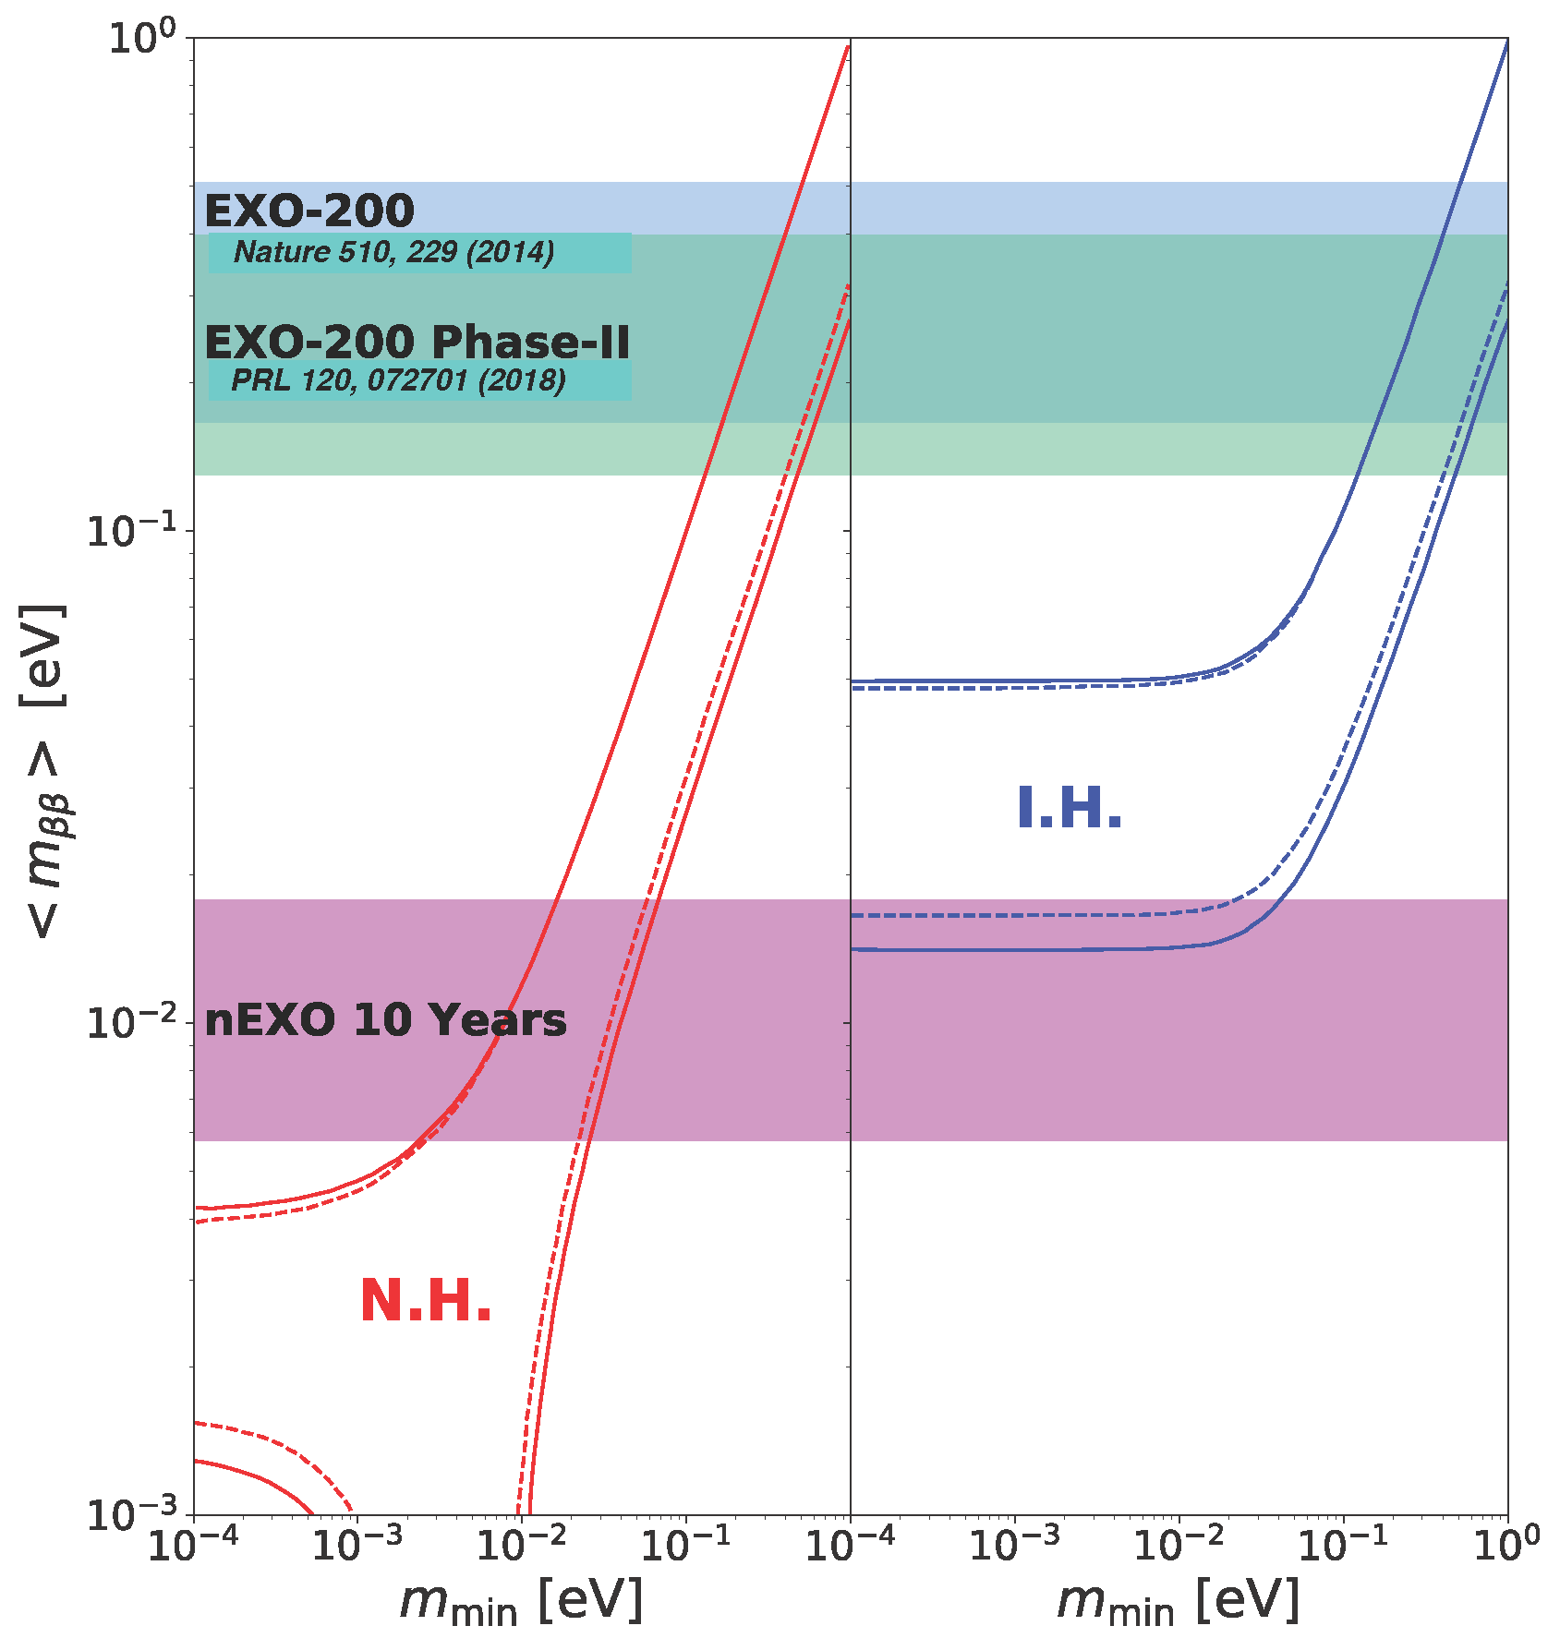
Milestone II: Projected nEXO Sensitivity
J.B. Albert et al. Phys. Rev. C. 97 065503 (June 2018)
Projected sensitivity based on actual background level measurements!
EXO-200
1906.02723
5.0x10²⁵ y
EXO-200
(2018)
- g_{A}= g_{A}^{free}=-1.2723
- Band is the envelope of NME:
EDF: T.R. Rodríguez and G. Martínez-Pinedo, PRL 105, 252503 (2010)
ISM: J. Menendez et al., Nucl Phys A 818, 139 (2009)
IBM-2: J. Barea, J. Kotila, and F. Iachello, PRC 91, 034304 (2015)
QRPA: F. Šimkovic et al., PRC 87 045501 (2013)
SkyrmeQRPA: M.T. Mustonen and J. Engel PRC 87 064302 (2013)

Slide 17
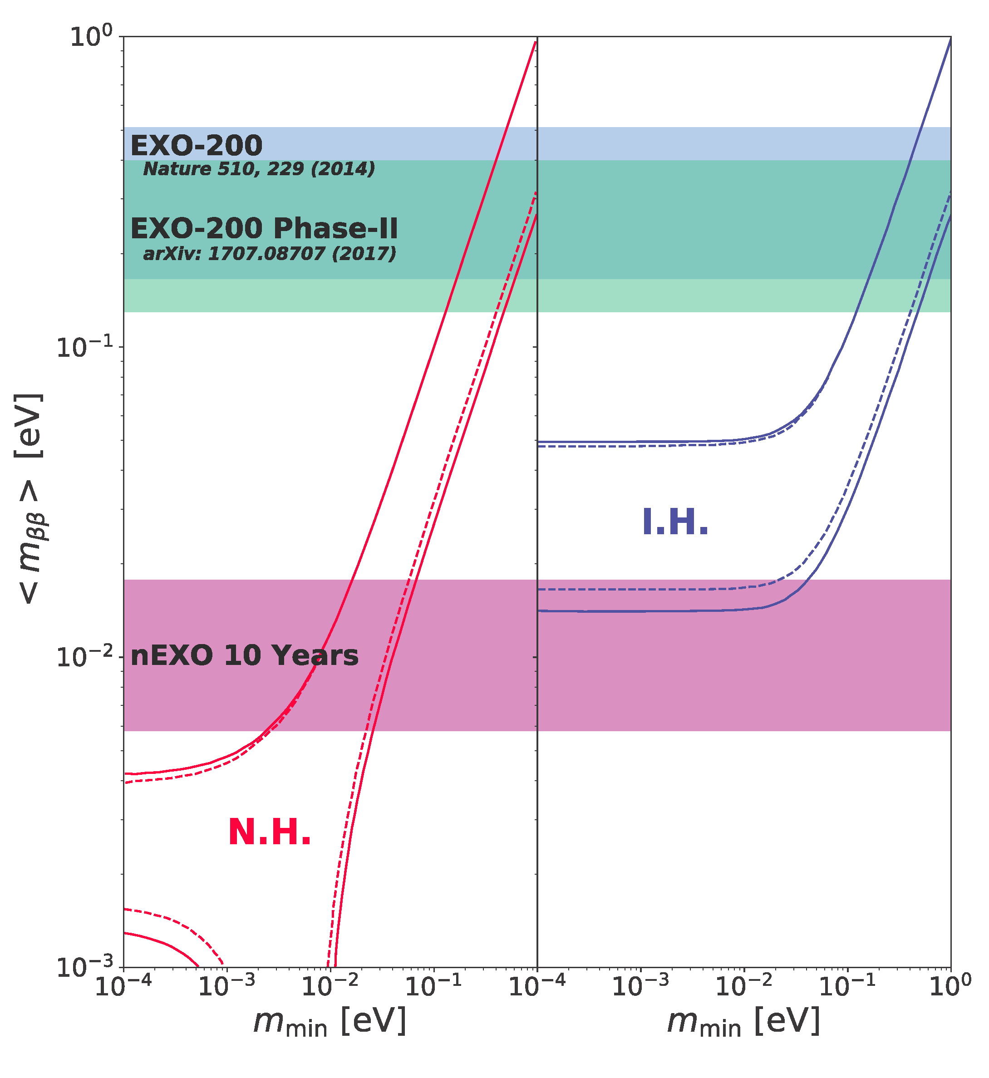
0νββ search with EXO
0νββ most promising approach to search for Majorana neutrinos
Observation of 0νββ violates Lepton number by 2
Multi-phase program with LXe TPC:
EXO-200 – at WIPP mine:
  ~175kg xenon enriched at ~80%
  Current limit on 0νββ:
  1.8 x 10²⁵ years (EXO-200)
  Finished data taking in December 2018
  Sensitivity: 100-200 meV
nEXO - R&D underway:
  5T xenon enriched at ~90%
  Sensitivity: 5-30 meV
  Improved techniques for background suppression and possibly Ba tagging
→ Development of nEXO is well advanced
Notes:
Y-axis label is hard to read. Also, I'm not sure you've defined the effective majorana mass anywhere, but you could just say it in words when explaining the plot

Slide 18
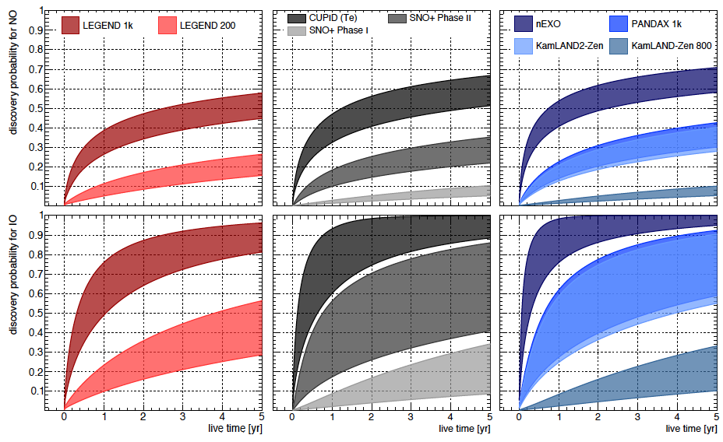
0νββ Discovery Potential
Agostini, et al.
arXiv:1705.02996v1
0νββ is the most practical way to test the Majorana nature of neutrinos.
An observation of 0νββ always implies physics beyond the Standard Model!

Slide 19
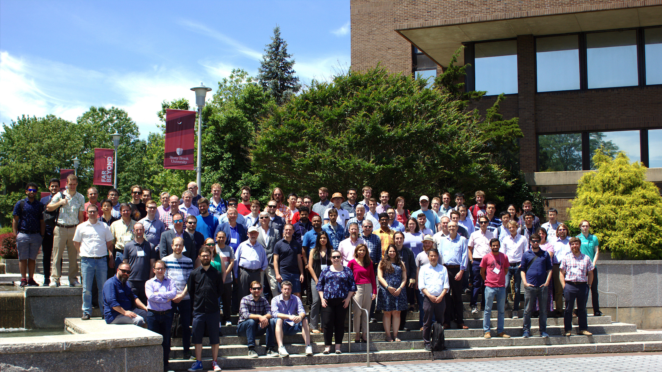







University of Alabama, Tuscaloosa AL, USA
M Hughes, P Nakarmi, O Nusair, I Ostrovskiy, A Piepke, AK Soma, V Veeraraghavan
University of Bern, Switzerland — J-L Vuilleumier
University of British Columbia, Vancouver BC, Canada — G Gallina, R Krücken, Y Lan
Brookhaven National Laboratory, Upton NY, USA
M Chiu, G Giacomini , V Radeka E Raguzin, S Rescia, T Tsang
University of California, Irvine, Irvine CA, USA — M Moe
California Institute of Technology, Pasadena CA, USA — P Vogel
Carleton University, Ottawa ON, Canada
I Badhrees, B Chana, D Goeldi, R Gornea, T Koffas, C Vivo-Vilches
Colorado School of Mines, Golden CO, USA — K Leach, C Natzke
Colorado State University, Fort Collins CO, USA
A Craycraft, D Fairbank, W Fairbank, A Iverson, J Todd, T Wager
Drexel University, Philadelphia PA, USA — MJ Dolinski, P Gautam, EV Hansen, M Richman, P Weigel
Duke University, Durham NC, USA — PS Barbeau
Friedrich-Alexander-University Erlangen, Nuremberg, Germany
G Anton, J Hößl, T Michel, S Schmidt, M Wagenpfeil, W G Wrede, T Ziegler
IBS Center for Underground Physics, Daejeon, South Korea — DS Leonard
IHEP Beijing, People’s Republic of China
GF Cao, WR Cen, YY Ding, XS Jiang, P Lv, Z Ning, XL Sun, T Tolba, W Wei, LJ Wen, WH Wu, J Zhao
ITEP Moscow, Russia — V Belov, A Karelin, A Kuchenkov, V Stekhanov, O Zeldovich
University of Illinois, Urbana-Champaign IL, USA — D Beck, M Coon, J Echevers, S Li, L Yang
Indiana University, Bloomington IN, USA — SJ Daugherty, LJ Kaufman, G Visser
Laurentian University, Sudbury ON, Canada — E Caden, B Cleveland,
A Der Mesrobian-Kabakian, J Farine, C Licciardi, A Robinson, M Walent, U Wichoski
Lawrence Livermore National Laboratory, Livermore CA, USA
JP Brodsky, M Heffner, A House, S Sangiorgio, T Stiegler
University of Massachusetts, Amherst MA, USA
J Bolster, S Feyzbakhsh, KS Kumar, O Njoya, A Pocar, M Tarka, S Thibado
McGill University, Montreal QC, Canada
S Al Kharusi, T Brunner, D Chen, L Darroch, Y Ito, K Murray, T Nguyen, T Totev
University of North Carolina, Wilmington, USA — T Daniels
Oak Ridge National Laboratory, Oak Ridge TN, USA — L Fabris, RJ Newby
Pacific Northwest National Laboratory, Richland, WA, USA
IJ Arnquist, ML di Vacri, EW Hoppe, JL Orrell, GS Ortega, CT Overman, R Saldanha, R Tsang
Rensselaer Polytechnic Institute, Troy NY, USA — E Brown, A Fucarino, K Odgers, A Tidball
Université de Sherbrooke, QC, Canada — SA Charlebois, D Danovitch, H Dautet, R Fontaine,
F Nolet, S Parent, J-F Pratte, T Rossignol, N Roy, G St-Hilaire, J Sylvestre, F Vachon
SLAC National Accelerator Laboratory, Menlo Park CA, USA — R Conley, A Dragone, G Haller, J Hasi,
LJ Kaufman, C Kenney, B Mong, A Odian, M Oriunno, A Pena Perez, PC Rowson, J Segal, K Skarpaas VIII
University of South Dakota, Vermillion SD, USA — T Bhatta, A Larson, R MacLellan
Stanford University, Stanford CA, USA
R DeVoe, G Gratta, M Jewell, S Kravitz, BG Lenardo, G Li, M Patel, M Weber
Stony Brook University, SUNY, Stony Brook NY, USA — KS Kumar
TRIUMF, Vancouver BC, Canada — J Dilling, G Gallina, R Krücken Y Lan, F Retière, M Ward
Yale University, New Haven CT, USA — A Jamil, Z Li, DC Moore, Q Xia
We are looking for new collaborators!

Slide 20
Backup

Slide 21
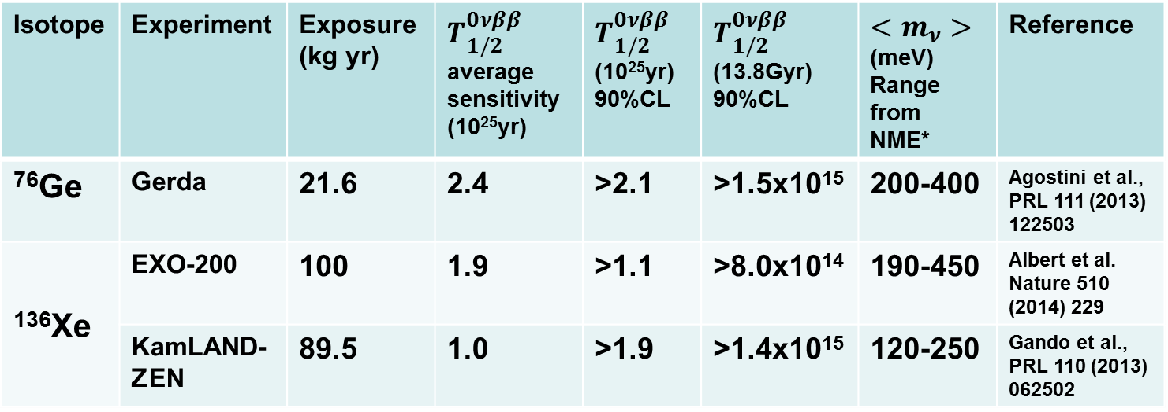
Current best 0νββ sensitivities
Several preliminary results were presented at TAUP 2019 but are not included
Isotope | Experiment | Exposure (kg yr) |  |  |  | Reference
⁷⁶Ge | GERDA | 46.7 | 5.8 | >8.0 | <120-270 | M. Agostini et al. GERDA arxiv:1803.11100
 | Majorana Demonstrator | 26.0 | 4.8 | >2.7 | <200-433 | C.E. Aalseth, et al arXiv:1902.02299v1
¹³⁰Te | CUORE | 86.3 | 0.7 | >1.5 | <140-400 | C. Alduino, et al., arXiv:1710.07988v1
¹³⁶Xe | EXO-200 | 234.1 | 5.0 | >3.5 | <93-286 | Anton et al. arXiv:1906.02723
 | KamLAND-ZEN | 504** | 4.9 | >11 (run 2) | <60-161 | Gando et al., PRL 117 (2016) 082503
Note that the range of “viable” NME is chosen by the experiments and uncertainties related to g_{A} are not included. ** All Xe. Fiducial Xe is more like ~150 kg yr
To achieve higher sensitivity, the next generation of experiments will be at the ton-scale.
Thomas Brunner
21

Slide 22
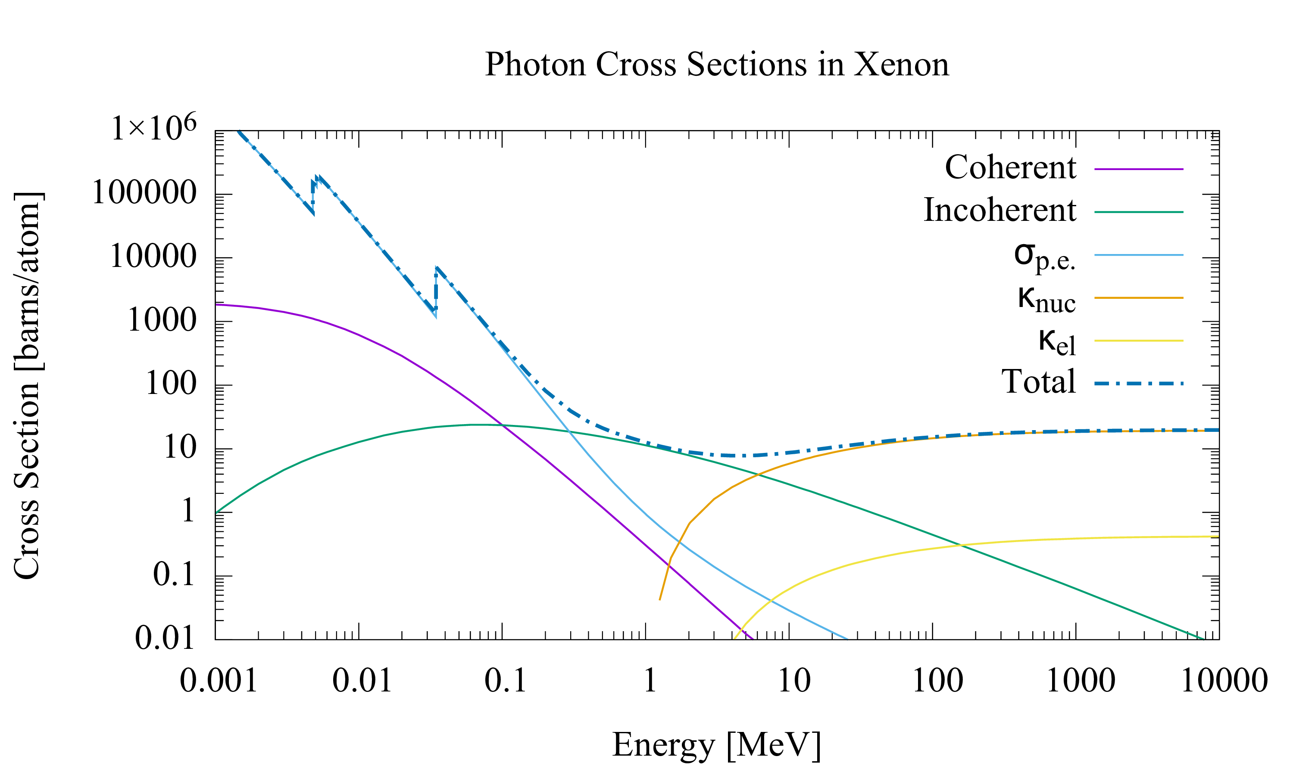
γ backgrounds – a challenge in 0νββ search
Shielding a detector from MeV gammas is difficult!
Example:
γ–ray interaction length
in Ge is 4.6 cm,
comparable to the size
of a germanium detector.
Typical 0νββ
Q-values
Shielding 0νββ decay detectors is much harder than shielding dark matter detectors
We are entering the “golden era” of 0νββ decay experiments as detector sizes exceed interaction length

Slide 23
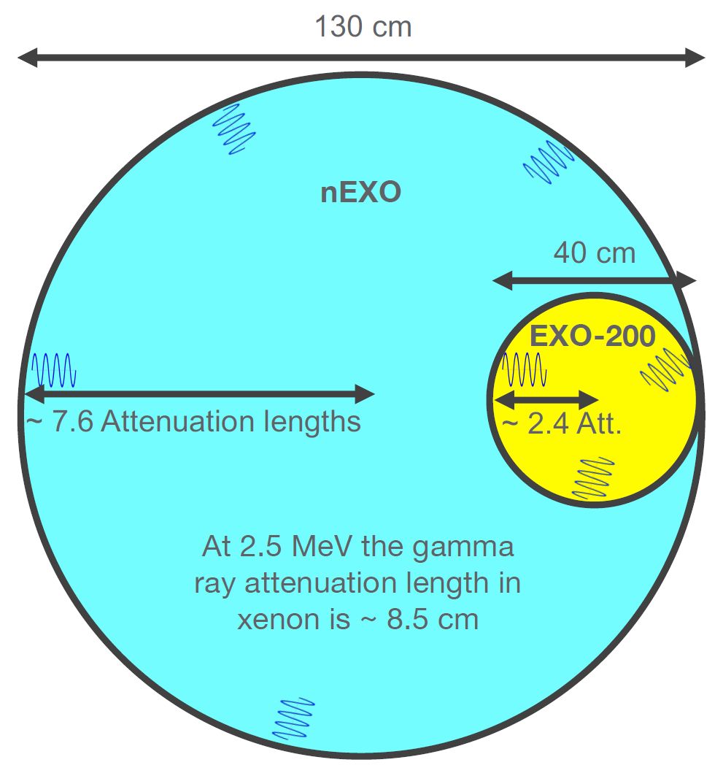
Self-shielding in monolithic detectors
The large, monolithic volume of nEXO and
high density of liquid xenon (2.9 g/cm3) is
extremely beneficial to the attenuation of
gamma rays coming from external materials
The innermost LXe mostly measures signal
The outermost LXe mostly measures background
The overall fit knows all this (and more) very well and uses all the information available to obtain the best sensitivity
Notes:
Median background as a function of the LXe fiducial mass derived from 104 toy-MC simulations with detector livetime of 10 yr. The band corresponds to the 95% confidence belt of the distribution of background counts at each fiducial mass value.

Slide 24
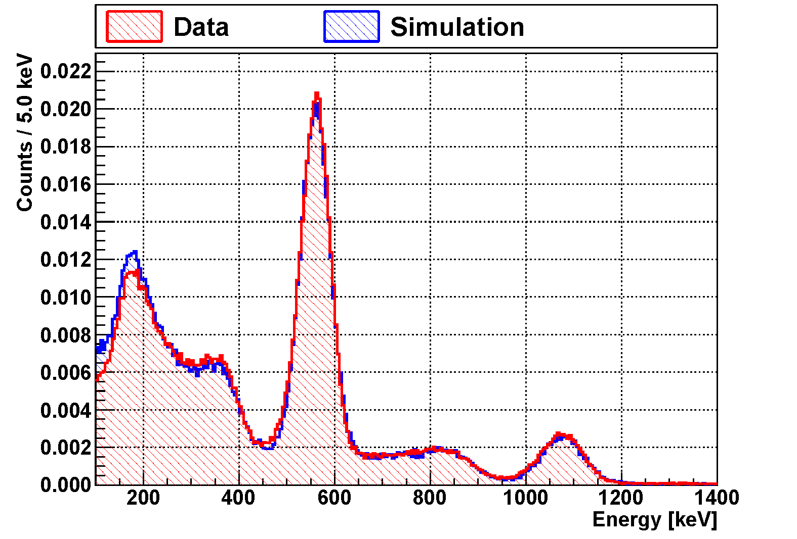
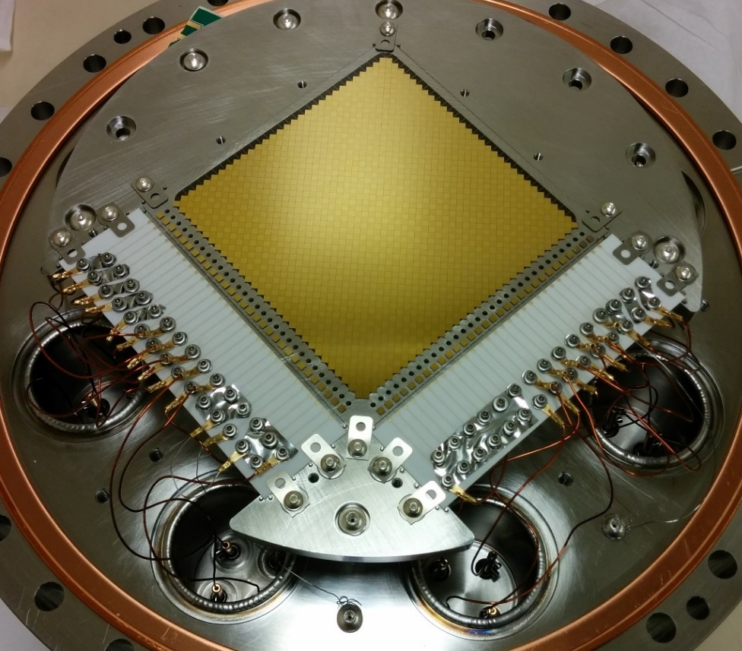
Charge Readout
Data
Geant IV + Electronics model
Charge will be collected on arrays of strips fabricated onto low background dielectric wafers
(low radioactivity quartz has been identified)
Self-supporting/no tension
Built-on electronics (on back)
Far fewer cables
Ultimately more reliable, lower noise, lower activity
Max metallization cover
with min capacitance
JINST 13, P01006 (2018)
arXiv 1710.05109
10µm
~10cm
10 x 10cm² Prototype Tile
Metallized strips on fused silica substrate
60 orthogonal channels (30 x 30), 3mm strip pitch
Strip intersections isolated with SiO₂ layer

Slide 25
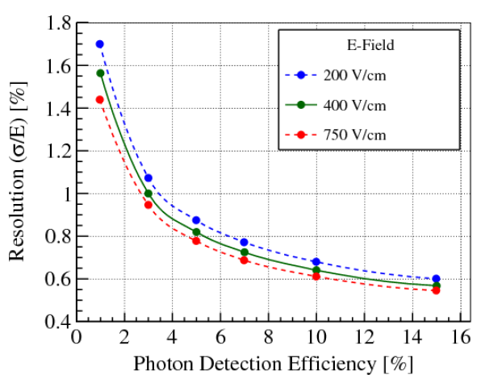
Photon Detection Efficiency Requirements
To achieve 1% energy resolution, an overall 3% photon detection efficiency is required, consisting of two parts:
  Photon detection efficiency (PDE) of SiPM
    Determined by filling factor, transmittance, quantum efficiency and trigger efficiency.
    Can be measured by a standalone setup.
  Photon transport efficiency (PTE)
    Detector geometry
    Reflective electrodes in TPC
    Reflectivity of SiPM
ε_{light} > 3%
  For VUV photons, more than 50% will be reflected on SiPM surface, assuming Si-SiO₂ interface.
Light Detection Efficiency [%]
Thomas Brunner
arxiv:1805.11142
October 15, 2019
25

Slide 26

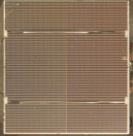
Choice of Photosensor for nEXO
EXO-200 used 500 Bare APDs
VUV sensitive SiPM for nEXO
~ 1500 V bias
Low gain (G~200)
Large (dG/G)/dT ~ 5%/K
Large (dG/G)/(dV/V) ~ 15
VUV photon detection efficiency per area, 25%*
Low leakage current at LXe temperature
* Accounting for inactive area
30 - 80 V bias
High Gain (10⁵ – 10⁶)
Lower (dG/G)/dT ~ 0.6%/K
Lower (dG/G)/(dV/V) ~ 0.3
VUV photon detection efficiency per area, up to 15%
Dark noise and correlated noise
Individual photon counting with high gain and low noise. Resolution limited by dark counts and correlated avalanches.
Noise goes up with increased capacitance, while signal size remains constant, difficult to reach σ/E ~ 1%.

Slide 27
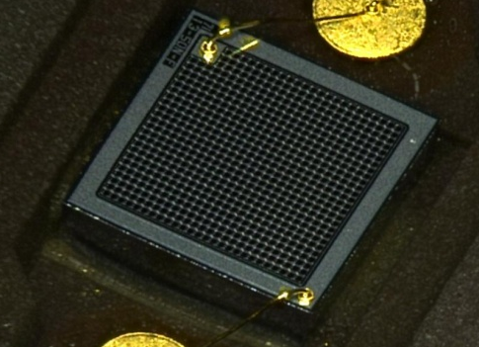
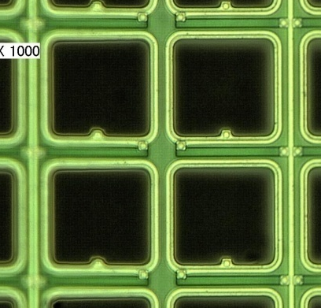
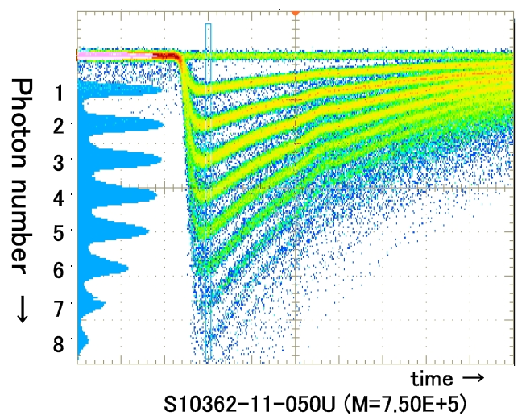
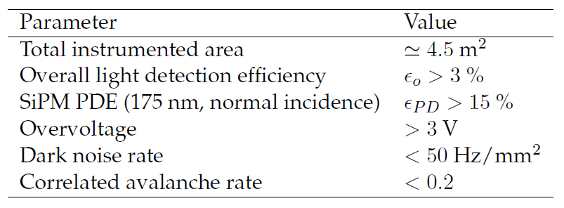
Analog SiPMs - baseline solution for nEXO
1.3x1.3 mm² T2K Multi-Pixel Photon counter
Pictures courtesy of Kyoto University
High gain (low noise)
Large manufacturing capabilities
But efficiency and radioactivity need work
2mm
50μm
nEXO key parameters (1805.11142):
K. Yamamoto et al. PD07(04)

Slide 28
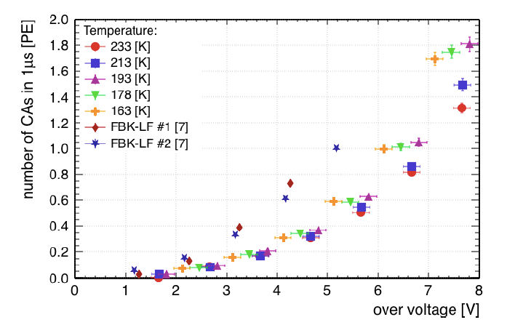
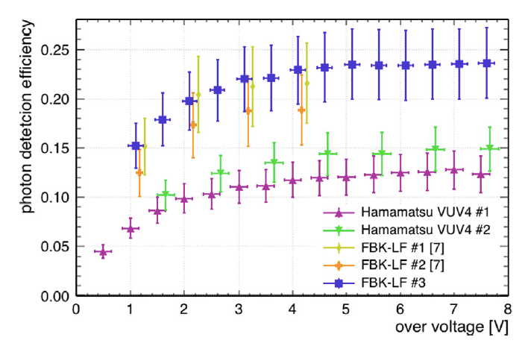
PDE Measurements
Center of wavelength: 180 nm.
A, Jamil, et al. IEEE Trans.Nucl.Sci. 65, 2823 (2018)
G. Gallina et al. Nucl. Instrum. Meth., 940, 371 (2019)
The uncertainty is dominated by quantum efficiency of the reference PMT.
To achieve 1% energy resolution, the SiPM correlated avalanches (CA) need to be below 20%.
VUV4 from Hamamatsu has low CA than FBK-VUV-LF, thus can be operated at a higher over-voltage.
Dark noise rates for both type devices are comfortably below nEXO requirement of < 50Hz/mm².
October 15, 2019
Thomas Brunner
28

Slide 29
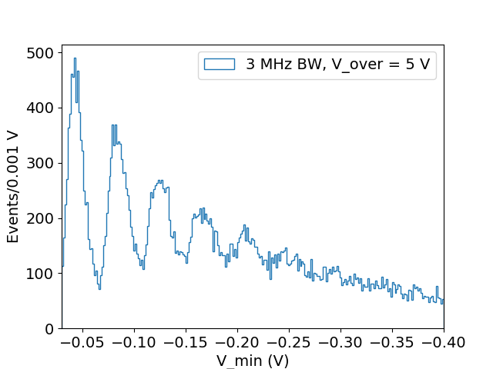
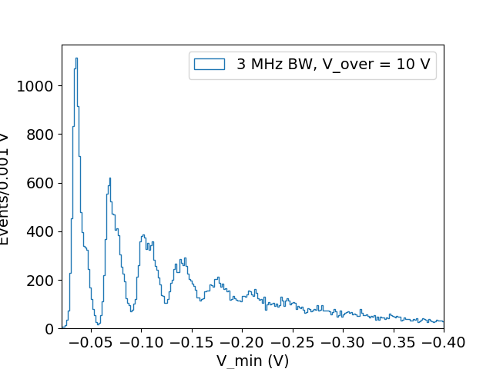
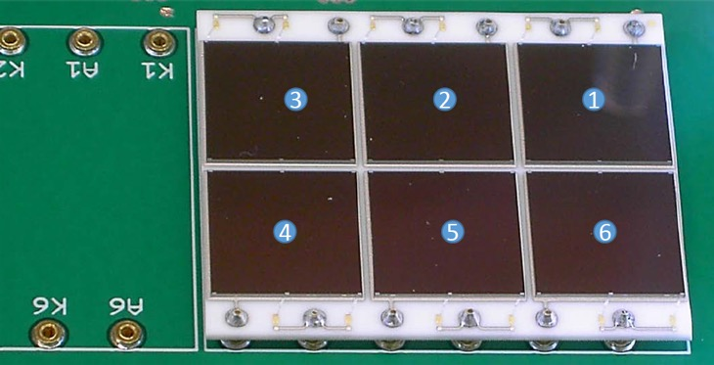

Large Area SiPM Readout
Requirements
  Single photoelectron detection capability.
  Low electronics noise (< 0.1 p.e.)
Analog readout prototype testing
  Up to 6 cm² SiPMs can be read out with a single front end channel in either parallel or series configuration.
  2.5 mW/ch front end power meets the power requirement.
  Provides valuable information for the ASIC design.
R= 0.19 SPE
preliminary
Six 1 ${cm}^{2}$ FBK SiPM on a ceramic carrier board
R= 0.12 SPE
October 15, 2019
Thomas Brunner
29

Slide 30
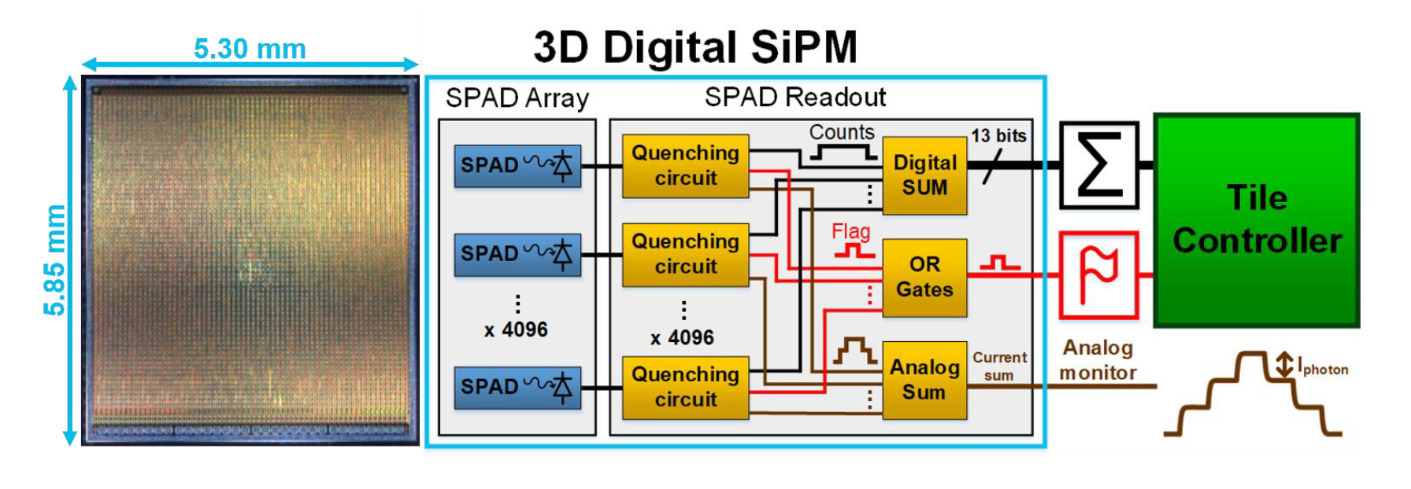
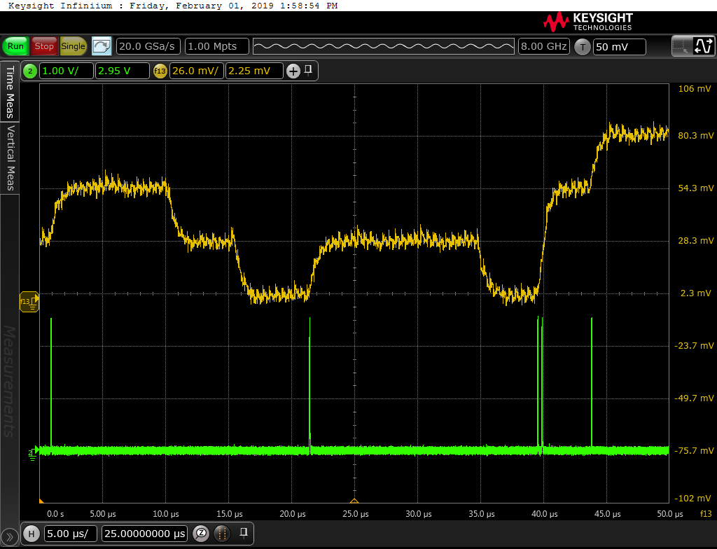
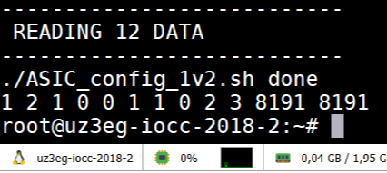
Beyond baseline nEXO R&D– 3DdSiPMs
A SPAD is a Boolean detector: digital information available at the sensor level
With a digital SiPM, each SPAD is coupled one-to-one with its individual readout circuit.
  Photon to bit conversion at the sensor level
  Improved noise immunity
  Output capacitance is not an issue (compared to SiPM)
  Single photon counting mitigated
  Control over each SPAD: faulty or radiation damaged = shut off
  Lower dead time (sense-quench-recharge < 10 ns)
  No trigger = Low power consumption
October 15, 2019
Thomas Brunner
30

Slide 31
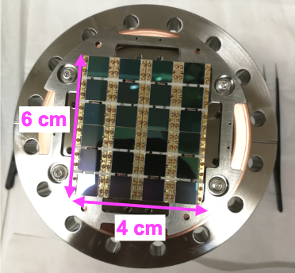
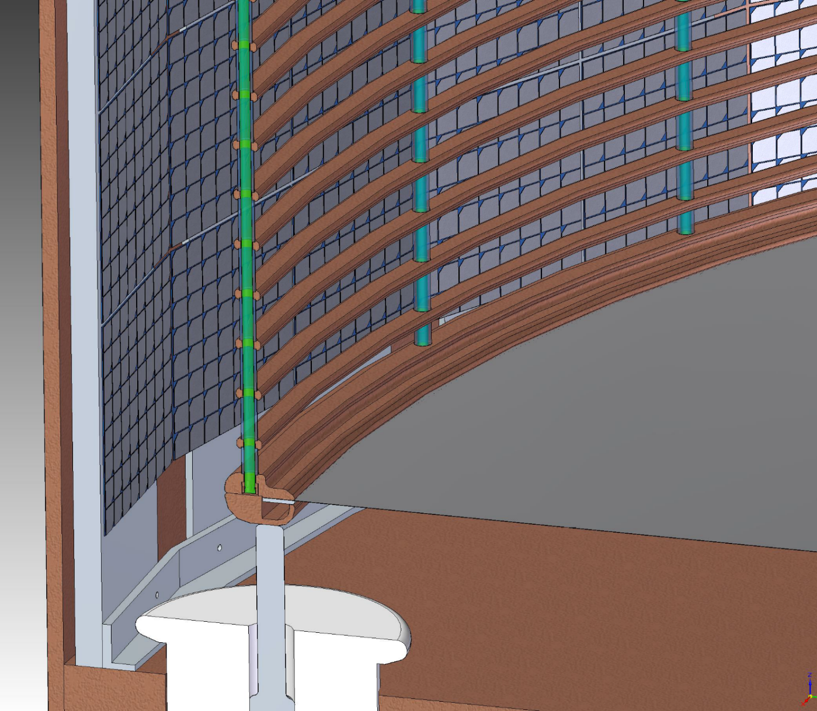
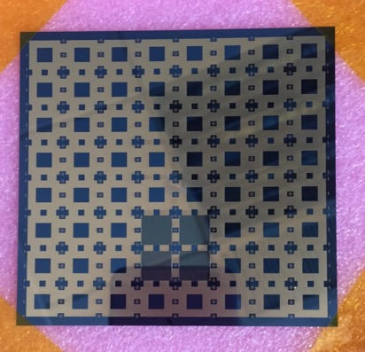

Analog SiPMs - baseline solution for nEXO
Prototype SiPM Tile
Integrate SiPMs into ‘tiles’ (~10 x 10 cm²).
ASIC chip to read out tile.
Tiles mounted on ‘stave’ (~20 x 120 cm²).
Staves mounted inside LXe behind field cage.
ASIC (ZENON) for SiPM
readout under design (BNL)
System on Chip
16 channel
Peak detection
Analog to digital conversion
On-chip LDOs
Prototype silicon interposer
Conceptual design of the photo detector system underway
Thomas Brunner

Slide 32


Energy measurement (EXO-200 data)
Scintillation vs. ionization, ²²⁸Th calibration:
Reconstructed energy, ²²⁸Th calibration:
ALPHA CUT
Q_{ββ}= 2458 keV
Anticorrelation between scintillation and ionization in LXe known since early EXO R&D and now standard in LXe detectors [E.Conti et al. Phys Rev B 68 (2003) 054201]
Rotation angle determined weekly using ²²⁸Th source data, defined as angle which gives best rotated resolution
EXO-200 has achieved ~ 1.15% (arxiv:1906.02723) energy resolution at the double-beta decay Q value in Phase II

Slide 33


Position and multiplicity (EXO-200 data)
Allows for background measurement and reduction
Events with > 1 charge cluster: multi-site events (MS)
Events with 1 charge cluster: single-site events (SS)
0νββ: ~90% SS
γ-rays: ~15% SS at 0νββ Q-value
²²⁸Th calibration data, SS:
²²⁸Th calibration data, MS:
Data
Monte Carlo
Counts/20 keV
Counts/20 keV
Rotated energy [keV]
Rotated energy [keV]

Slide 34

EXO-200 Phase-I Results
Precision ¹³⁶Xe 2νββ Measurement
EXO-200 start data taking in June 2011
Discovery of 2ν mode [PRL 107, 212501 (2011)]
Confirmation by KamLAND-Zen [PRC 85, 045504 (2012)]
[Phys. Rev. C 89 (2014) 015502]
Longest and most precisely measured 2νββ half-life

Slide 35


Reflectivity Measurements
SiPM reflectivity in vacuum
SiPM reflectivity in liquid xenon
preliminary
preliminary
Hamamatsu VUV4
Oscillation due to SiO₂ layer, negligible in LXe.
Lower specular reflectivity for VUV4, comparing to FBK SiPMs.
Similar diffuse reflections between VUV4 and FBK SiPMs.
²⁵²Cf fission sources used to produce scintillation light in LXe.
Specular reflectivity decreases with angle of incidence.
October 15, 2019
Thomas Brunner
35

Slide 36




SiPM Performance under E-field
η_{PDE}
Gain
η_{PDE}
CT
JINST 13, T09006, 2018
In nEXO, SiPMs will be exposed to external E-fields up to ~20 kV/cm.
SiPM performance in various E-fields at cryogenic temperatures (~150K) have been tested in CF₄.
The tested SiPMs show good stability under the influence of different electric field strengths.
Need to test in LXe and understand if surface charge buildup is an issue.
η_{PDE}
PDE
0
5
10
15
20
25
30
E [kV/cm]
October 15, 2019
Thomas Brunner
36
Notes:
The entire assembly, including the anode and the cathode, is submerged in liquefied CF4 (LCF4)
at 149K and a pressure of 1.4 atm. This measurement was carried out in LCF4 as a practical
alternative to LXe. The relevant electrical and thermal properties of LCF4 are close to those of
LXe, as the LCF4 static dielectric constant (1.614 at 149K [13]) is only 15% lower than that of
LXe (1.874 at 165K [14]) and its boiling point (145K at 1 atm) is only 12%lower than that of the
LXe (165K at 1 atm) [15]. Because of the use of CF4, this study does not explore the characteristics
of LXe breakdown relevant to nEXO.

Slide 37


SiPM R&D for nEXO
SiPM PDE (at VUV region) and nuisance parameters (in cold)
  Stanford U.
  TRIUMF
  Erlangen
  BNL
  IHEP
  U. Mass.
Reflectivity of SiPM
  In vacuum or N₂
    IHEP
    TRIUMF
  In liquid xenon
    U. Alabama
    Erlangen
    UMASS
IEEE TRANS. NUC. SCIENCE, VOL. 62, NO. 4, AUGUST 2015
Tested SiPMs
  FBK
    NUV, VUV-LF-HD, VUV-STD-HD
  Hamamatsu
    VUV3, VUV4
October 15, 2019
Thomas Brunner
37
Nuclear Inst. and Methods in Physics Research, A 940 (2019) 371

Slide 38


The EXO-200 Detector
Upgraded detector operating running since June 2016 (Phase II)
High purity
Heat transfer fluid
HFE7000
> 50 cm
25 mm ea
Muon veto
50 mm thick plastic scintillator panels
surrounding TPC on four sides
95.5 ± 0.6 % efficiency
Veto cuts (8.6% combined dead time)
  25 ms after muon veto hit
  60 s after muon track in TPC
  1 s after every TPC event
1.37 mm
> 25 cm
VETO PANELS

Slide 39

Copper vessel 1.37 mm thick
175 kg LXe, 80.6% enr. in ¹³⁶Xe
Copper conduits (6) for:
APD bias and readout cables
U+V wires bias and readout
LXe supply and return
Epoxy feedthroughs at cold and warm doors
Dedicated HV bias line
EXO-200 detector: JINST 7 (2012) P05010
Characterization of APDs: NIM A608 68-75 (2009)
Materials screening: NIM A591, 490-509 (2008)

Slide 40

EXO-200 TPC
Teflon Reflectors
(increase light collection)
APD plane and wire planes
(wires are photo-etched)
40 cm
Central HV plane
(photo-etched phosphor bronze)
Acrylic supports and field shaping rings
20 cm
(half)
Kapton flex cables
(spring connections eliminate solder joints and glue)

Slide 41

The 2014 incidents
EXO-200 note pad
EXO-200 is about 1.2 km from the radiation event
Feb. 5 2014: Fire in WIPP underground
Feb. 14, 2014: Radiation release event
So far no radioactivity has been measured at EXO-200
EXO clean up finished
Low background data taking resumed in April 2016

Slide 42
nEXO publications (since 2018)
Simulation of charge readout with segmented tiles in nEXO
Z. Li, et al., (nEXO), Accepted for publication with JINST arXiv:1907.07512.
Characterization of the Hamamatsu VUV4 MPPCs for nEXO (paper led by G. Gallina and TRIUMF group)
Accepted for publication in NIM (2019) (nEXO collaboration)
Study of Silicon Photomultiplier Performance in External Electric Fields
JINST 13, T09006 (2018) (arXiv:1807.03007) (nEXO Collaboration)
VUV-sensitive Silicon Photomultipliers for Xenon Scintillation Light Detection in nEXO
IEEE Transactions on Nuclear Science 1 (2018) (arXiv:1806.02220)(nEXO Collaboration)
nEXO Pre-Conceptual Design Report
arXiv:1805.11142v2 (nEXO Collaboration)
Characterization of an Ionization Readout Tile for nEXO
JINST 13, P01006 (2018) (arXiv: arXiv:1710.05109v1)(nEXO Collaboration)
Sensitivity and Discovery Potential of nEXO to Neutrinoless Double Beta Decay
Physical Review C 97, 065503 (2018) (arXiv: arXiv:1710.05075v1)(nEXO Collaboration)
Imaging individual Ba atoms in solid xenon for barium tagging in nEXO
Nature 569, 203 (2019) (arXiv:1806.10694)(nEXO Collaboration)

