Slide 1



On the way to a world-competitive fission fragment facility at SARAF
Israel Mardor^{1,2}, Timo Dickel^{3,4}, Leo Weissman¹
¹Soreq NRC, Yavne, Israel
²Tel Aviv University, Tel Aviv, Israel
³Justus-Liebig-Universität Gießen, Gießen, Germany
⁴GSI, Darmstadt, Germany
SMI2019, Montreal QC, Canada, July 15th-19th

Slide 2
Outline
Overview of SARAF and Liquid-Lithium target (LiLiT)
SARAF + Liquid target+ Ion Catcher:
  High rate n-rich isotope generation via neutron induced fission

Slide 3
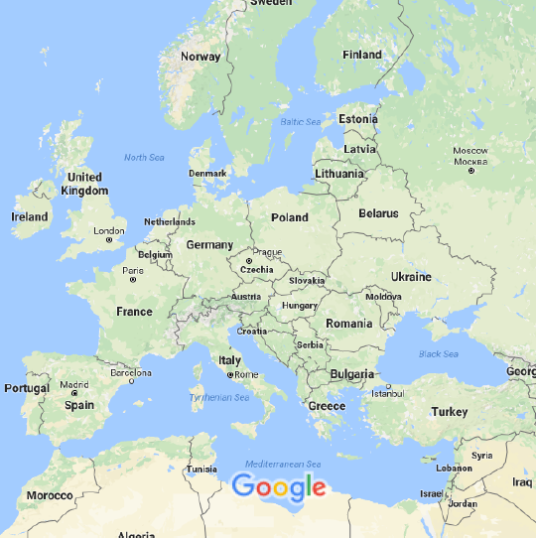
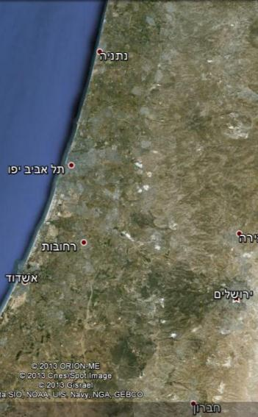
Our geographical location
Montreal – Tel Aviv: ~8,800 km, ~11 hours flight
Soreq NRC, Yavne
Notes:
Zooming in you can get a better idea of our geographical location. The distance between the Venue and Soreq NRC is 30 km.

Slide 4
SARAF – Soreq Applied Research Accelerator Facility
To enlarge the experimental nuclear science infrastructure and promote research in Israel
To develop and produce radioisotopes for bio-medical applications
To modernize the source of neutrons at Soreq and extend neutron based research and applications
Notes:
4

Slide 5
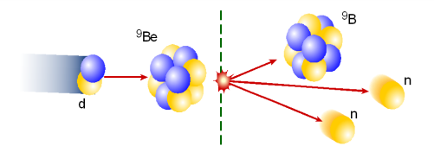

SARAF concept and top level requirements
Parameter | Value | Comment
Ion Species | Protons/Deuterons | M/q ≤ 2
Energy Range | 5 – 40 MeV | Variable energy
Current Range | 0.04 – 5 mA | CW (and pulsed)
Maintenance | Hands-On | Very low beam loss
[3] radiation and isotopes
Planned for 2023
[2] target
OLD initial Phase-II design
[1] 30 m long accelerator
3) applications
2) nuclear reaction
NEW lattice under design
1) fast particles
SARAF-II linac
N. Pichoff et al. IPAC 2017
SARAF-I: to characterize and proof novel acceleration technologies
In operation since 2009

Slide 6
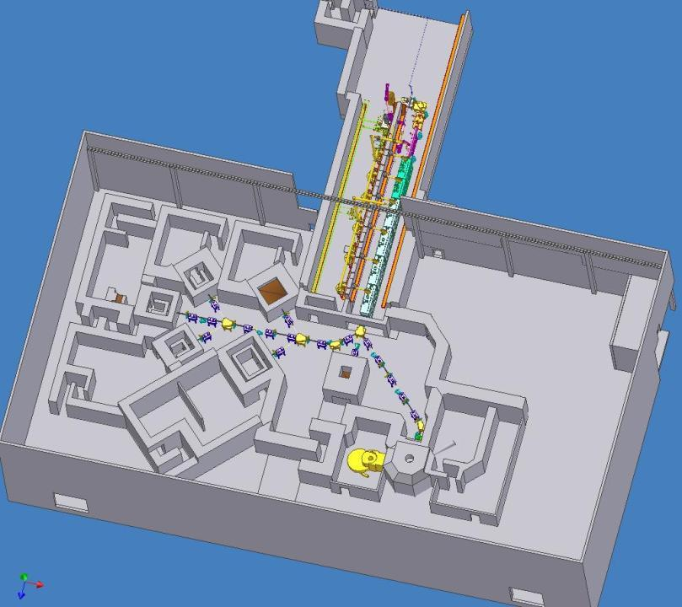
Target Hall
(2022)
2001
2010
SARAF II 2023
√ Phase-I accelerator
Phase-II accelerator
2014
2022
Radiopharmaceutical
R&D
Phase I Target Room
2016-2018
GaIn Beam
Dump
2018-2022
Reactor
alternative
2014-2023
Basic Research
Thermal n source
40 m
diffractometer
radiography
Notes:
6

Slide 7
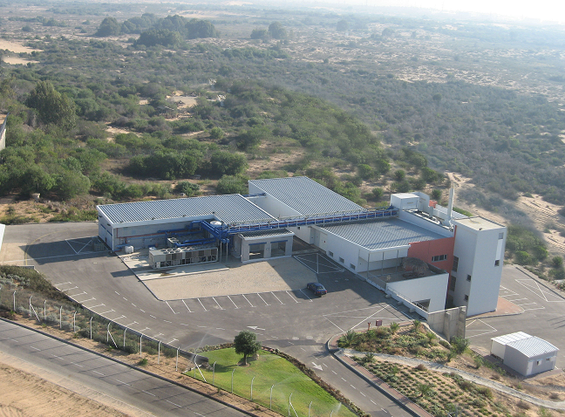
SARAF I (and the SARAF II area)
SARAF II construction area

Slide 8
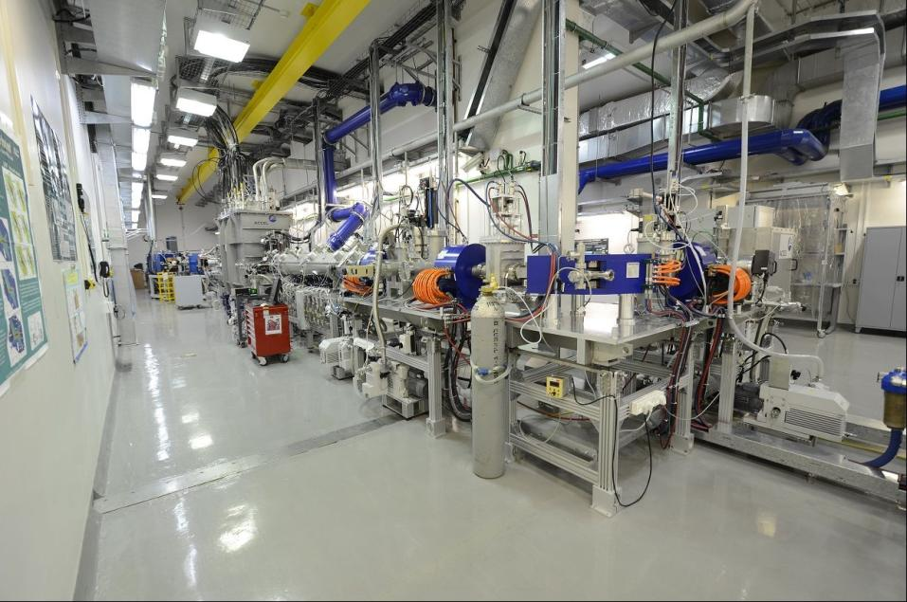
SARAF-I on site collaboration with Research Instruments (formerly Accel Instruments)
Commissioning
A. Nagler, Linac 2006
K. Dunkel, PAC 2007
C. Piel, PAC 2007
C. Piel, EPAC 2008
A. Nagler, Linac 2008
J. Rodnizki, EPAC 2008
J. Rodnizki, HB 2008
I. Mardor, PAC 2009
A. Perry, SRF 2009
I. Mardor, SRF 2009
L. Weissman, DIPAC 2009
L. Weissman, Linac 2010
Operation
D. Berkovits, Linac 2012
L. Weissman, RuPAC 2012
A. Kreisel, Linac 2014
L. Weissman, WAO 2014
L. Weissman, JINST 2014
L. Weissman, JINST 2015
 | MeV | mA
p | 4 | 1 CW
p | 2 | 2 CW
d | 5.6 | 1 (10%)
d | 2.6 | 1.1 CW
… see therein several contributions regarding components design, upgrades and developments

Slide 9
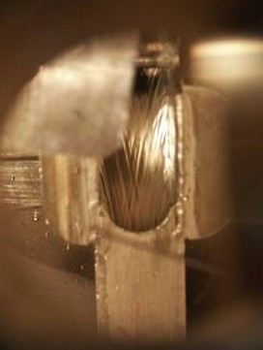
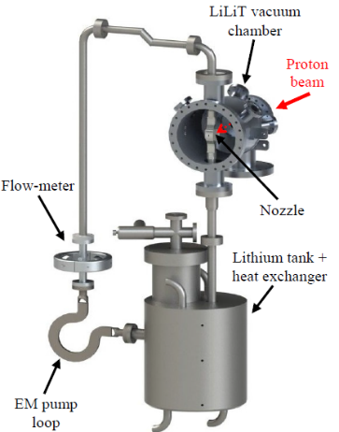
Liquid Lithium Target (LiLiT) overview
SARAF I
18 mm
Incident beam power: ̴2-3 kW
peak power areal density: ̴ 2.5 kW/cm²
peak power volume density protons: ̴ 0.5 MW/cm³
peak power volume density electrons: ̴ 2 MW/cm³
S. Halfon et al., RSI 84, 123507 (2013)
S. Halfon et al., RSI 85, 056105 (2014)
S. Halfon et al., ARI 106, 57 (2015)
I_{p} = 1-2 mA, 1.91 MeV
I_{n} < 3 - 5 × 10¹⁰ n/s
Thanks to J. Nolen, C. Reed & Y. Momozaki (ANL)
for the help with design and training
Notes:
9

Slide 10
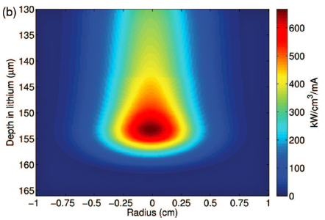
LiLiT: neutrons from ⁷Li(p,n) with a
mA-proton (kW) beam at SARAF I
(~ 200°C)
Windowless
1.91 MeV
1-2 mA
2-4 kW
Flow: 2-4 m/s
Jet thickness: 1.5 mm
neutron production
Ep= Ep_thresh = 1.880 MeV
power dissipation
by fast flow
Li flow: both neutron producing target and power dump

Slide 11
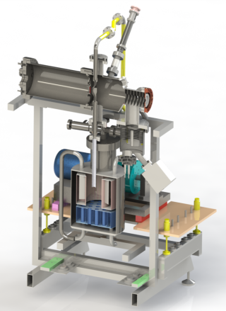
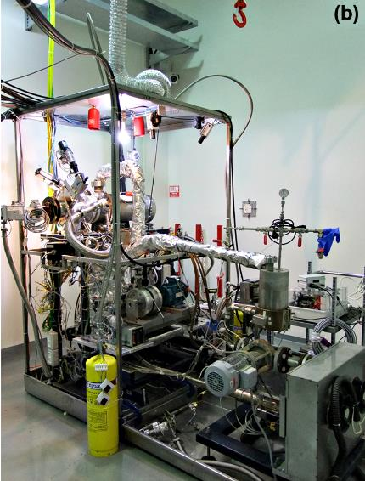
LiLiT at SARAF I beam corridor (1/2)
Beam
Beam
Oil heat exchanger
⁷Be cold trap

Slide 12
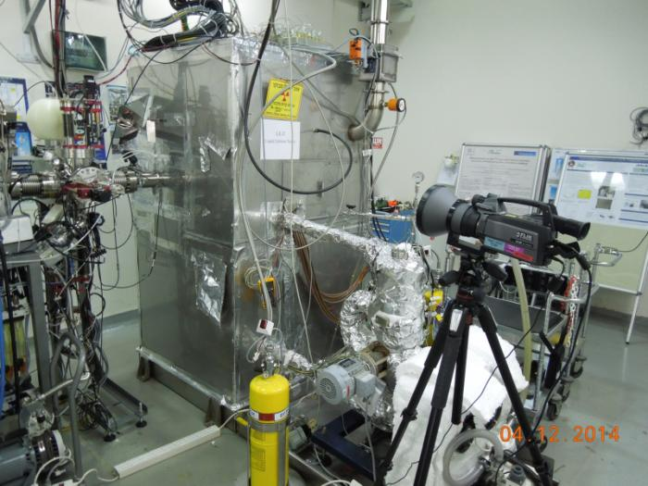
LiLiT at SARAF I beam corridor (2/2)
Beam

Slide 13
SARAF I - LiLiT nucleosynthesis research program
status | Collaboration HU-SARAF- | Detection technique | Target
M. Tessler et al., PLB 751 (2015) 418 | - | spec | ^{nat}Zr(n,γ)
Under analysis | - | spec | ^{nat}Ce(n,γ)
S. Pavetich et al., NIC 2016 | Goethe U Frankfurt –Dresden-Rossendorf-ANU | γ spec + AMS | ²³Na^{35,37}Cl(n,γ)
Under analysis | ANU-ANL | AMS | ⁹²Zr(n,γ)
L. Weissman et al., PRC 96 015802 (2017) | U. Seville | γ spec | ²⁰⁸Pb(n,γ)²⁰⁹Pb
A. Shor et al., PRC 96 055805 (2017) | JRC IRMM Geel | α + β + γ spec | ²⁰⁹Bi(n,γ)^{210g}Bi
Under analysis | ANL - Goethe U - U. Bern | γ + β spec + MOT atom trap | ^{nat}Kr(n,γ)
M. Tessler et al., PRL 121, 112701 (2018) | ANL - Goethe U | AMS + γ spec | ^{36,38,40}Ar(n,γ)
M. Gai et al., Preliminary results | U Conn - PSI - CERN | CR-39 | ⁷Be(n,α)
C. Guerrero et al., submitted to PRL | U. Seville-PSI-CERN | spec | ¹⁷¹Tm(n,γ)
C. Guerrero, ND2016 | U. Seville-PSI-CERN | spec | ¹⁴⁷Pm(n,γ)
Benchmark and higher precision
Noble gases
Radioactive
targets
Notes:
13

Slide 14
Neutron θ=0° flux at SARAF I and II
I. Mardor et al., EPJA 54, 91 (2018)

Slide 15
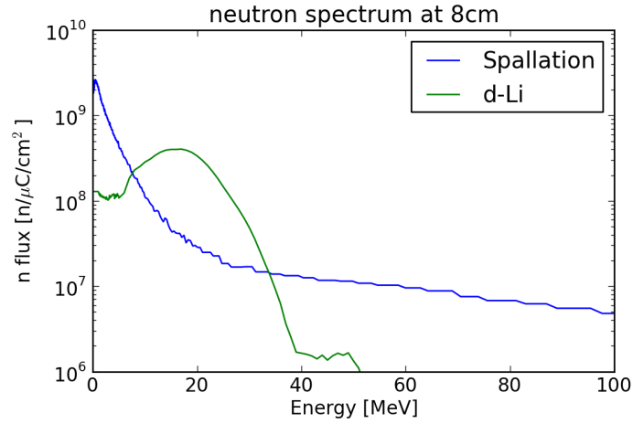
Spallation vs. stripping neutron spectra
40 MeV d-Li vs. 1400 MeV p-W, 0° spectra, 8 cm downstream the primary target
Spallation
Direct + stripping
SARAF II - simulated
ISOLDE - measured
Area optimal for (n,α) (n,p) (n,2n) (n,f)
T. Hirsh, WIS PhD Thesis 2012
D. Berkovits et al. LINAC 2012
I. Mardor et al., EPJA 2018
T. Stora et al., EPL, 98, 32001 (2012)

Slide 16
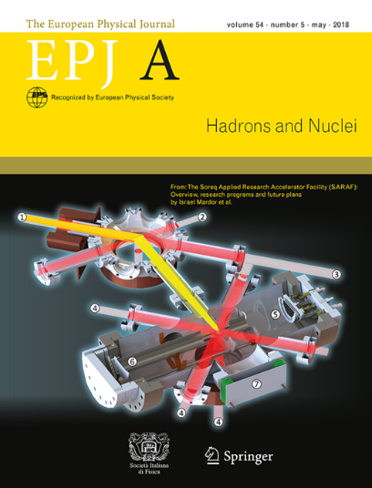
The Science at SARAF (Phases I, II)
Searches for Beyond Standard Model Physics (a_{βν} of ⁶He, ²³Ne, etc.)
Nuclear Astrophysics (s-process cross sections, r-process input)
Exploration of Exotic Nuclei (low z and fission products)
High Energy Deuteron and Neutron Induced Cross Sections (up to E_{n} ~ 50 MeV)
Material Research (Gen-IV, transmutation, fusion, blistering)
Neutron Based Therapy (Boron neutron capture therapy)
Development of New Radiopharmaceuticals (Diagnostics and Therapy)
Accelerator based neutron imaging (thermal and high energy)
Positron Annihilation Spectroscopy
And maybe also – neutrino physics (well-defined, pulsed, high energy, n and anti-n)
I. Mardor et al.,
"The Soreq Applied Research Accelerator Facility (SARAF) – Overview, Research Programs and Future Plans",
Eur. Phys. Jour. A 54, 98 (2018)

Slide 17
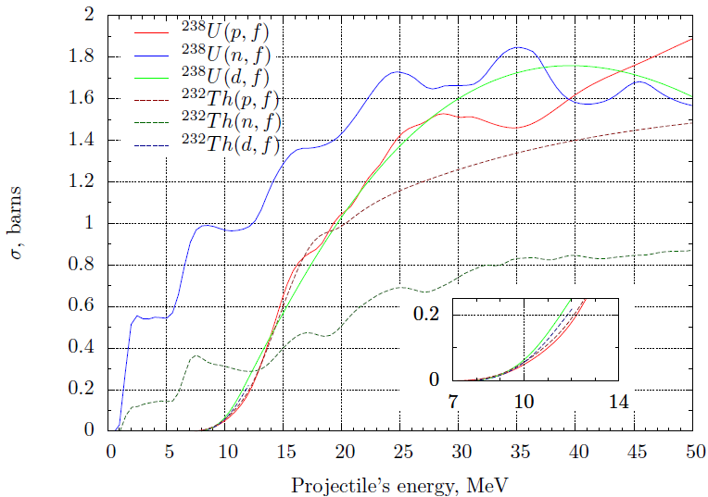
Fission fragments research potential at SARAF
n induced fission cross section at ~10 MeV is similar to p, d at ~20 MeV and higher
Advantage of neutron irradiation is the production of n-richer fission fragments
E_{n} ~ 10 MeV is optimal in terms of n-rich fission fragments versus prompt neutrons
Dmitry Gorelov, PhD thesis, U. Jyvaskyla, December 2015; D. Gorelov et al., NIM B376, 46 (2016)

Slide 18
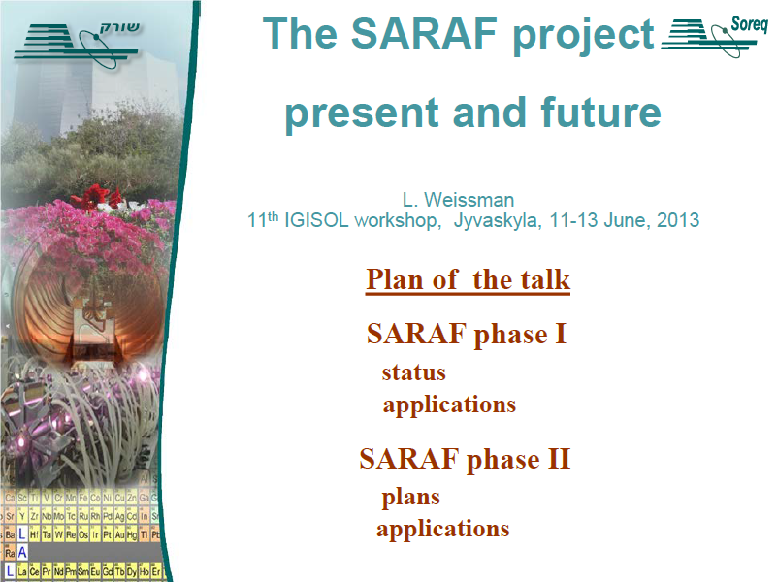
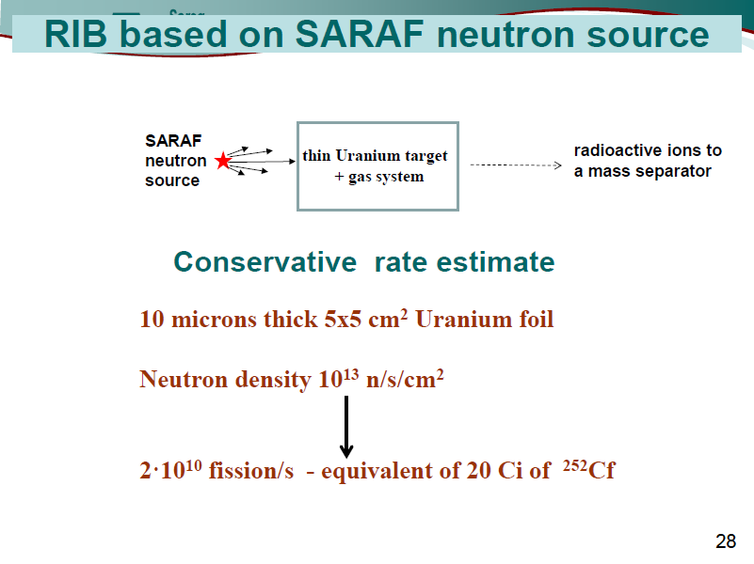
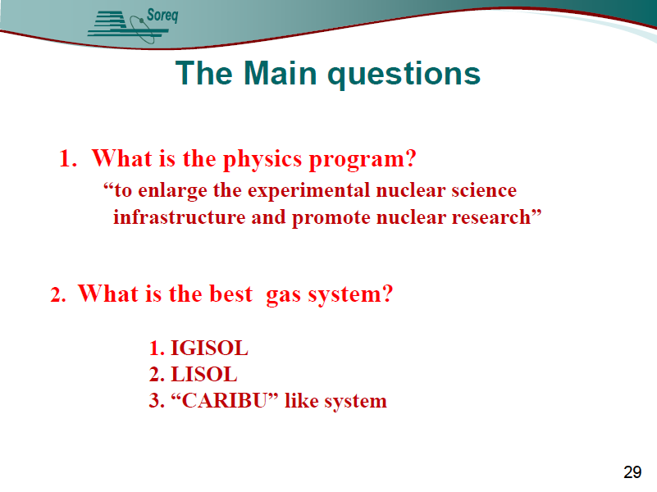
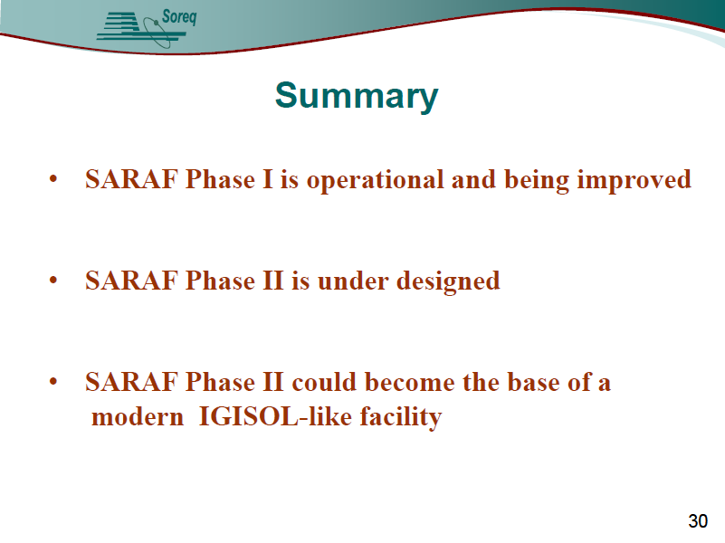

Slide 19

SARAF-II n-rich facility layout
The combination of SARAF high power accelerator, LiLiT and FRS Ion Catcher
may bring SARAF to be competitive with world planned facilities of n-rich exotic isotopes
Deuteron
beam
Actinide
Neutrons
S. Halfon et al., RSI 84, 123507 (2013)
W. R. Plass et al., NIM B 317 457 (2013)

Slide 20
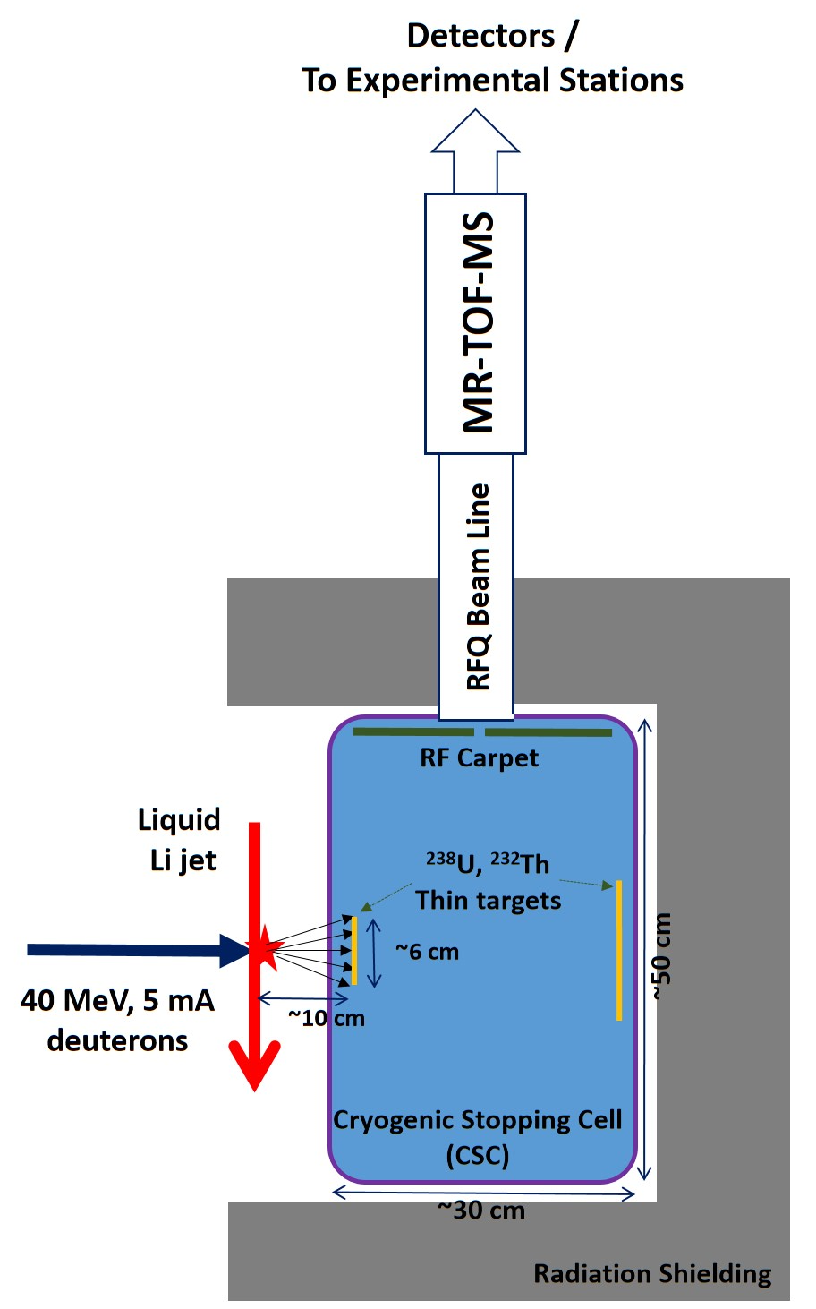
Conceptual layout for the SARAF Ion Catcher
Avoid neutron irradiation of instrumentation
Use next generation CSC design for FAIR:
He buffer gas density: ~0.2 mg/cm³
Fission product (FP) range in CSC: ~10 cm
Almost full stopping of FPs in CSC
CSC Extraction efficiency: 60%
RFQ Transmission: 90%
MR-TOF-MS efficiency: 50%
Detector efficiency / Transfer transmission to experiments: 80%
In following estimations: 1 thin target
I. Mardor et al.,
EPJA 54, 91 (2018)
T. Dickel et al.,
NIMB 376 216 (2016)
Liquid
Target jet

Slide 21
Target Hall
(2022)
2001
2010
SARAF II 2023
√ Phase-I accelerator
Phase-II accelerator
2014
2022
Radiopharmaceutical
R&D
Phase I Target Room
2016-2018
Fission
Fragment
Facility
Reactor
alternative
2014-2023
Basic Research
Thermal n source
40 m
diffractometer
radiography
Notes:
21

Slide 22
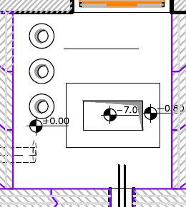
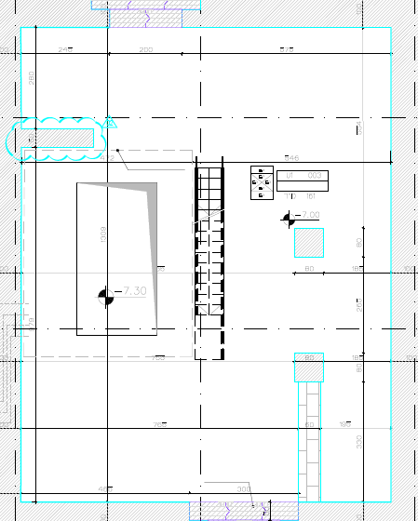
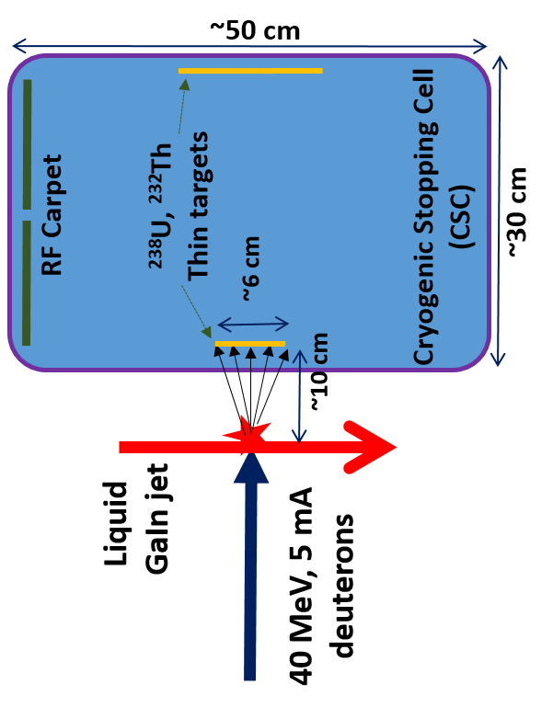
Possible SARAF Fission Fragment Facility Layout
Top View
Ground Level
Basement Level
1020
Data, Power, vacuum, gas
Ion Catcher control and power racks
RFQ beam line
1309
300
RFQ beam line +
MR-ToF-MS (upright)
270
Space and openings have been designed for installation of a CSC, RFQ beam line and MR-ToF-MS

Slide 23
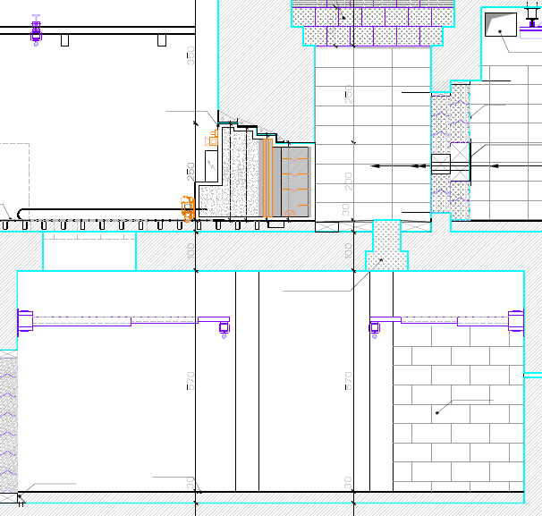
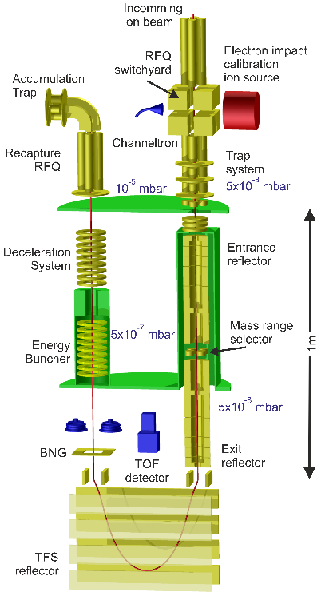
Possible SARAF Fission Fragment Facility Layout
Side View
300
Ground Level
450
CSC
GaIn jet
RF carpet
Ion Beam
Space and openings have been designed for installation of a CSC, RFQ beam line and MR-ToF-MS
RFQ beam line
Basement Level
Data, Power, etc.
1309
570
Ion Catcher control and power racks
MR-ToF-MS

Slide 24
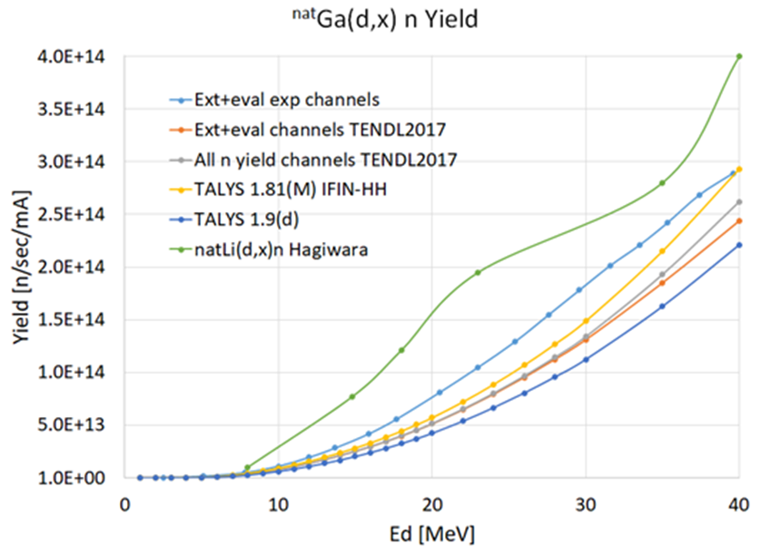
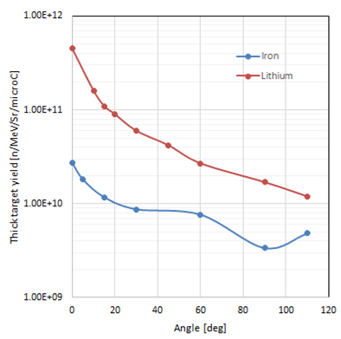
Expected fission fragment rate from the SARAF II Liquid GaIn beam dump (1)
GaIn integral yield is ~0.5 of Li
GaIn angular distribution is less forward peaked than Li
(assume GaIn is similar to the measured Fe)
E. Eliyahu et al., SNRC Report 2019
M. Avrigeanu, V. Avrigeanu, private communication
M. Hagiwara et al. Fus. Sci. Tech., 48 1320 2005
T. Itoga et al., CYRIC Ann. Rep. 2004, 33

Slide 25
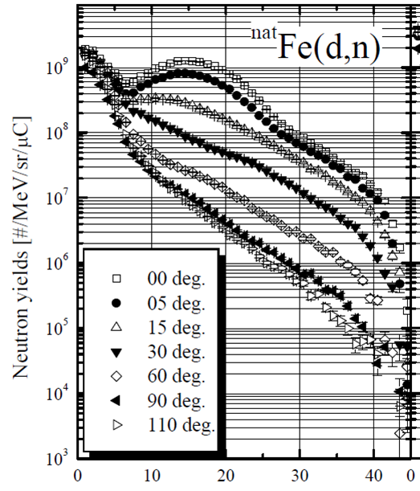
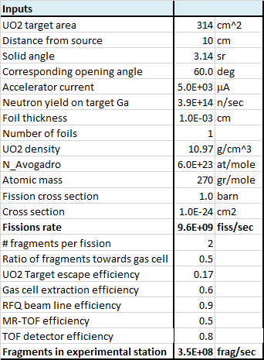
Expected fission fragment rate from the SARAF II Liquid GaIn beam dump (2)
Assume GaIn has similar n energy distribution as Fe
Neutron energy [MeV]
Setup may be improved by
  Increasing solid angle
  Optimizing actinide target angle w.r.t. beam
  Adding more actinide targets
Nevertheless, next slides use above estimate

Slide 26
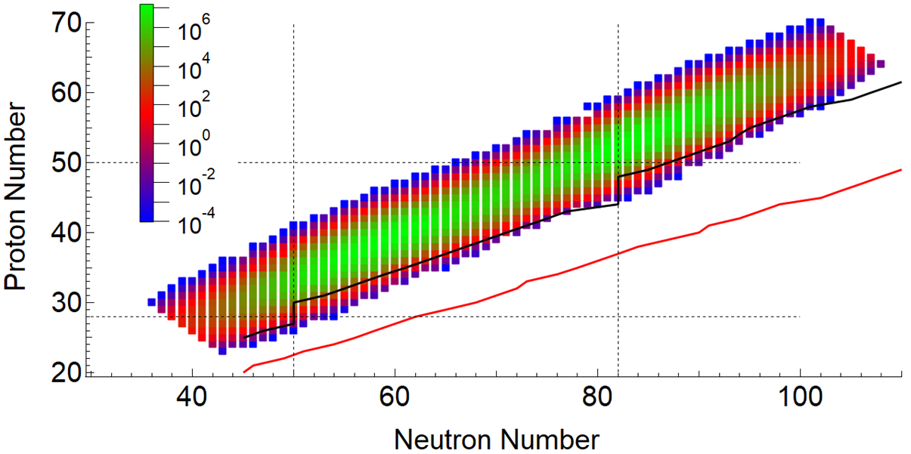
SARAF II n-rich isotope production rates
~950 different fragments
r-process path (S_{n} ~ 3 MeV)
n drip line (S_{n} ~ 0)
SARAF-II isobarically separated isotopes in the experimental station, after MR-TOF-MS (isotopes/sec)
Based on ²³⁸U and ²³²Th targets (higher yield option per fission product)
Use E_{n}=14 MeV (n, fiss) cross sections (1.0 barn for ²³⁸U, 0.33 barn for ²³²Th)
Fission yields from JENDL FPY-2011 http://wwwndc.jaea.go.jp/cgi-bin/FPYfig?iso=nU238&eng=e2

Slide 27
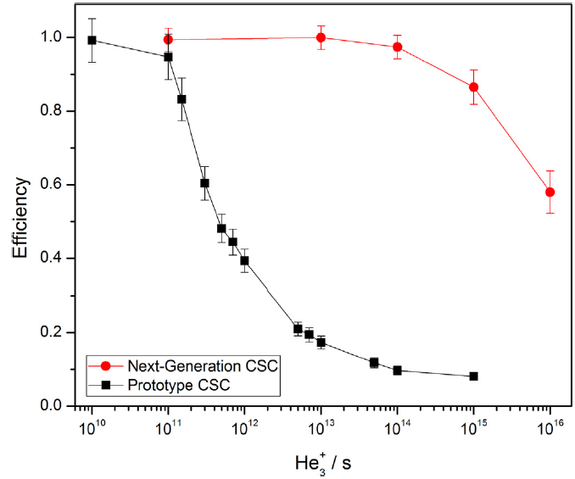
Handling of SARAF-II high rates at an ion catcher
~40 eV → 1 He-e⁻ pair
~100 MeV / FP →
~2×10⁶ He-e⁻ pairs / FP
~10¹⁰ FP/sec in buffer gas → ~2×10¹⁶ He-e⁻ pairs/sec
~60% extraction efficiency for LEB design
Dedicated design for SARAF CSC could yield higher efficiency
(also for higher rates)
Do not need/want to measure all FPs at once:
Degraders around actinide targets will suppress heavier FPs
Lower buffer gas pressure will suppress lighter FPs (will hit CSC walls)
Coarse mass filtering prior to high-resolving MR-TOF-MS mass measurements / filtering:
RFQ beam line – M/ΔM ~ 250 (~1u), 90% transmission, (~10⁹ FP/sec)
MR-TOF-MS itself – M/ΔM ~ up to 70,000 (re-trapping schemes) (~10⁷ FP/sec)
Detailed design and simulations needed to ensure full utilization of SARAF’s output

Slide 28
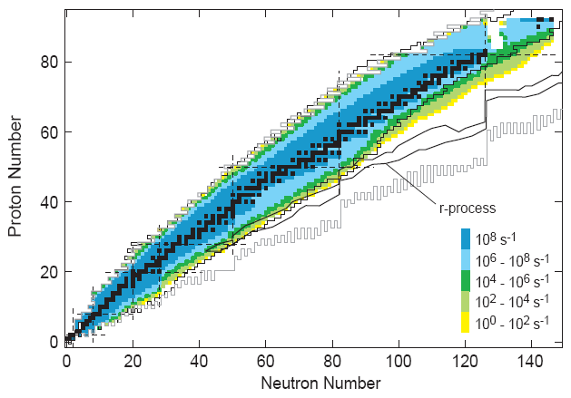
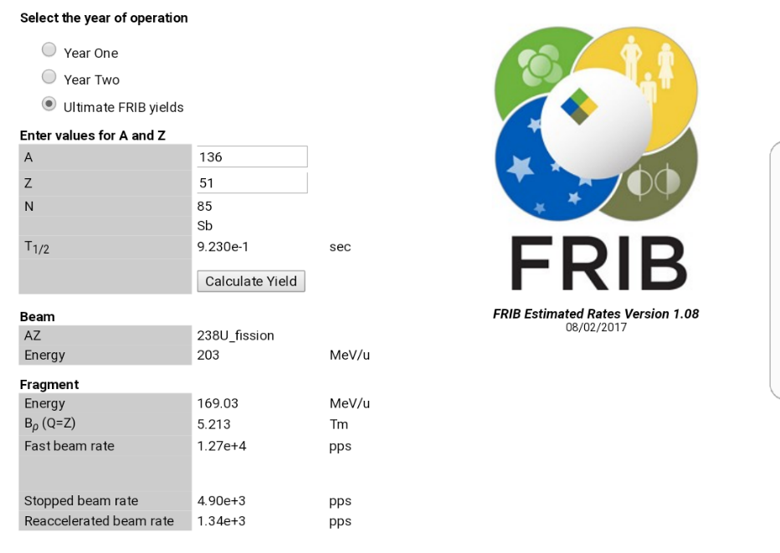
Perspective – FRIB expected rates
B. Sherrill, Facility for Rare Isotope Beams, HRIBF Workshop (2009)
For all SARAF-II expected FPs, extracted FRIB rates from their online calculator:
‘Stopped beam’ rates
‘Ultimate FRIB yields’
‘FRIB Estimated Rates Version 1.08’, August 2017
Fission products cross sections from LISE++ 3EER Model
https://groups.nscl.msu.edu/frib/rates/fribrates.html
Plotted FPs for which R(SARAF-II) > R(FRIB)

Slide 29
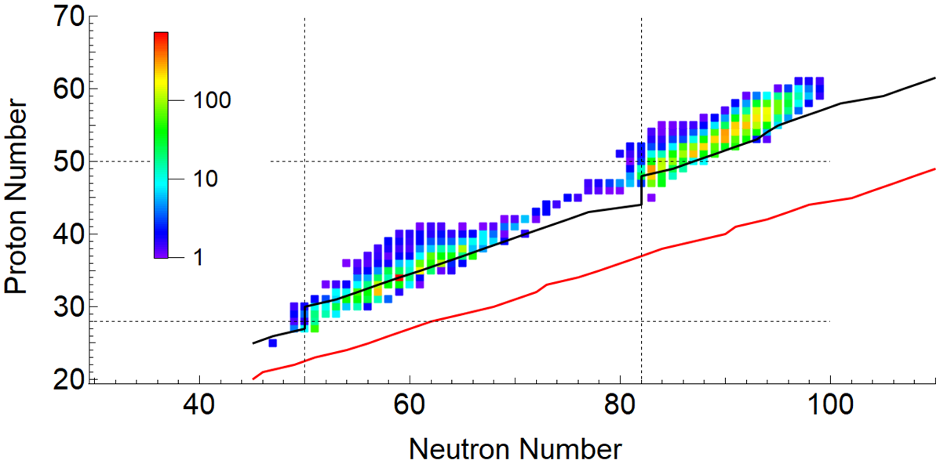
SARAF II / FRIB rates ratio
~270 different fragments
r-process path (S_{n} ~ 3 MeV)
n drip line (S_{n} ~ 0)
FPs for which R(SARAF-II) > R(FRIB)
FRIB rates are ‘stopped beam’
FRIB rates taken from ‘FRIB Estimated Rates Version 1.08’, August 2017 (‘Ultimate FRIB yields’)
Fission products cross sections from LISE++ 3EER Model
https://groups.nscl.msu.edu/frib/rates/fribrates.html

Slide 30
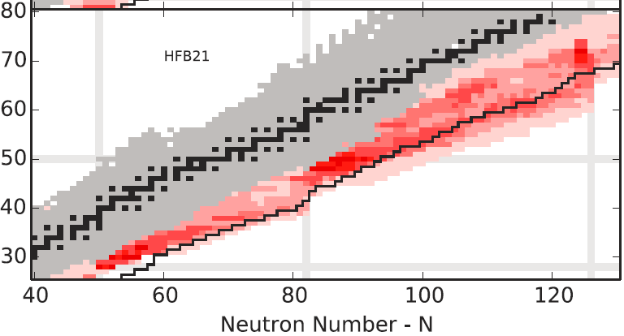
Impact of nuclear properties on the r-process
A. Aprahamian et al., Sensitivity studies for the main r process: nuclear masses, AIP Advances 4, 041101 (2014)
Proton Number - Z

Slide 31
Impact of nuclear properties on the r-process
A. Aprahamian et al., Sensitivity studies for the main r process: nuclear masses, AIP Advances 4, 041101 (2014)
Proton Number - Z

Slide 32

Impact of nuclear properties on the r-process
A. Aprahamian et al., Sensitivity studies for the main r process: nuclear masses, AIP Advances 4, 041101 (2014)
Proton Number - Z

Slide 33
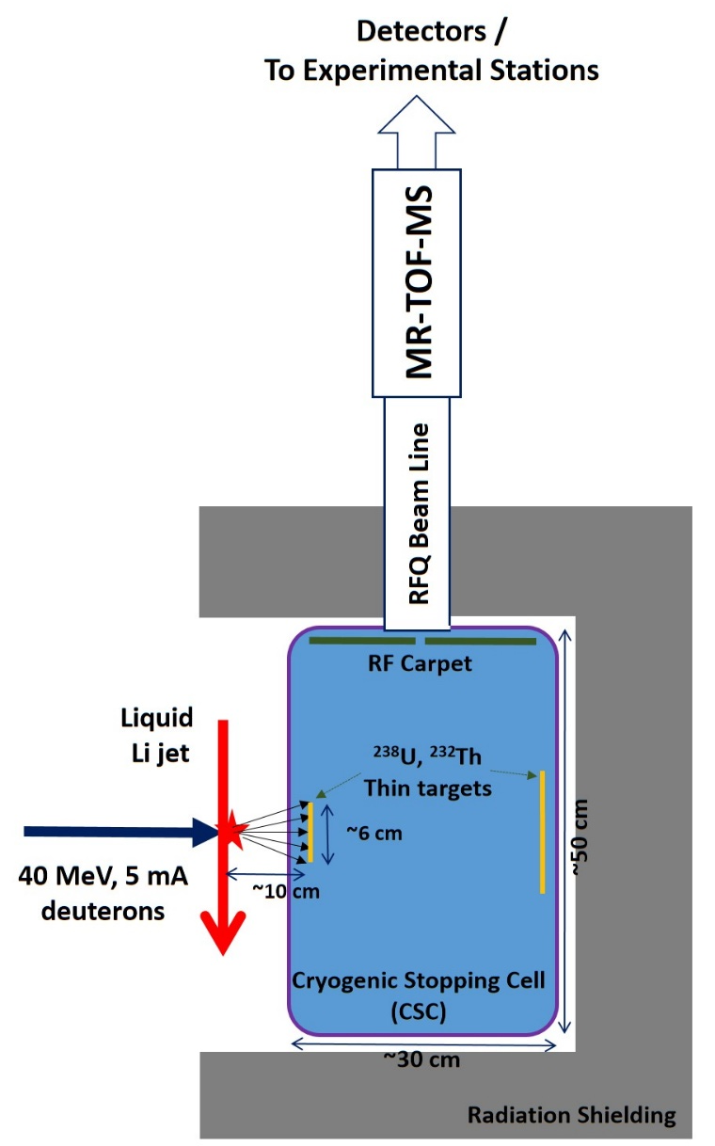
Nuclear properties of n-rich isotopes at SARAF-II
Array of n, β and γ detectors such as
VANDLE
Versatile Array of Neutron Detectors at Low Energy
W. A. Peters et al., NIM A 836, 122-133 (2016)
Laser spectroscopy
such as in
IGISOL @ JYFL
A. R. Dicker et al., Hyp. Int. 227 139–145 (2014)
Masses, Q-values, n-separation energies
Half lives
Mass and isotope fission fragment distributions
Fission fragment isomer ratios
γ excitation levels
β-delayed neutron emission probabilities (P_{n})
n spectra and energy levels
  Constraints on σ(n,γ) from γ and/or neutron spectra
Spin, dipole and quadrupole moments
Mean-square charge radii

Slide 34
Acknowledgements
This initiative is inspired by and based on:
Leo Weissman & Michael Paul, Neutron-Rich Radioactive-Ion Production at SARAF Phase II, October 2013, internal report
Thanks for fruitful discussions with:
SARAF Group (Soreq NRC), Michael Paul (HUJI), Eli Piasetzky (TAU), Ishay Pomerantz (TAU), Stephane Goriely (ULB), Gabriel Martinez-Pinedo (TUD), Wolfgang R. Plaß and the FRS Ion Catcher Collaboration, Iain Moore and the JYFL IGISOL Group, Paul Constantin and the ELI-NP RIB Group, Stephan Pomp

Slide 35
Summary and Outlook
Soreq NRC is constructing SARAF as a versatile facility for the communities of applied and basic research and development
Scientific programs are ongoing at SARAF I, educating graduate students, and generating scientific results that are published and presented in international conferences
SARAF II is funded, to be completed at the first half of the next decade
Plans for SARAF II research programs are under development
The high neutron luminosity of SARAF + LiLiT and an Ion Catcher a la FRS, may constitute a world competitive facility for n-rich exotic isotopes research
Utilizing the SARAF II liquid GaIn beam dump may enable a realistic path towards the SARAF Fission Fragment Facility (no need for dedicated neutron source)
SARAF is open to new collaborators and contributions. We look forward to research proposals and letters of intent

