Slide 1
Improvement of a dc-to-pulse conversion efficiency of FRAC
S. Sato¹
M. Wakasugi², T. Ohnishi²,
M. Watanabe², A. Enokizono² K. Kurita¹
¹Department of Physics, Rikkyo University
²RIKEN Nishina Center for Accelerator-Based Science
July 18, 2019

Slide 2
Highlights
1/17
We developed a 2-step bunching method by cooperation of
ERIS^{※1}(Electron-beam-driven RI separator for SCRIT )
and
FRAC^{※2}(Fringing-RF-field-activated dc-to-pulse converter)
The DC beam was converted to a pulse beam with up to ~90% efficiency.
※1 Nucl. Instrum. Meth. B317, 357 (2013).
※2 Rev. Sci. Instrum. 89, 095107 (2018).

Slide 3
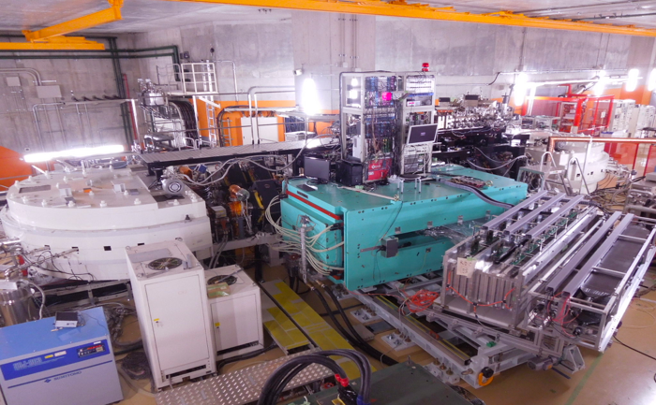
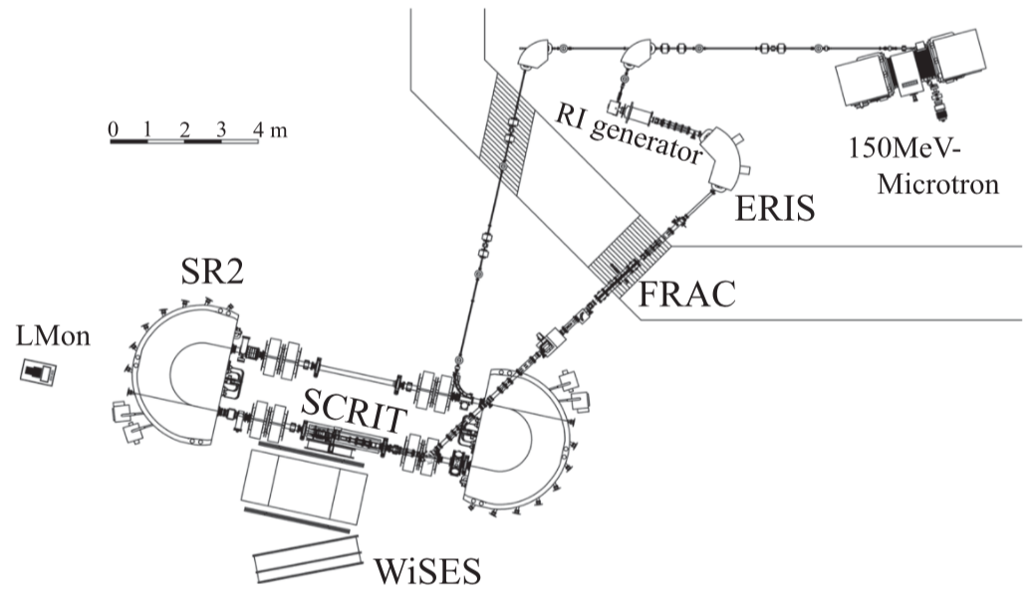
SCRIT facility @ RIKEN
2/17
SCRIT (Self Confining Radioactive isotope Ion Target)
The world’s first electron scattering of unstable nuclei
ISOL
Target
Buncher
Spectrometer
Nucl. Instrum. Methods B317(2013)668

Slide 4
Operation of SCRIT
3/17
Trapping
& scattering
Injection
Potential is opened for 500μs
: Ion
: e⁻ beam
: SCRIT potential
〜10⁸ ions need to be injected to SCRIT in 500μs

Slide 5
Goal and condition
4/17
The dc-to-pulse conversion efficiency : 100%.
Because
SCRIT requires : ~10⁸ ions
The production rate : 10⁵ ~10⁷ ions/s

Slide 6
Goal and condition
4/17
The dc-to-pulse conversion efficiency : 100%.
Because
SCRIT requires : ~10⁸ ions
The production rate : 10⁵ ~10⁷ ions/s
The degree of vacuum of FRAC : ~10⁻³ Pa.
Because
SCRIT is operated under high vacuum of ~10⁻⁸ Pa.
Ion capacity needs to be ~10⁸ ions.
Ions in FRAC need to be extracted with in 500us.

Slide 7
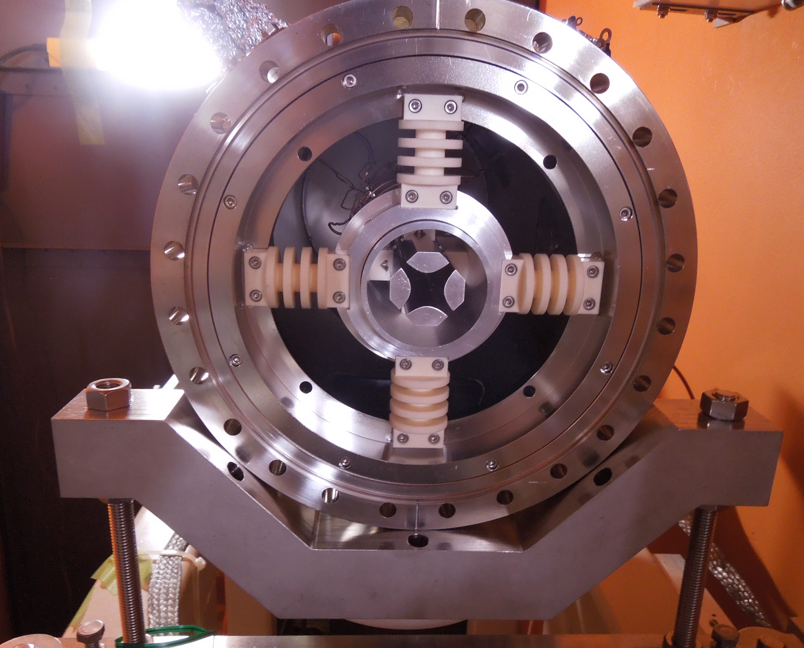
Setup
5/17
Length : 0.9m
Bore radius : 8 mm
RF amplitude : 500 V
RF frequency : 1.5 MHz
Buffer gas : Xe, ~10⁻³ Pa
end view of FRAC
grid
Barr1
Barr2
FRAC
ERIS
Segmented RFQ
FC2
FC1

Slide 8
2-step bunching method
6/17
Ion cooling by buffer gas of ~10⁻³ Pa
Long cooling time
DC beam can not be stacked
2-step bunching method

Slide 9
2-step bunching method
7/17
If the DC beam is injected…
Buffer gas
~10⁻³Pa
DC beam can not be stacked efficiently
Potential
ERIS
FRAC
L

Slide 10
2-step bunching method
8/17
1. The ions are stacked by ERIS
Buffer gas
~10⁻³Pa
Potential
ERIS
FRAC
L

Slide 11
2-step bunching method
8/17
2. The ions are extracted as a pre-pulse beam
Buffer gas
~10⁻³Pa
Potential
ERIS
FRAC
L

Slide 12
2-step bunching method
8/17
3. The injection barrier of FRAC is opened
Buffer gas
~10⁻³Pa
Potential
ERIS
FRAC
L

Slide 13
2-step bunching method
8/17
3. The ions are trapped and cooled in FRAC
Buffer gas
~10⁻³Pa
Potential
ERIS
FRAC
L

Slide 14
2-step bunching method
8/17
4. Next pre-pulse is extracted from ERIS
Buffer gas
~10⁻³Pa
Potential
ERIS
FRAC
L

Slide 15
2-step bunching method
8/17
5. Next pre-pulse is injected to FRAC
Buffer gas
~10⁻³Pa
Potential
ERIS
FRAC
L

Slide 16
2-step bunching method
1/17
1/20
8/17
6. The ions are trapped and cooled in FRAC
Buffer gas
~10⁻³Pa
Potential
ERIS
FRAC
L

Slide 17
2-step bunching method
1/20
8/17
7. The pre-pulses are stacked in FRAC
Buffer gas
~10⁻³Pa
Potential
ERIS
FRAC
L

Slide 18
2-step bunching method
1/20
8/17
8. The ions stacked in FRAC is extracted
Buffer gas
~10⁻³Pa
Potential
ERIS
FRAC
L

Slide 19
2-step bunching method
9/17
The potential value relative to the beam energy
50V
20V
0V(10kV)
-3.6V
-5V
Potential
V_{d}
-200V
-180V
ERIS
FRAC
L

Slide 20
2-step bunching method
10/17
ERIS : converts the DC beam to pre-pulse beam
FRAC : cools and stacks the pre-pulse beam
1. How long can ERIS hold the ions efficiently?
2. How long FRAC takes to cool the ions sufficiently?
Pre-pulsing frequency
ERIS efficiency
FRAC efficiency
High
Low
Pre-pulsing frequency is very important.

Slide 21
Determination the pre-pulsing frequency
1/20
11/17
1. The pre-pulsing frequency dependence of ERIS efficiency
Ion beam : ¹⁴⁰Cs
ions in the pre-pulse
ERIS efficiency =
ions in DC
DC beam
Pre-pulse beam
Intensity
Intensity
Time
Time
2. The energy of the ions in FRAC
Ion beam : ¹³³Cs
The energy of the ions in FRAC is estimated by pulse width of extracted pulse.

Slide 22
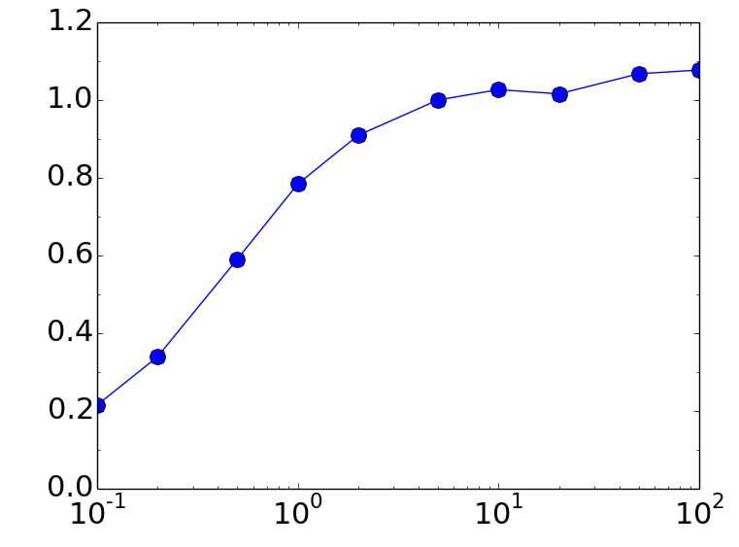
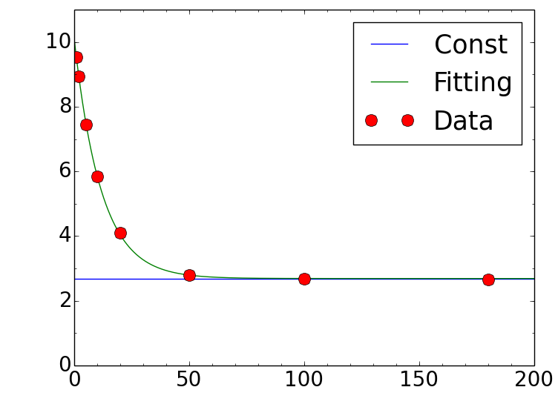
Determination the pre-pulsing frequency
1/20
12/17
ERIS efficiency
The energy of the ions in FRAC
pre-pulse / DC
Average energy [eV]
Pre-pulsing frequency [Hz]
Cooling time [ms]
Pre-pulsing frequency $≥$10Hz
Cooling time $≥$ 50ms
ERIS efficiency : 100%
The ions are cooled sufficiently.
The pre-pulsing frequency was determined 10Hz

Slide 23
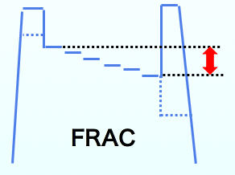
V_{d} dependence of pulse width
1/20
13/17
Measurement to determine appropriate V_{d}
Ion beam : ¹³³Cs
V_{d}
Extracted pulse
Extracted pulse
Increase of V_{d}
Intensity
Intensity
Time
Time

Slide 24
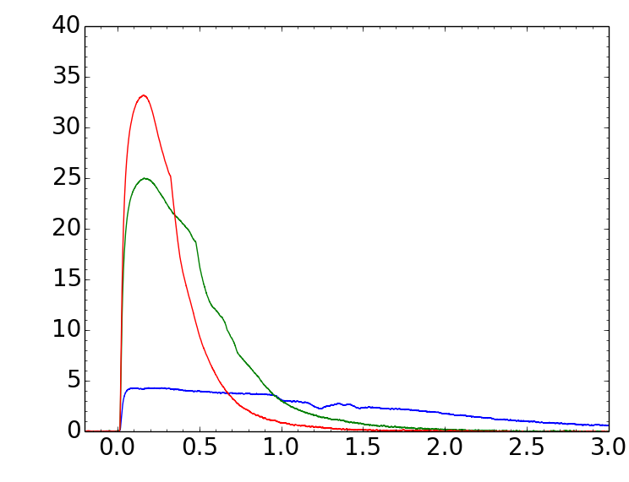
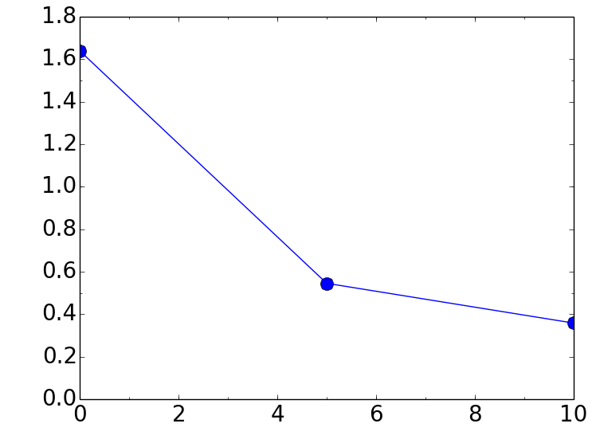
V_{d} dependence of pulse width
1/20
14/17
V_{d} = 10 V
V_{d} = 5 V
FWHM [ms]
Intensity [nA]
V_{d} = 0 V
Time [ms]
Potential difference V_{d} [V]
The pulse width was close to the target value when the potential difference V_{d} =10V

Slide 25
FRAC efficiency
1/20
15/17
The pre-pulsing frequency : 10Hz
The potential difference V_{d} : 10V
Ion beam : ¹³³Cs
extracted ions
FRAC efficiency =
Injected ions
Injected pre-pulses
Extracted pulse
Intensity
Intensity
…
Time
Time

Slide 26
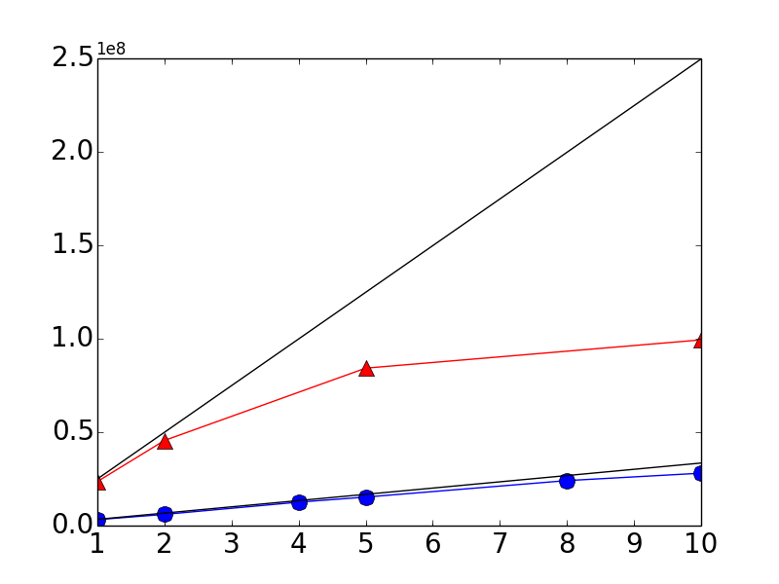
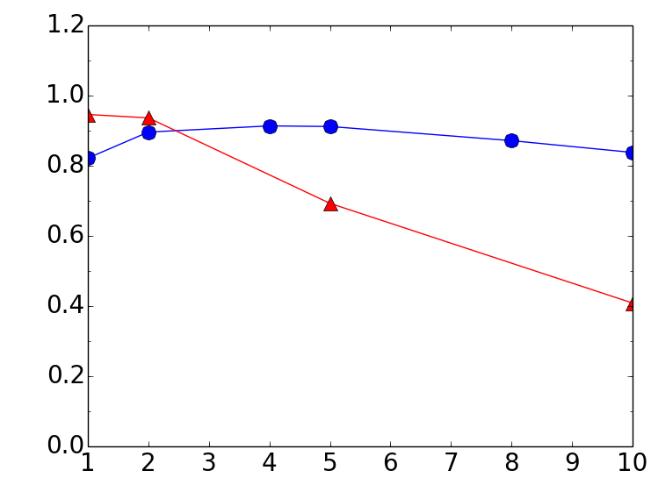
FRAC efficiency
1/20
16/17
×10⁸
2.5 × 10⁵ ions / pre-pulse
If the efficiency is 100%
FRAC efficiency
Extracted ions
2.5 × 10⁶ ions / pre-pulse
Stacking time [s]
Stacking time [s]
Injected ions
FRAC efficiency
< 4×10⁷
~90%
1×10⁸
~70%
2.5×10⁸
~40%

Slide 27
Summary
1/20
17/17
The DC beam is converted to a pulse beam with up to ~90% efficiency by the 2-step bunching method.
10⁸ ions can be extracted as a pulse beam with slightly lower efficiency above 4×10⁷ ions.
Next step
We want to convert the DC beam more efficiently when the injected ions is more than 4×10⁷.
Modifications are planned.

Slide 28
Back up
July 18, 2019

Slide 29
Previous performance of FRAC
1/20
1/2
FRAC(Fringing-RF-field-activated dc-to-pulse converter)
FRAC was operated under high vacuum of ~10⁻⁶ Pa
The ions were decelerated by fringing RF field
Barr1
FRAC
The conversion efficiency was achieved up to ~5%.

Slide 30
RI ion trapping by SCRIT
1/20
2/2
Transverse trap : Focus force made by electron beam
+
Longitudinal trap : electric potential made by barrier electrode
: ion
electrode
: electron
electric potential

Slide 31
Method to estimate the energy
1/20
2/2
The potential difference V_{d} : 0V
injected pulse
Extracted pulse
cooling
Intensity
Intensity
The length of FRAC
The energy is estimated
The width =
The velocity of ions

